Slide 1
Final Defense Capstone Presentation
Re-thinking school design through STEAM classrooms.
Sheridan Grady
Capstone

Slide 2
Sheridan Grady
INTERIOR DESIGN
CLASS OF 2023
ROCHESTER INSTITUTE OF TECHNOLOGY
Oral Defense
Capstone

Slide 3
Committee
B. Arch, M. Arch. Ph.D. Lecturer at Rochester Institute of Technology
K-12 Focused Architectural Interior Designer at Clark Patterson Lee (CPL)
Director of Curriculum, Technology and Innovation for Lake George Central School District
Oral Defense
Capstone
Oral Defense
Capstone

Slide 4
Agenda
Thesis Question
Literature Review
Research Agenda
Creative Agenda
Conclusions
Oral Defense
Capstone
Oral Defense
Capstone

Slide 5
Thesis Question
How can public school classrooms be transformed into a space for student creativity and growth through STEAM design to benefit learning from K-12?

Slide 6
Capstone Importance
Over time classroom design and the needs of students have shifted. So now, more than ever, student’s need a planned space that aids them in their journey through school.

Slide 7
Literature Review

Slide 8
LITERATURE REVIEW TOPICS
1
What is S.T.E.A.M. ?
2
Design Problems of Traditional Classrooms
3
Technology Integration in Classrooms
4
How does S.T.E.A.M. evolve from K-12?
5
S.T.E.A.M. design considerations

Slide 9
What is S.T.E.A.M?
S.T.E.A.M. previously referred to as S.T.E.M. stands for Science, Technology, Engineering, Art, and Mathematics. With the A added in for the missing creativity area in S.T.E.M.

Slide 10
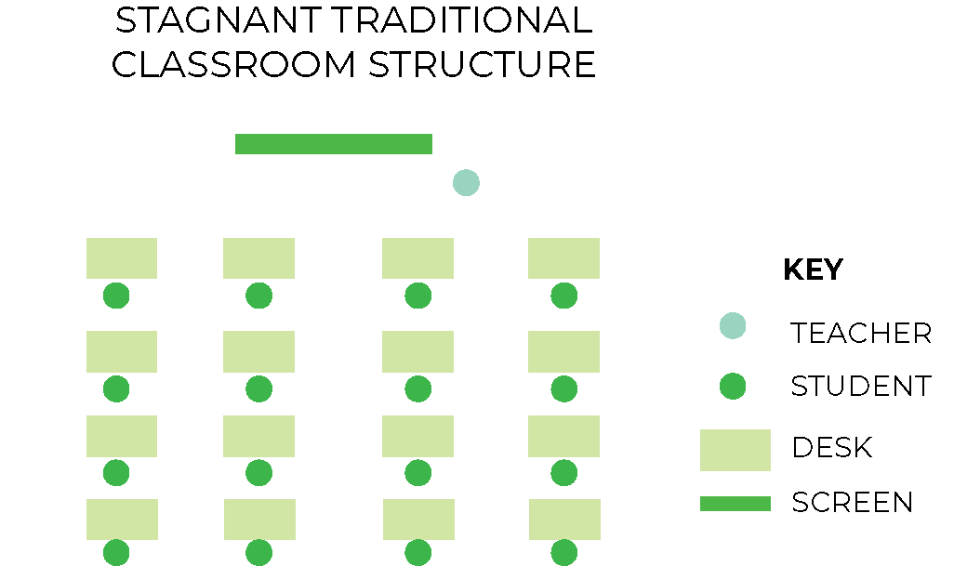
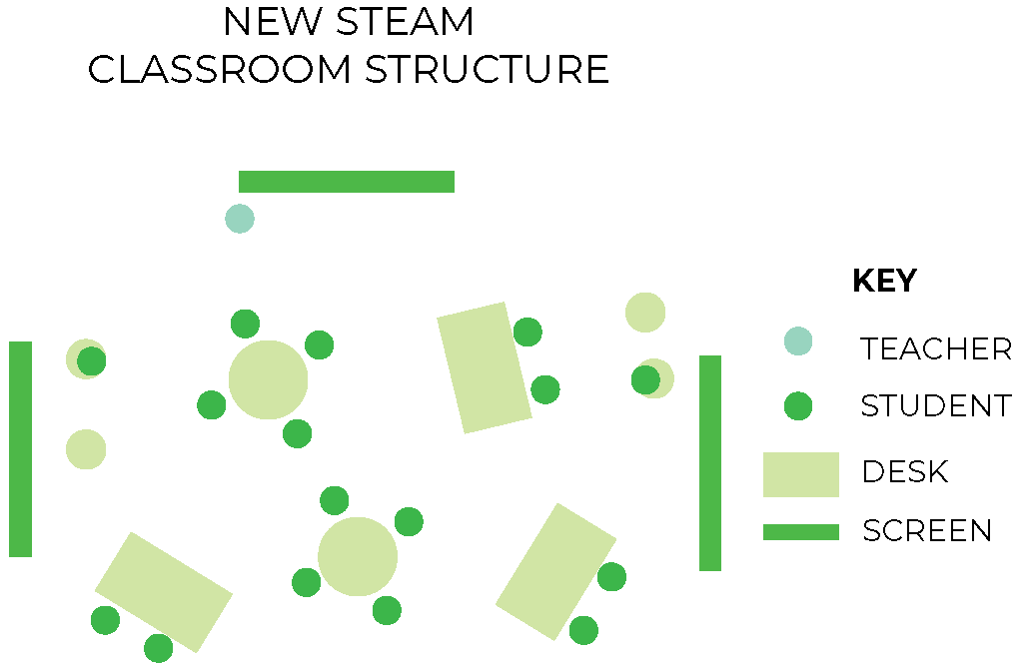
Design Problems of Traditional Classrooms

Slide 11
Technology Integration in Classrooms
Say technology helps them be more effective and efficient with students
Some possible forms of technology:
Computers
Tablets
Virtual Reality
3D printing
CAD
Drones
Makes students feel more prepared for class
Reduces stress in the classroom

Slide 12
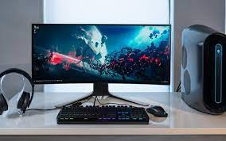
How does S.T.E.A.M. evolve from K-12?
Elementary
Middle School
High School

Slide 13
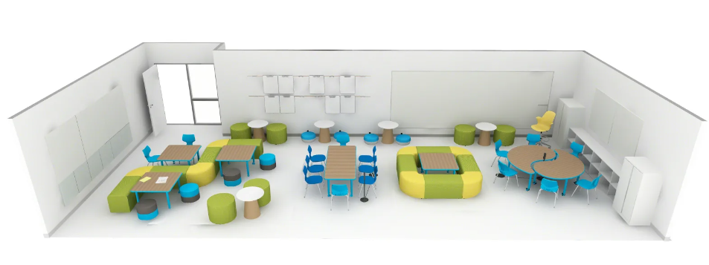
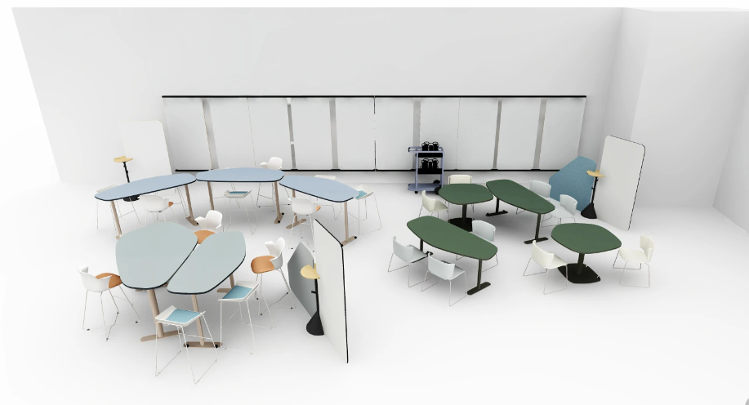
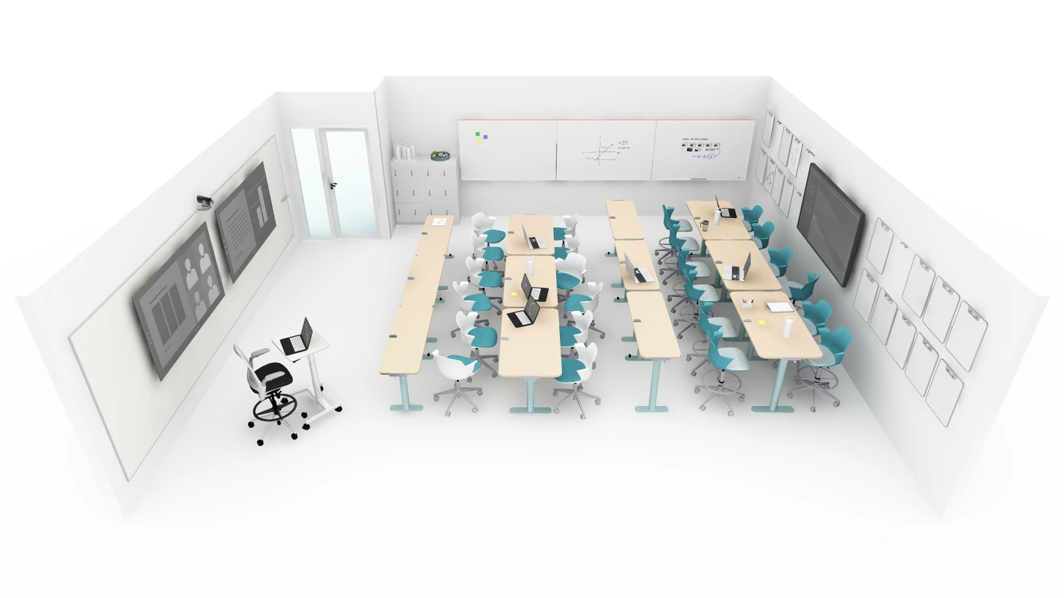
S.T.E.A.M. design considerations
The standards from K-12 help us understand what design needs would be in each space.
Elementary - Most basic
Middle School - Moderate
High School - Advanced

Slide 14
Research Agenda

Slide 15
Oral Defense
Capstone

Slide 16
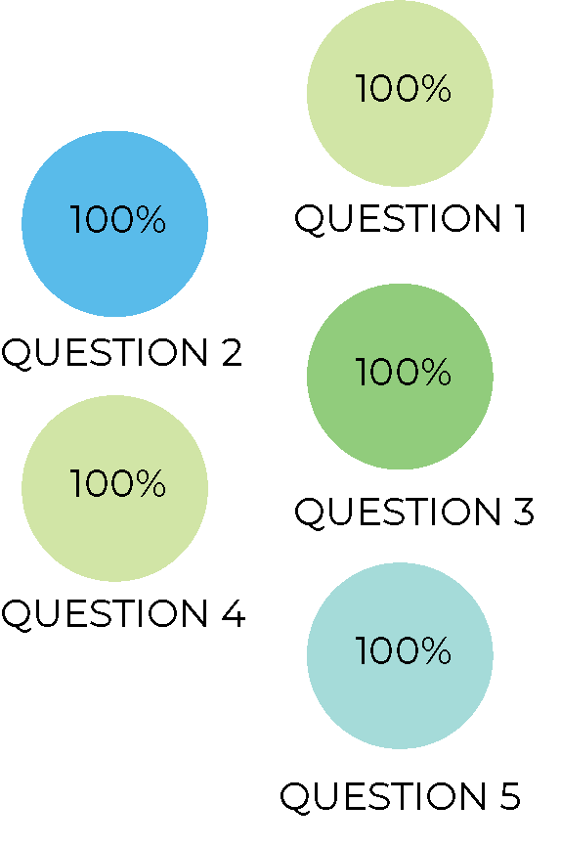
Key Survey #1 Data

Slide 17
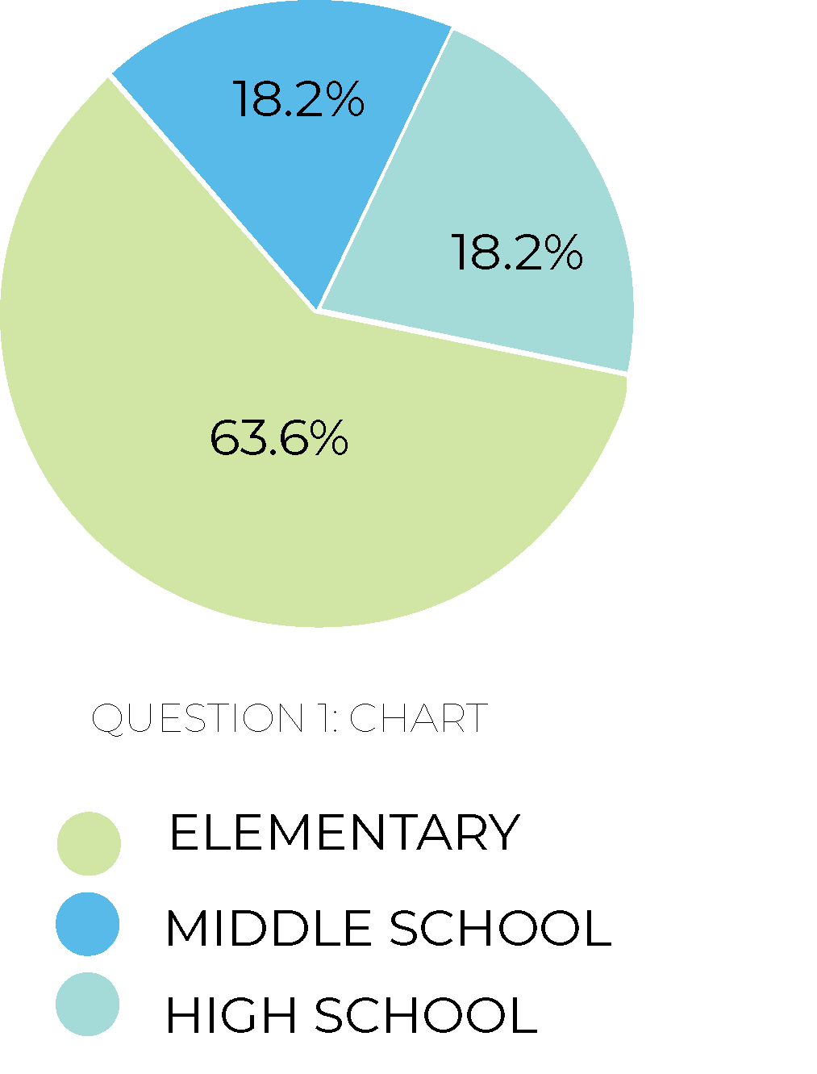
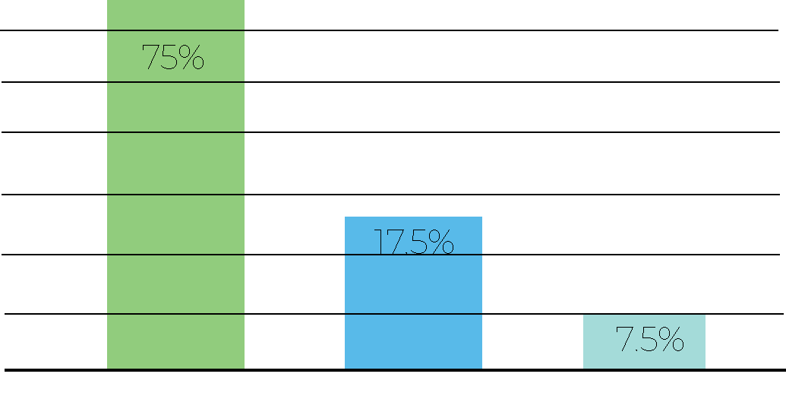
Key Survey #2 Data
Question 1: What grade do you primarily teach?
Question 2: What do you think the most important attribute of S.T.E.A.M. learning is?
Question 3: What types of technology do you see integrated in your level of teaching?
Question 4: Can you name any barriers within S.T.E.A.M. you have noticed?
Question 5: Do you agree or disagree with more technology integration in schools?
Agree
Somewhat Agree
Disagree

Slide 18
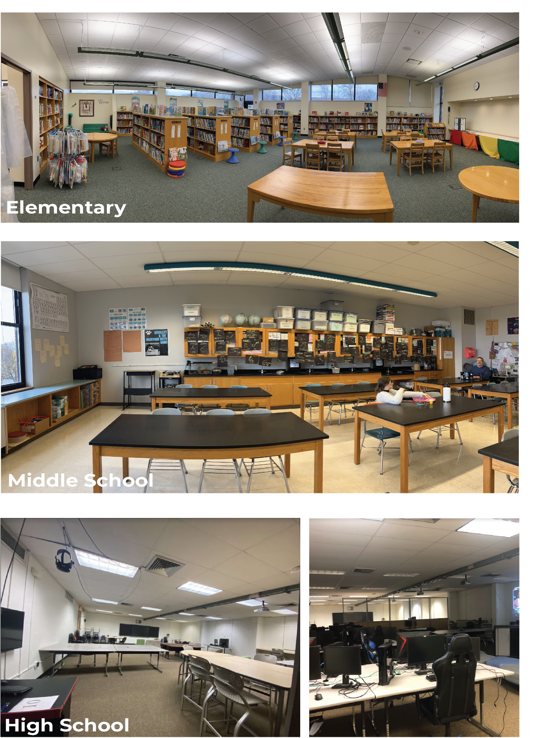
Site Visits Overview
Three schools were visited in Brockport Central School District:
Ginther Elementary School
A.D. Oliver Middle School
Brockport High School

Slide 19
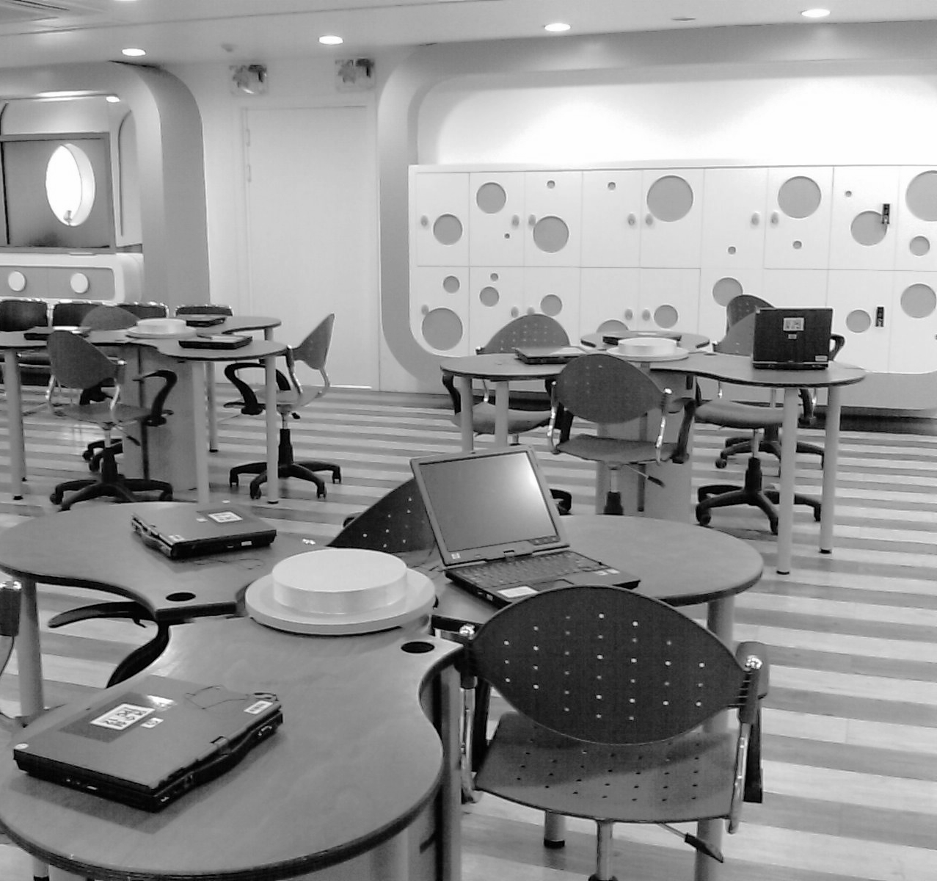
Creative Agenda

Slide 20
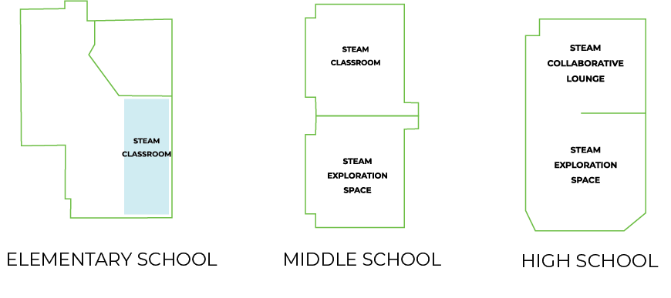
Three prototypical classrooms are re-imagined in this undergraduate capstone to show the benefits and design needs for STEAM classrooms. These classrooms are based off floor plans from Brockport Central School District in the Ginther elementary school, the Oliver AD Middle school and Brockport High school.

Slide 22
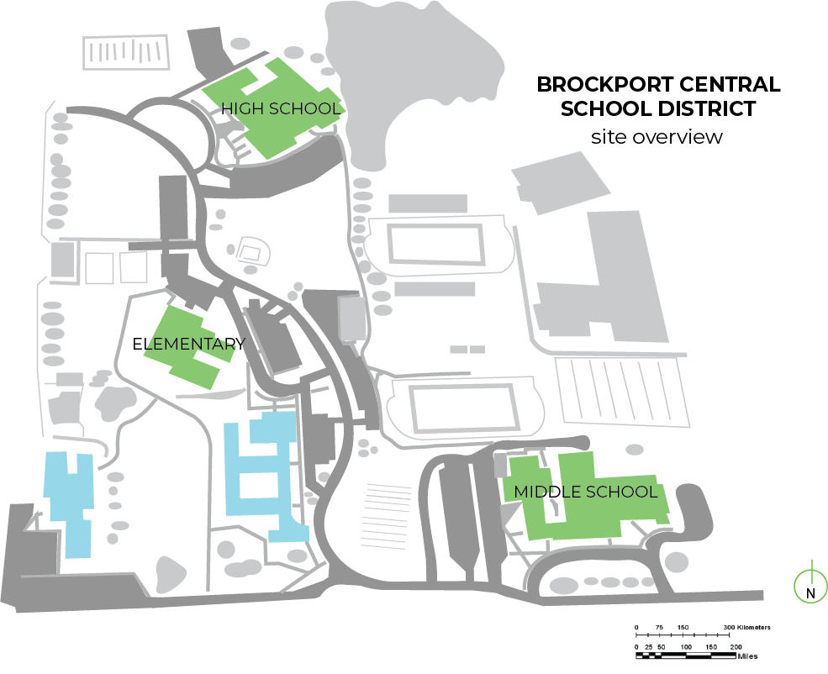

Slide 23
S. T. E. A. M. User Profiles
Oral Defense
Capstone
Oral Defense
Capstone

Slide 24
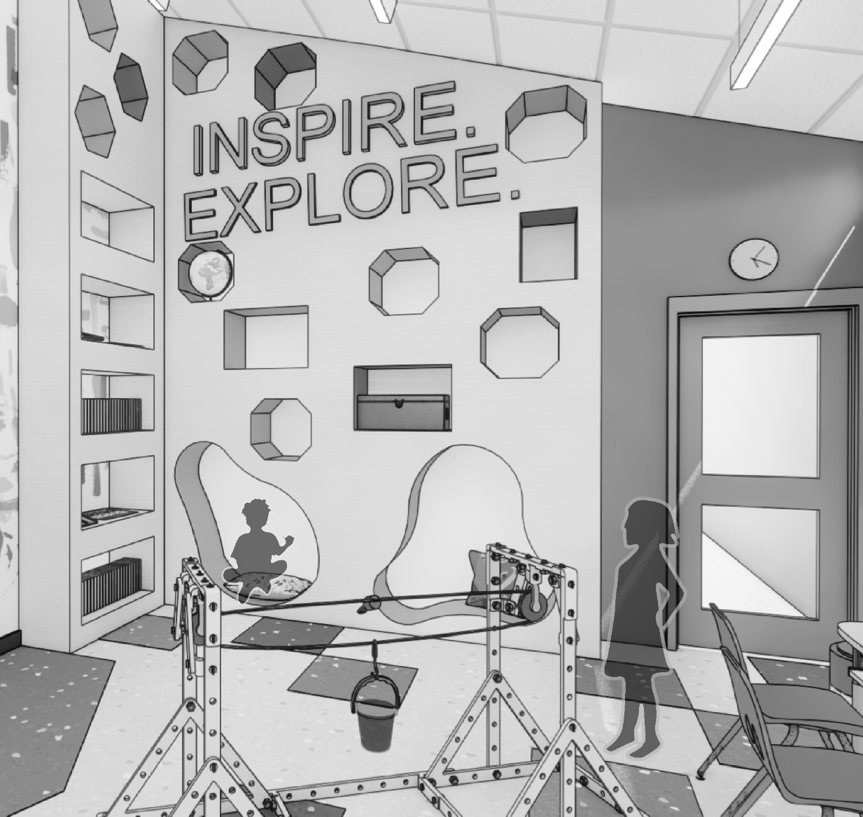
Elementary School

Slide 25
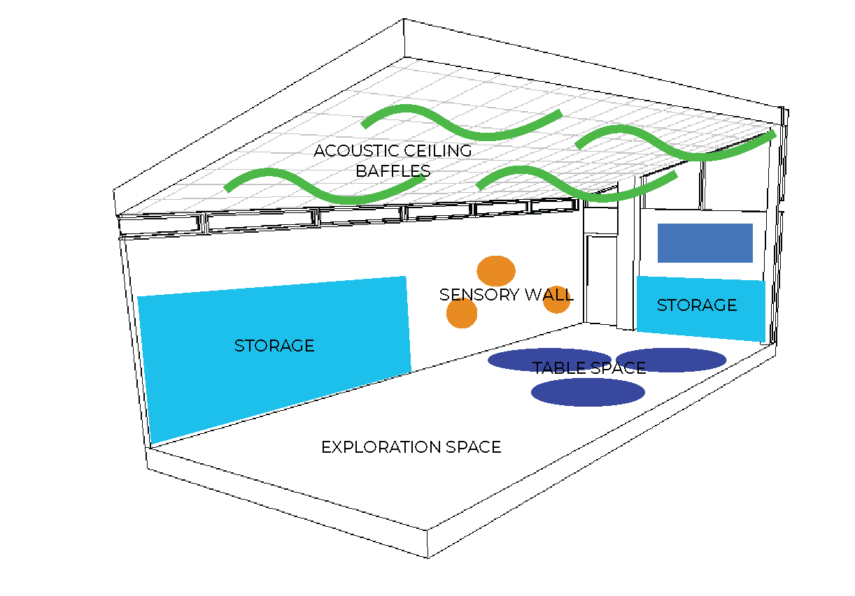
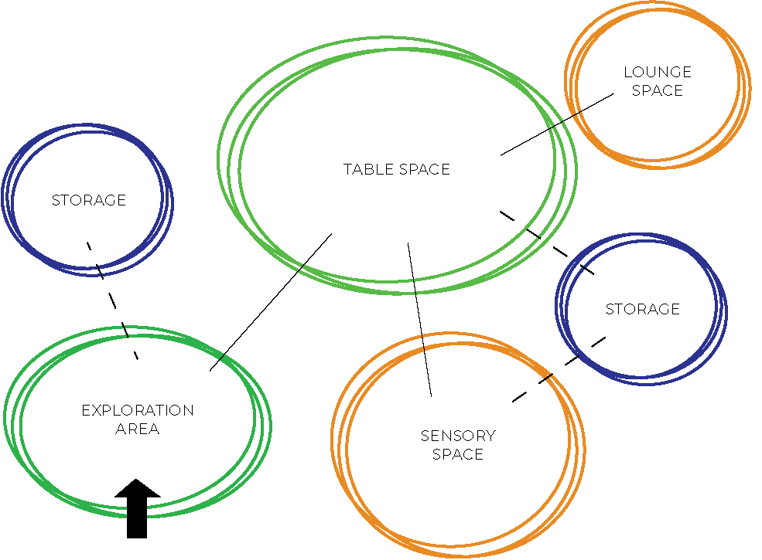
Programming

Slide 26
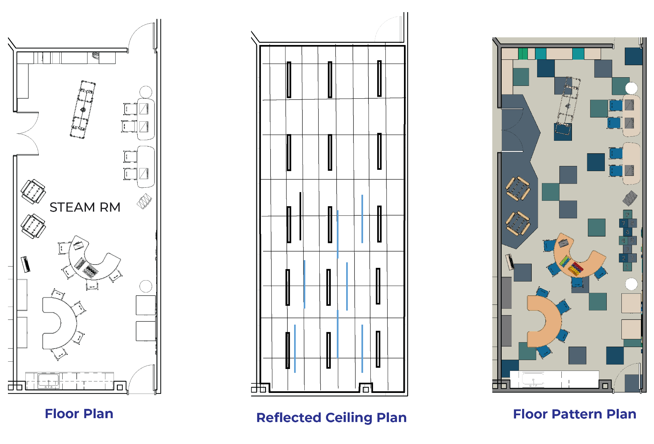

Slide 27
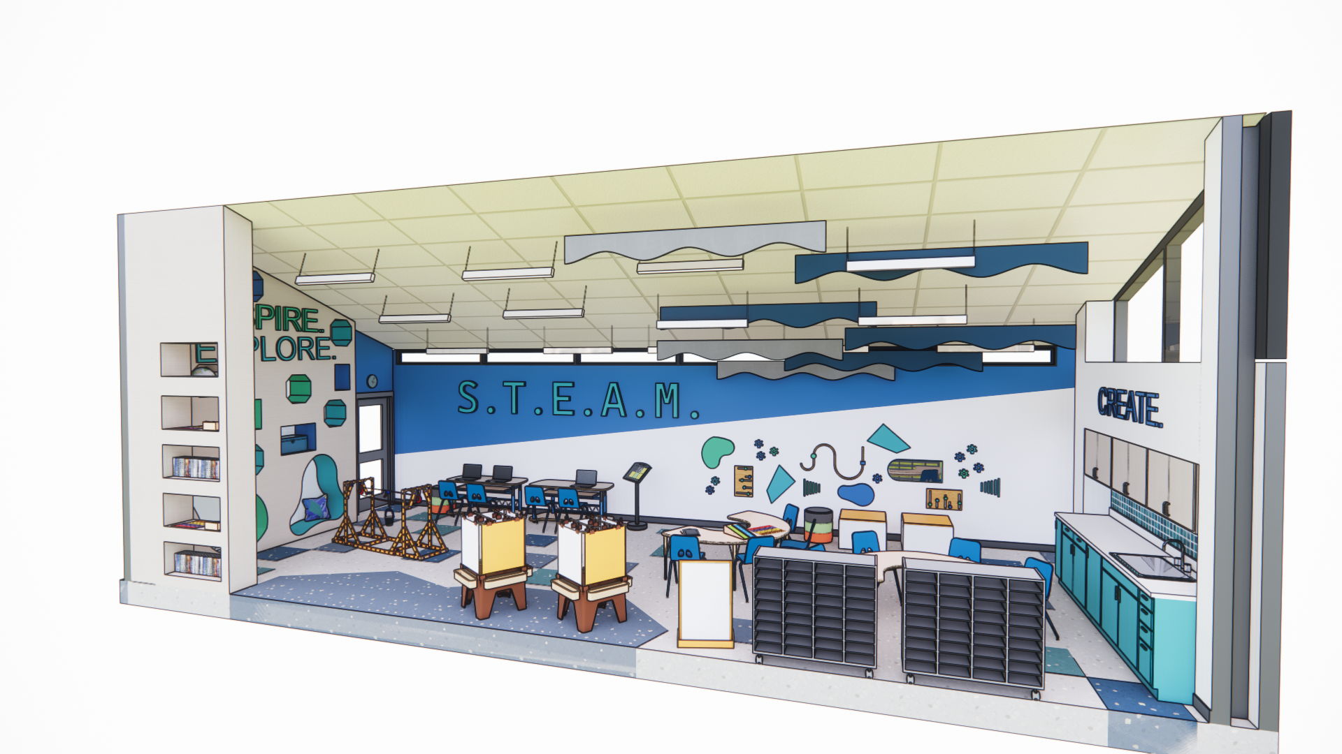

Slide 28
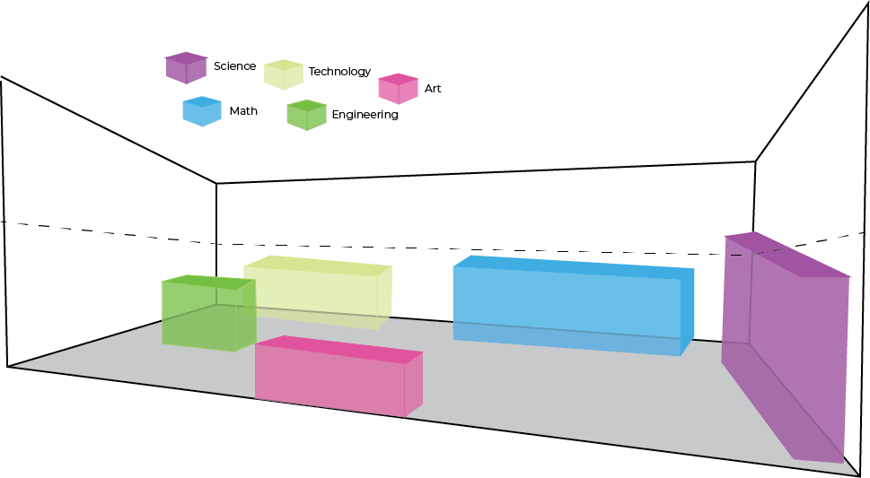

Slide 29
Elementary STEAM - Exploded

Slide 30
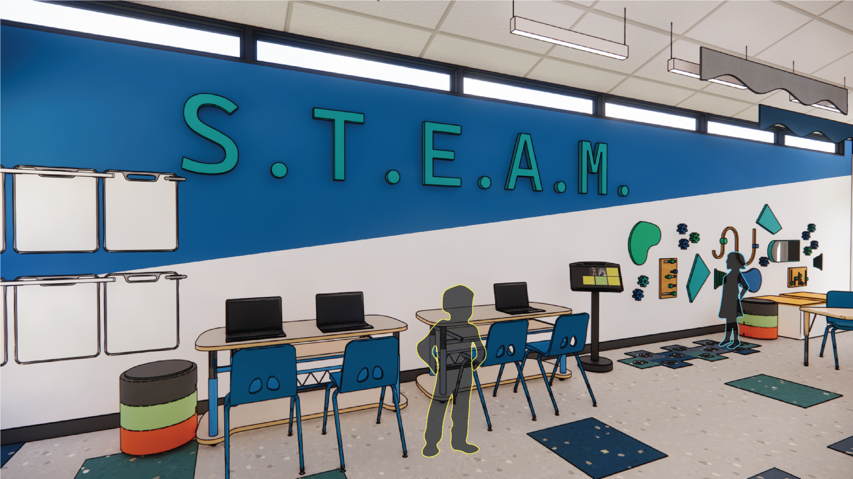
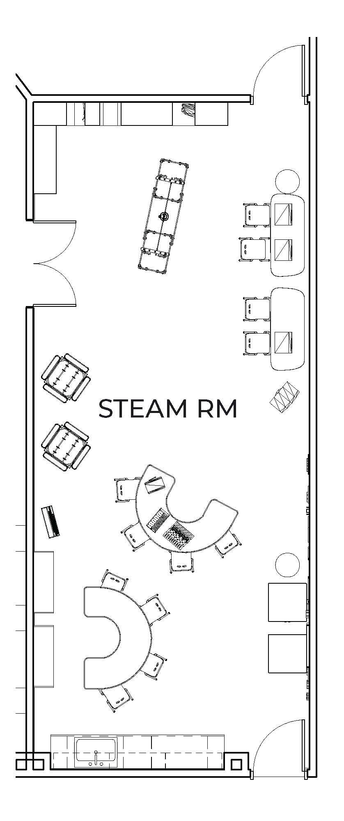
Overall Elementary STEAM wall

Slide 31
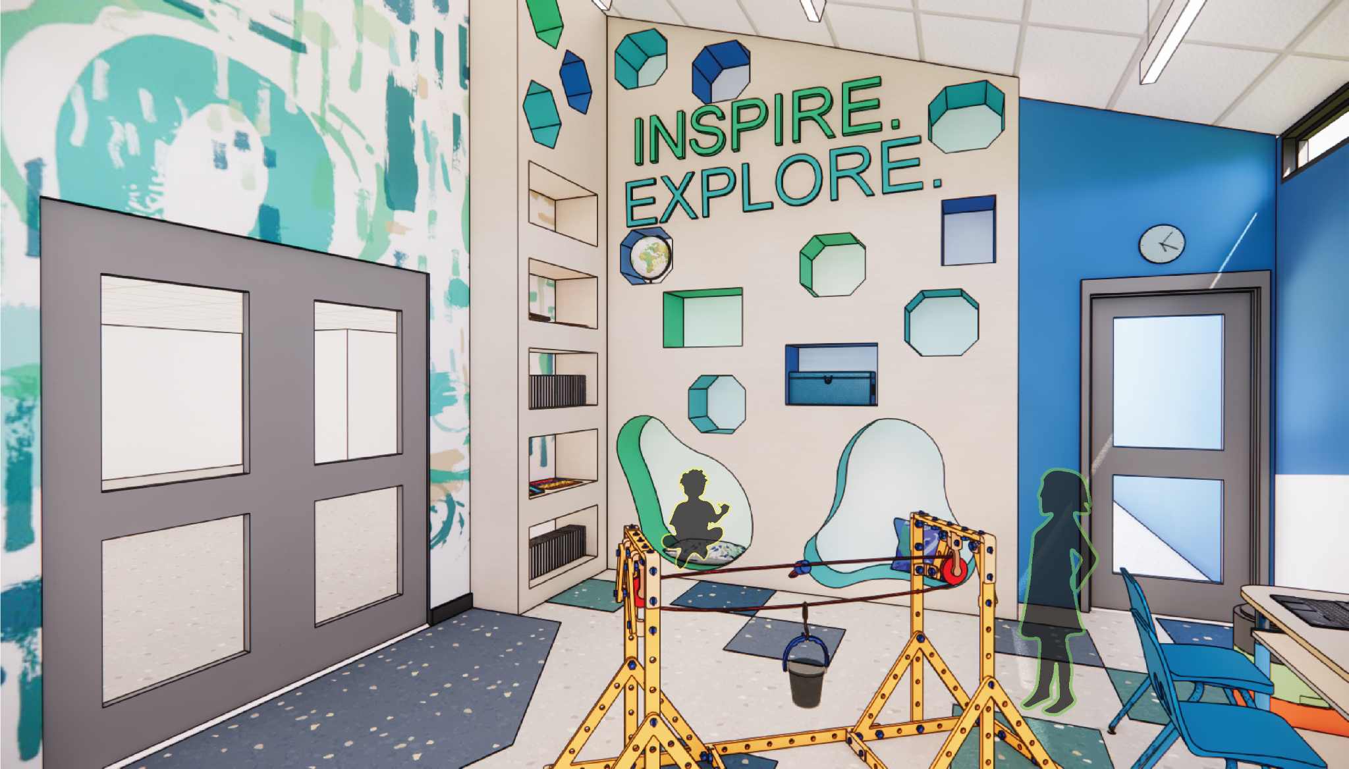
Elementary storage wall

Slide 32
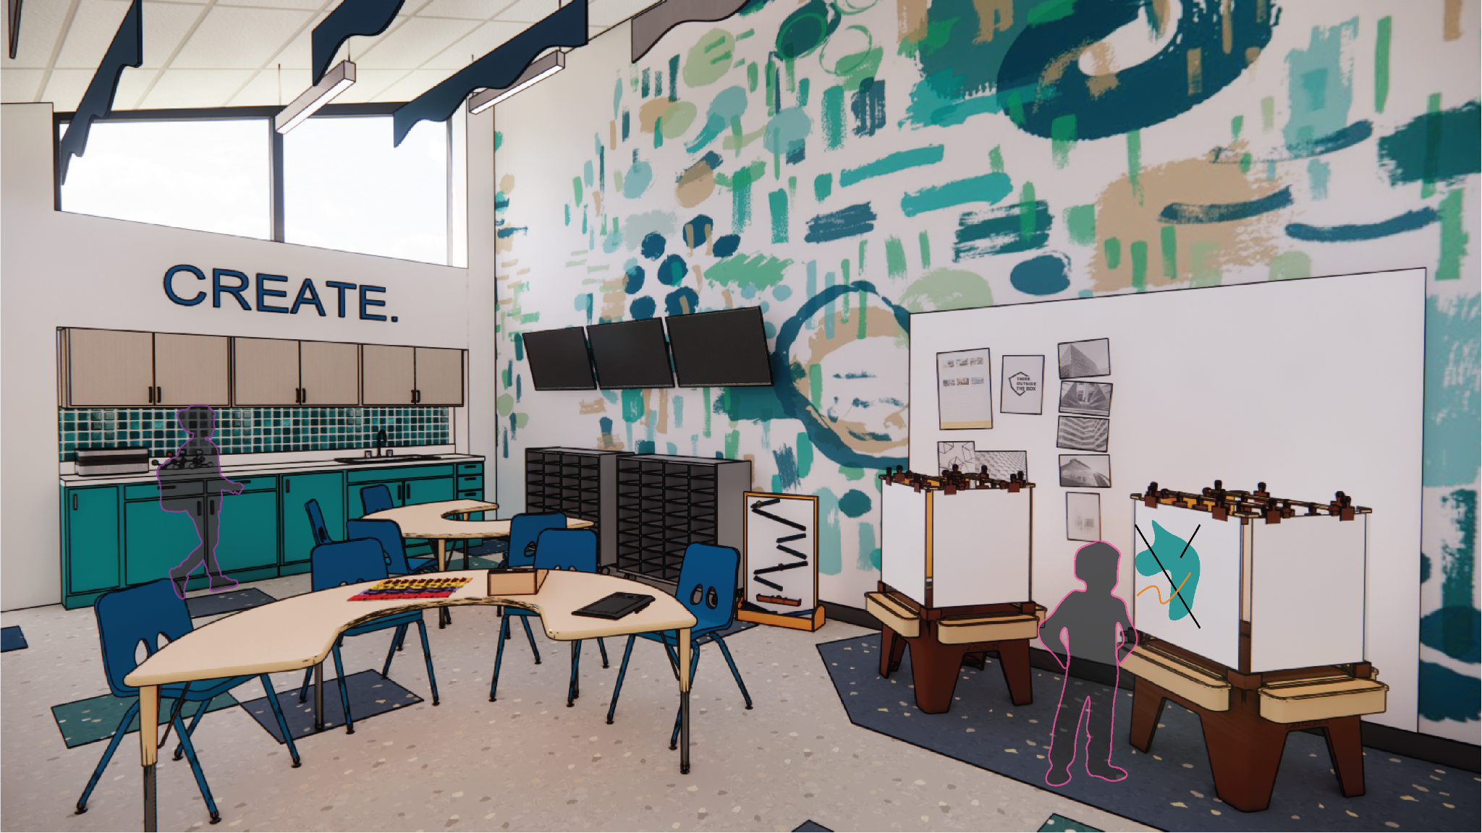
Elementary Graphics and explore area

Slide 33
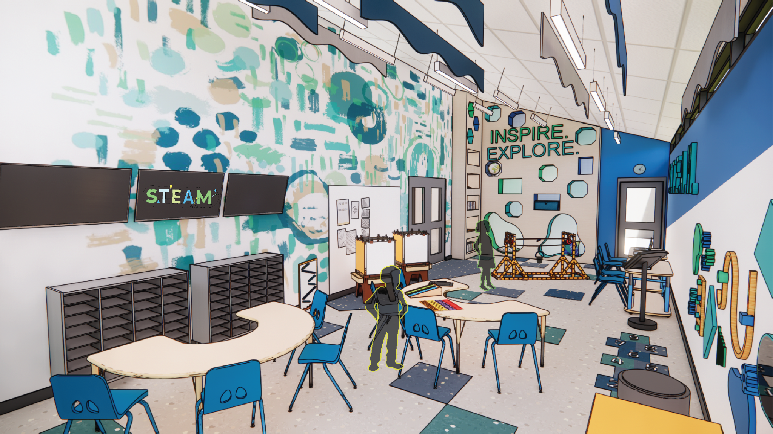
Overall Elementary STEAM room

Slide 34
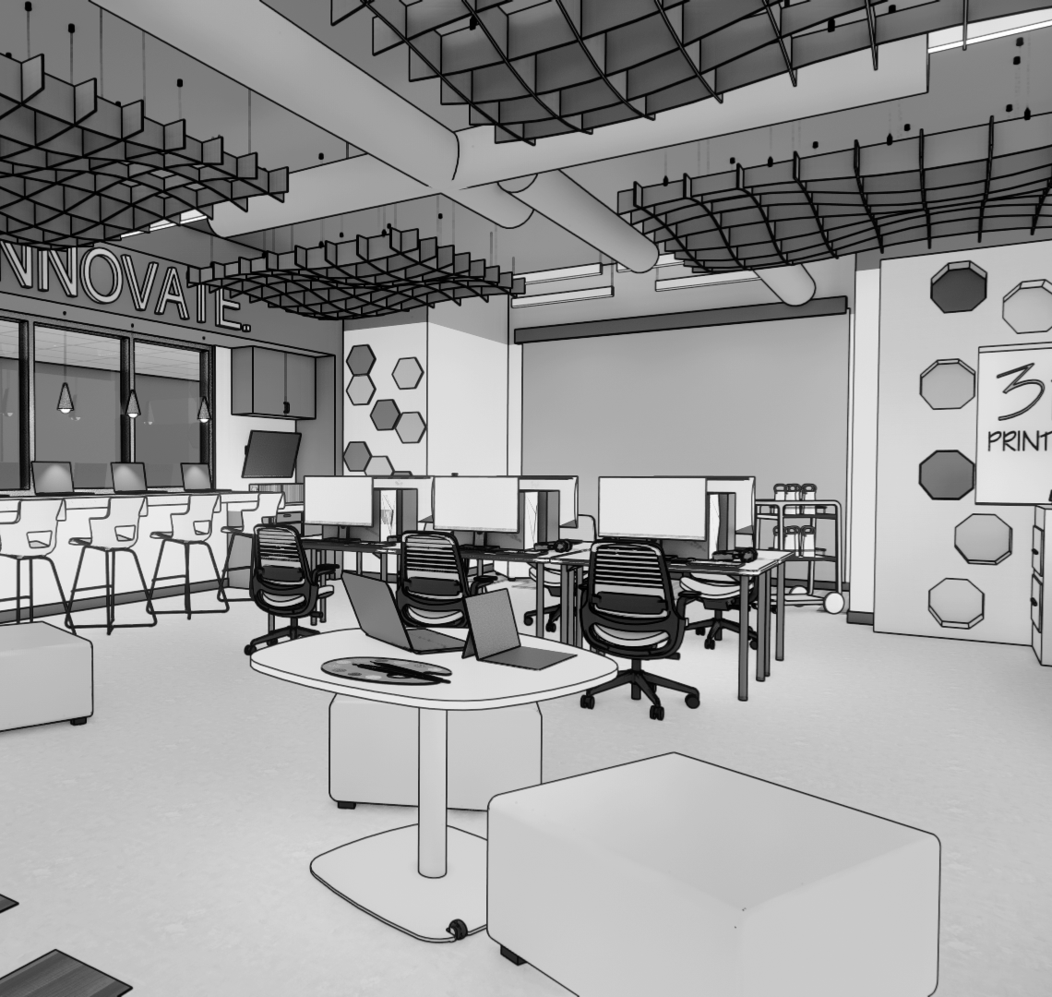
Middle School

Slide 35
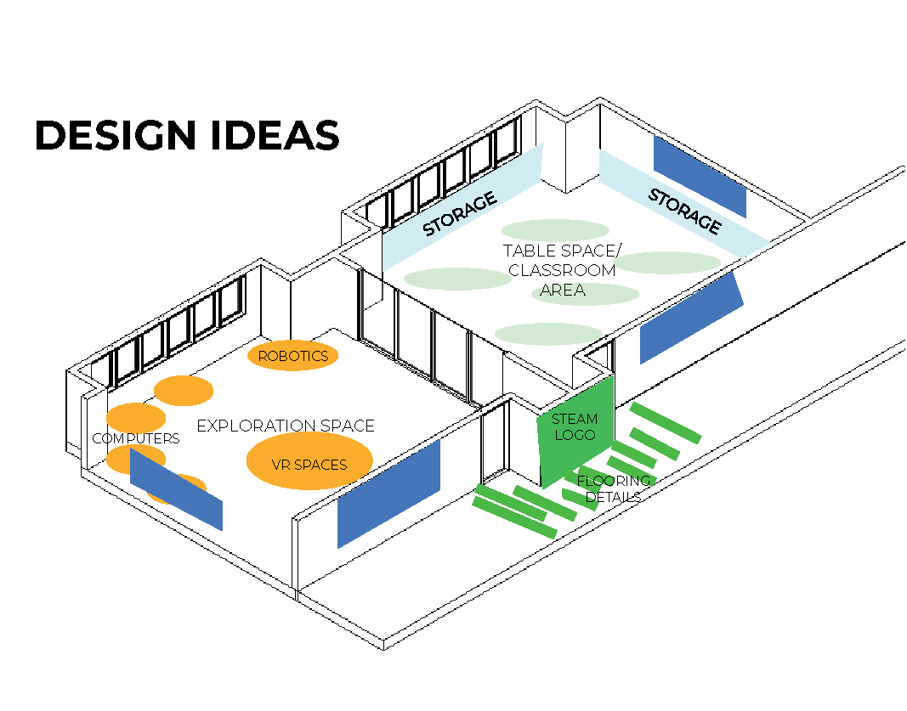
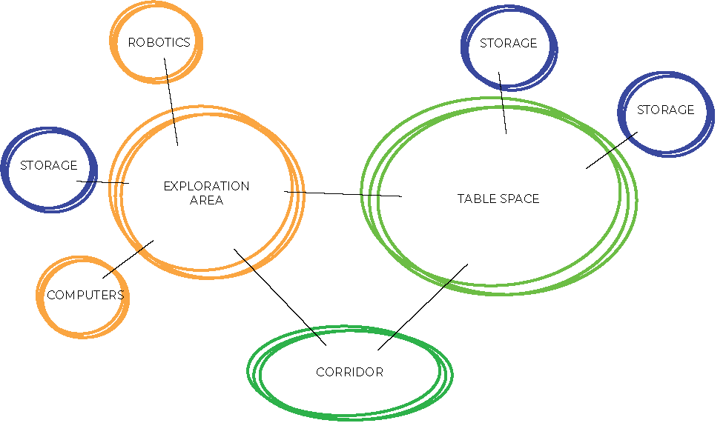
Programming

Slide 36
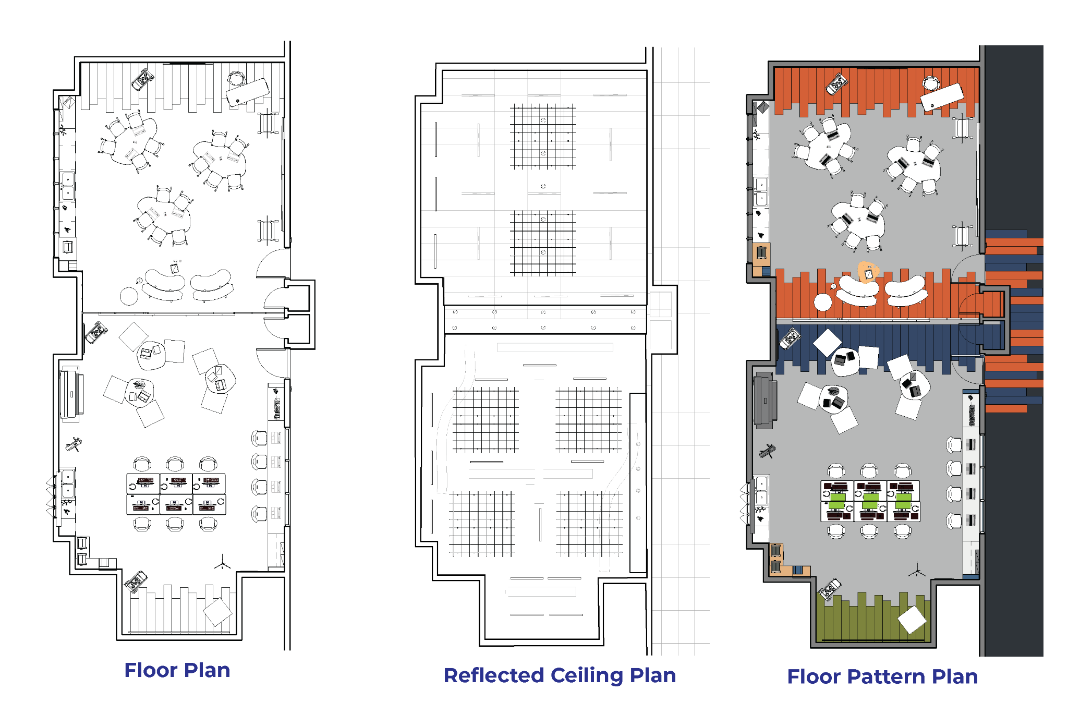

Slide 37
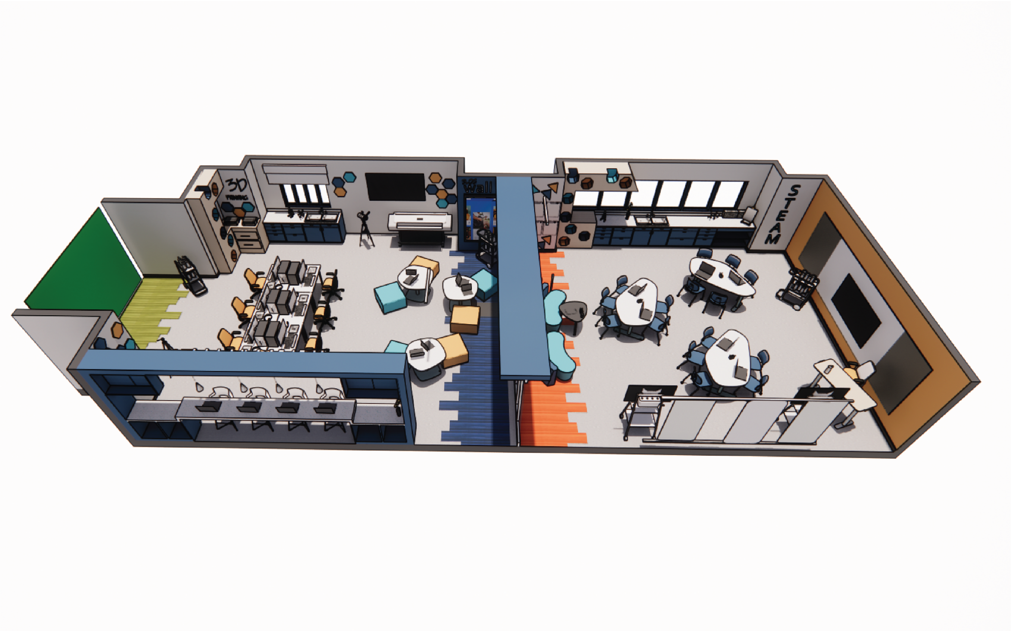

Slide 39
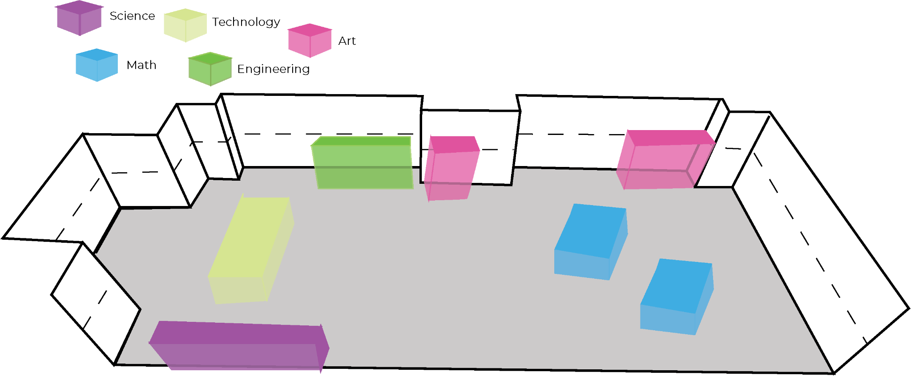
Middle School STEAM - Exploded

Slide 40
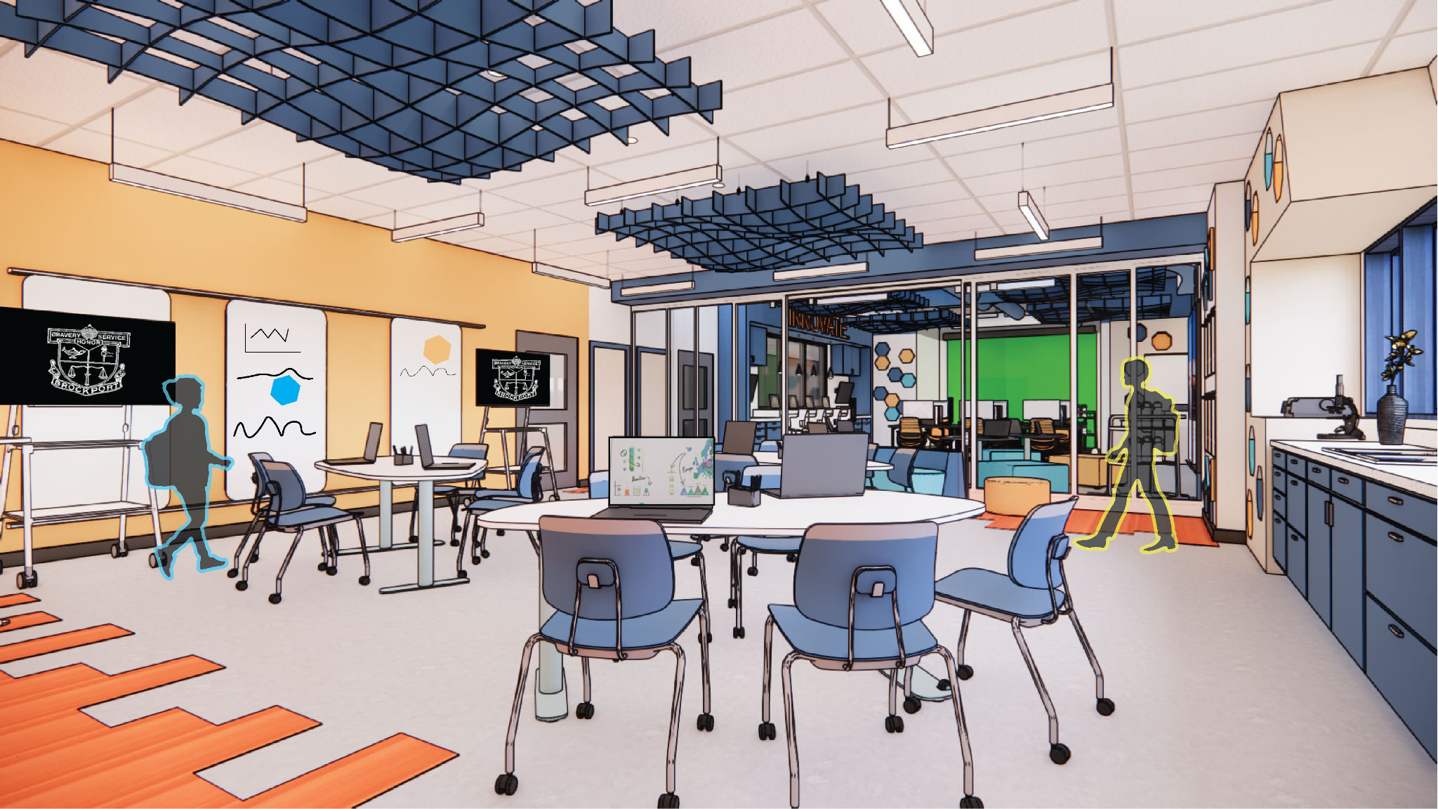
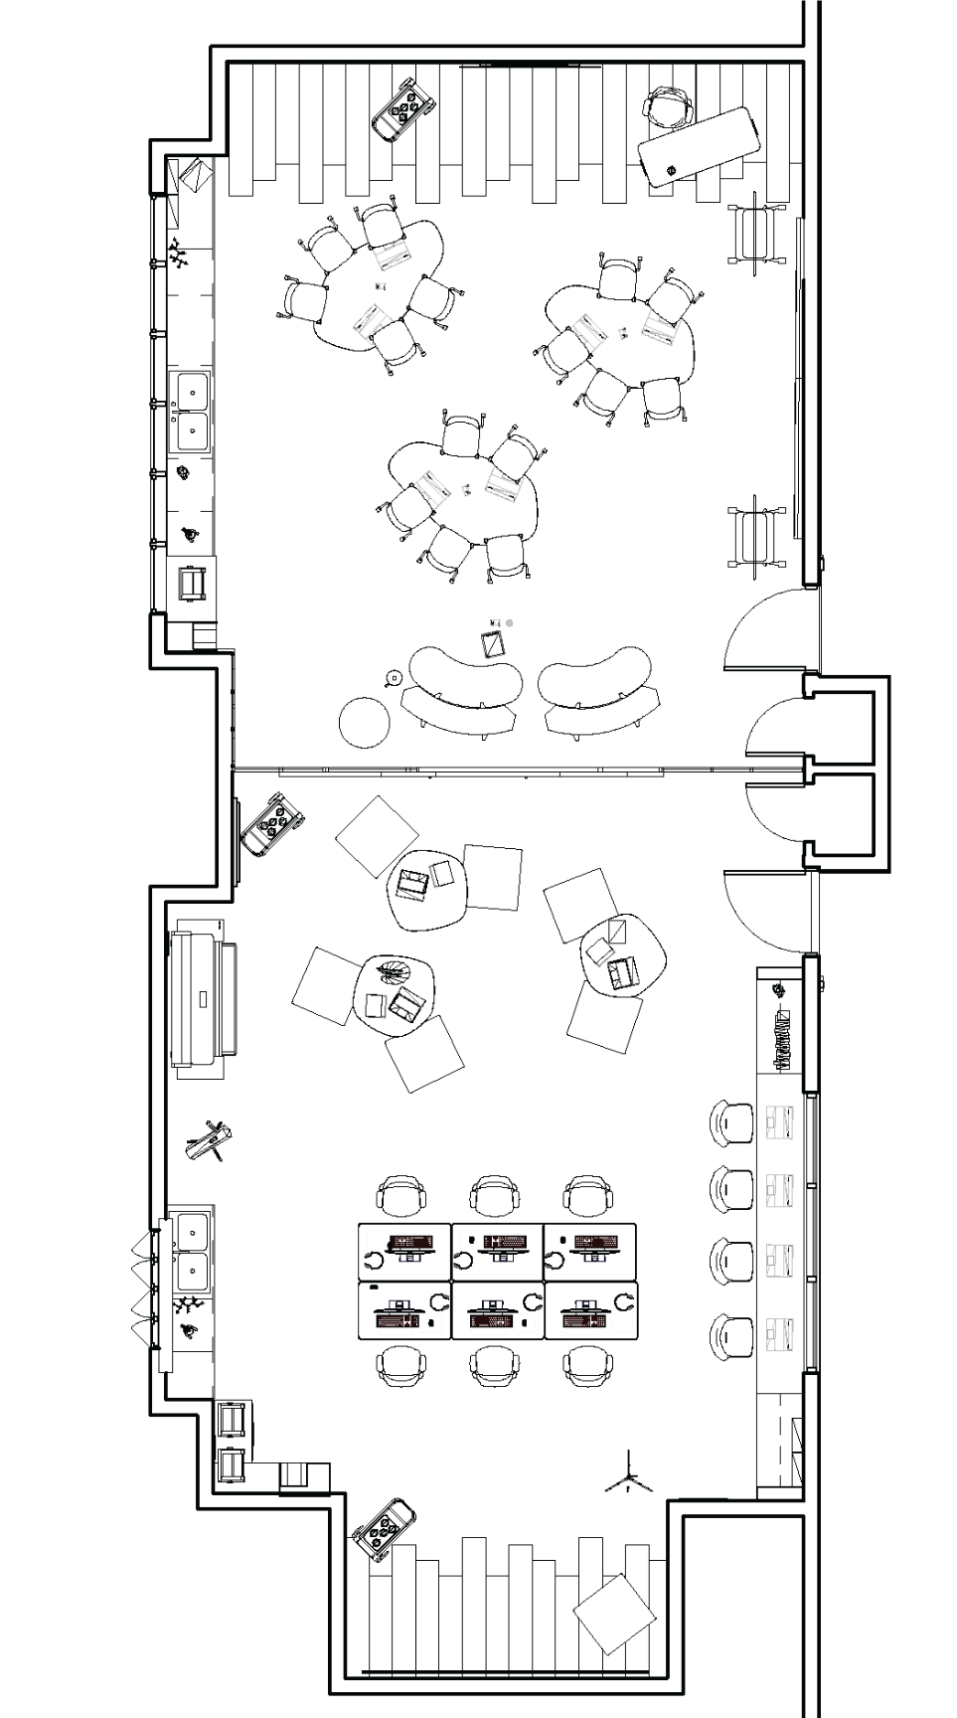
Middle school - STEAM classroom

Slide 41
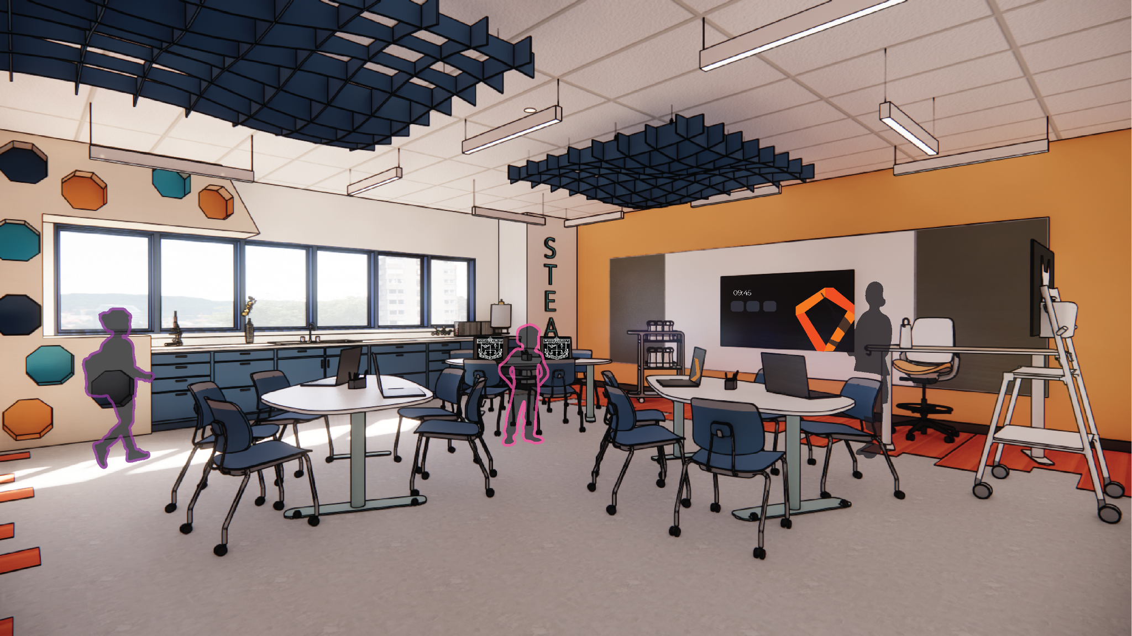
Middle school STEAM classroom 2

Slide 42
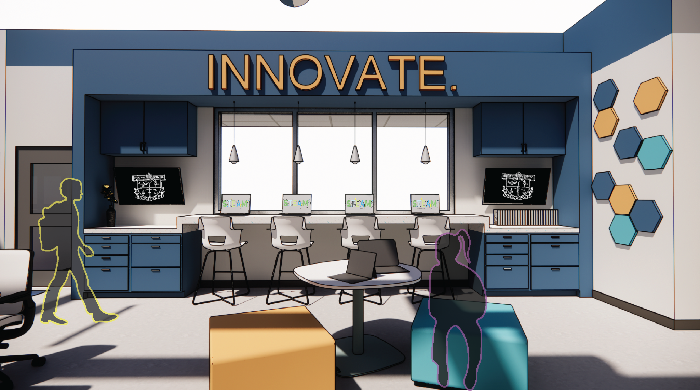
Middle school STEAM explore wall

Slide 43
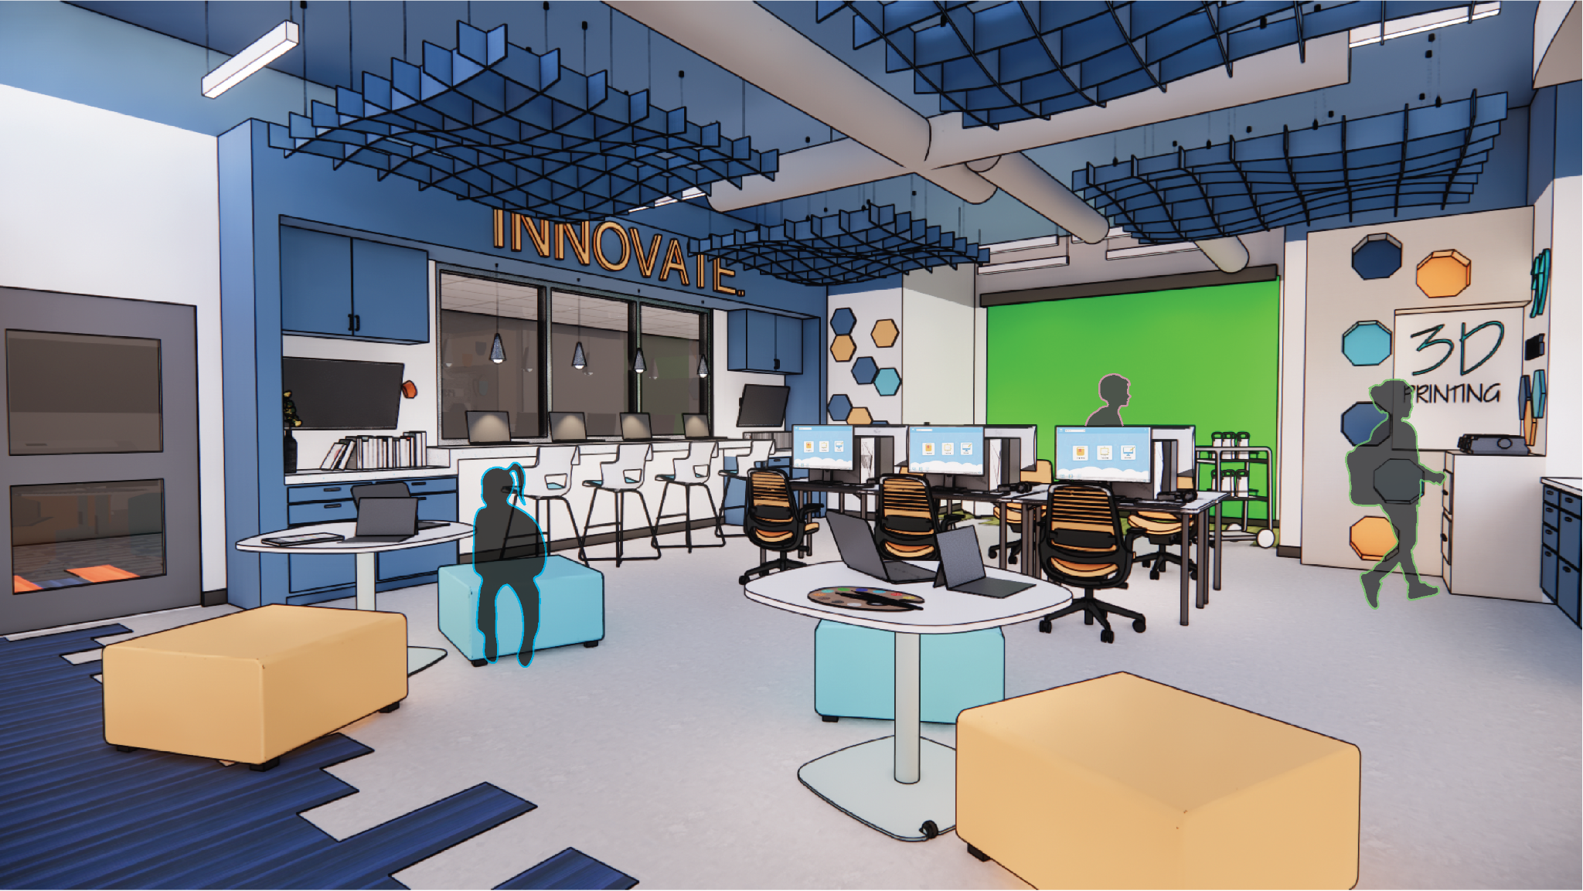
Middle school STEAM explore side

Slide 44
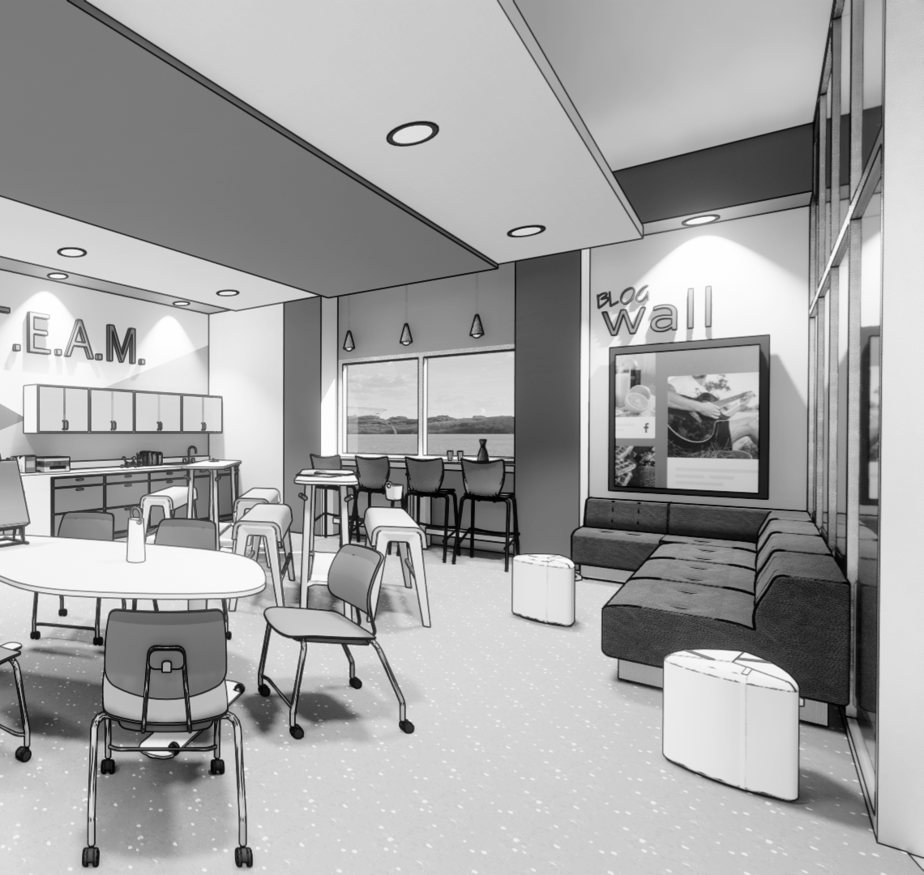
High School

Slide 45
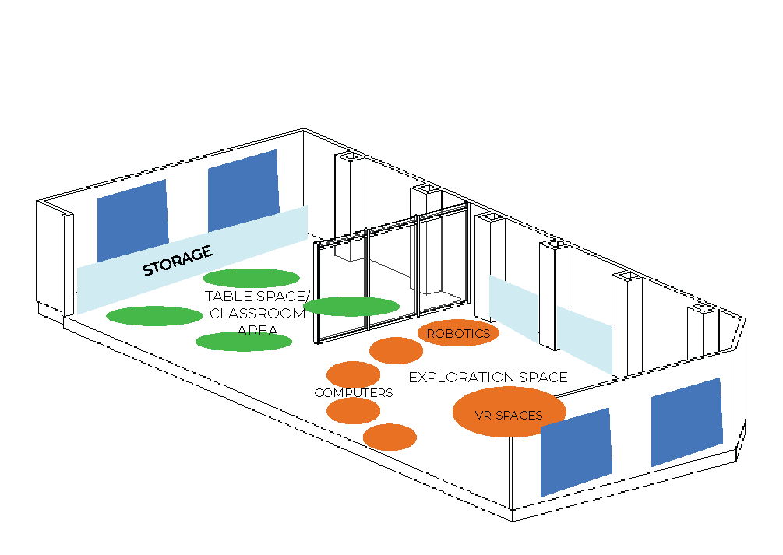
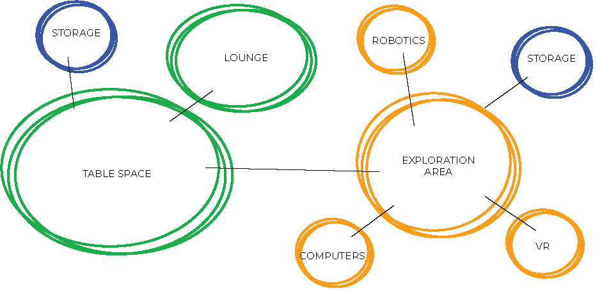
Programming

Slide 46
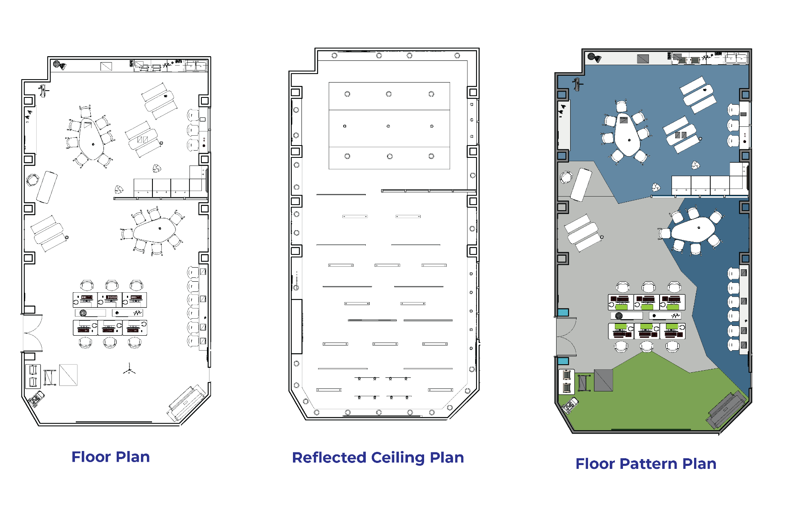

Slide 47
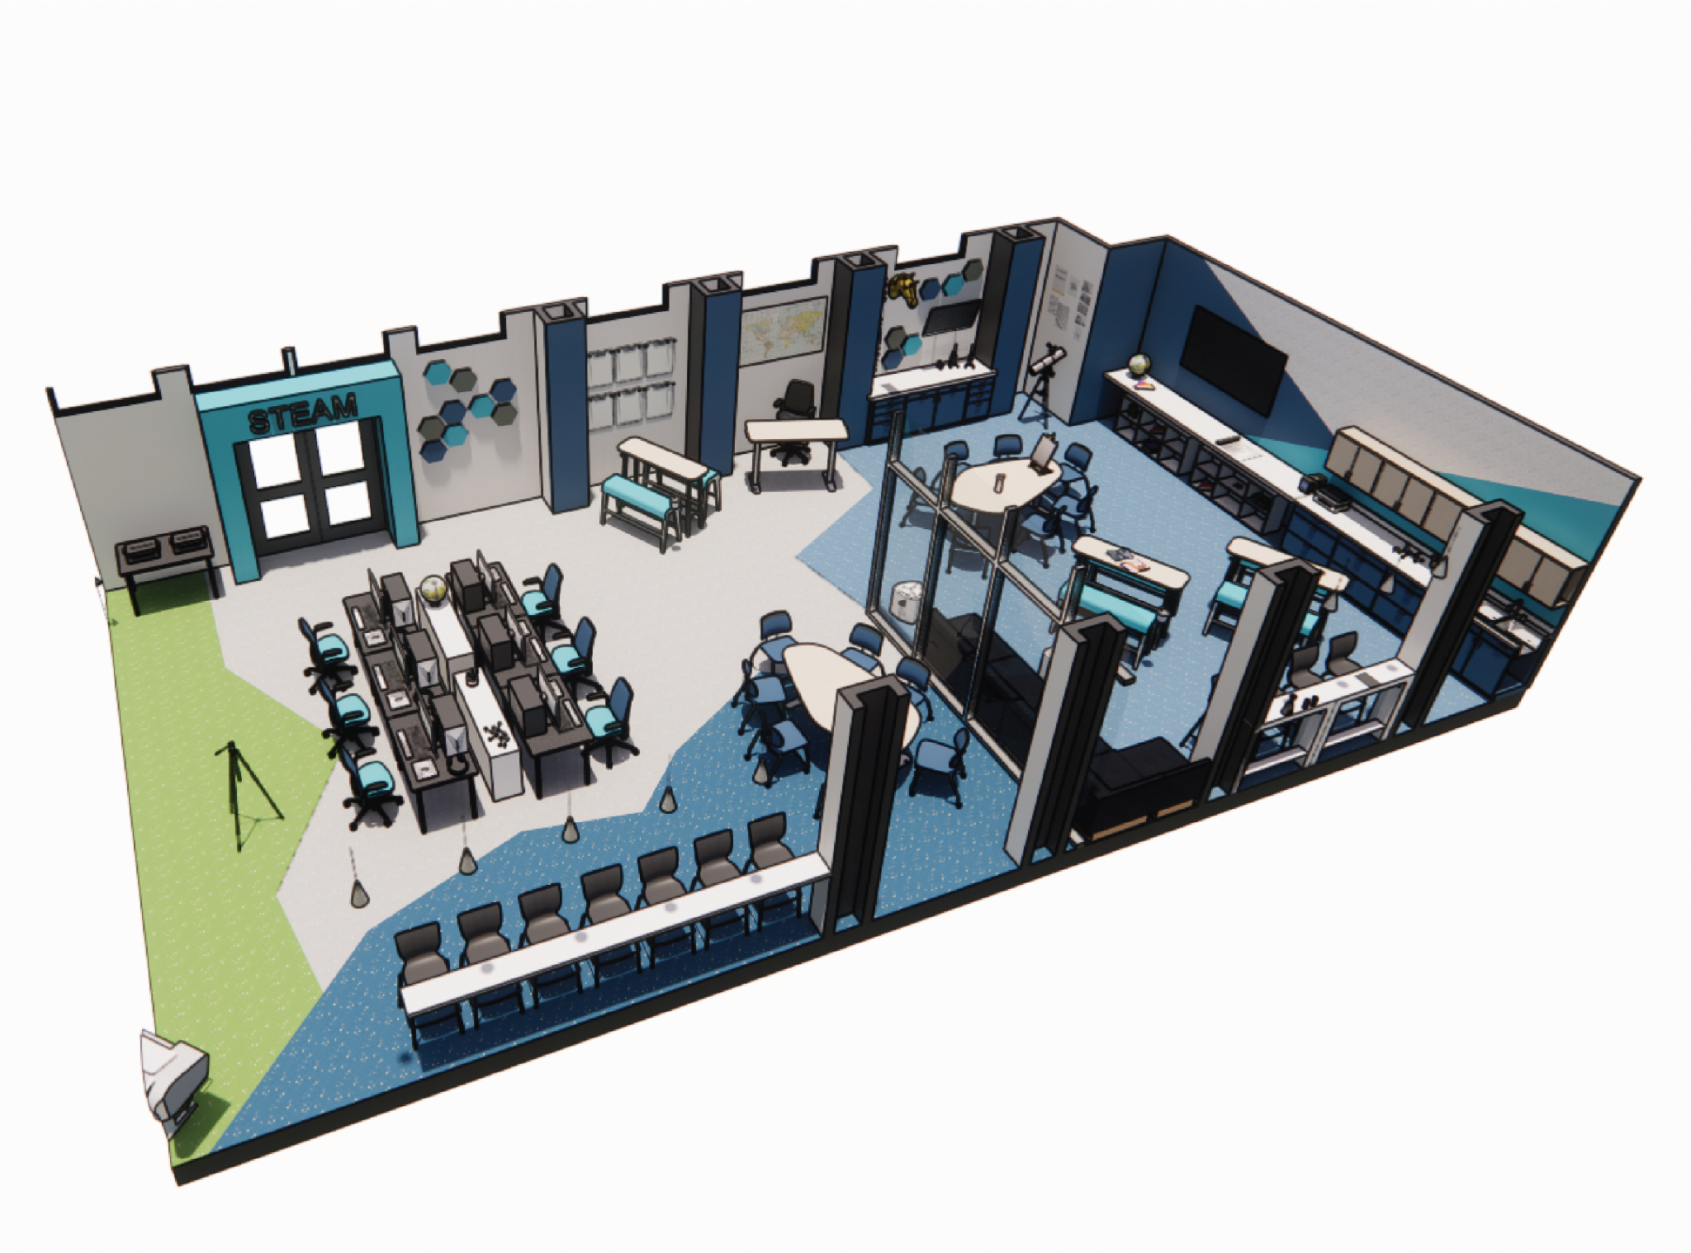

Slide 48
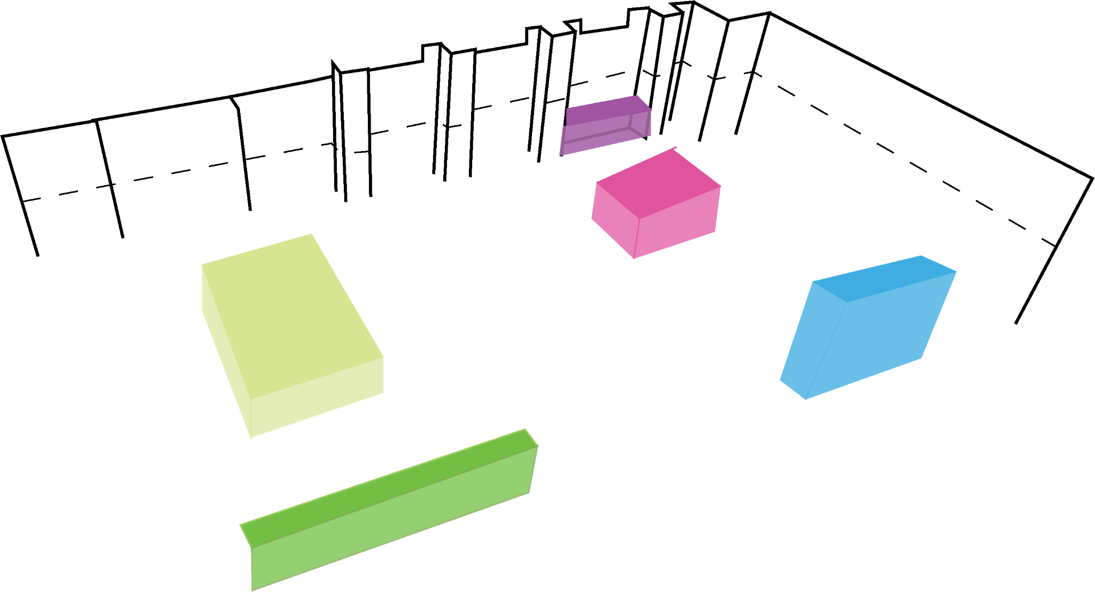

Slide 49
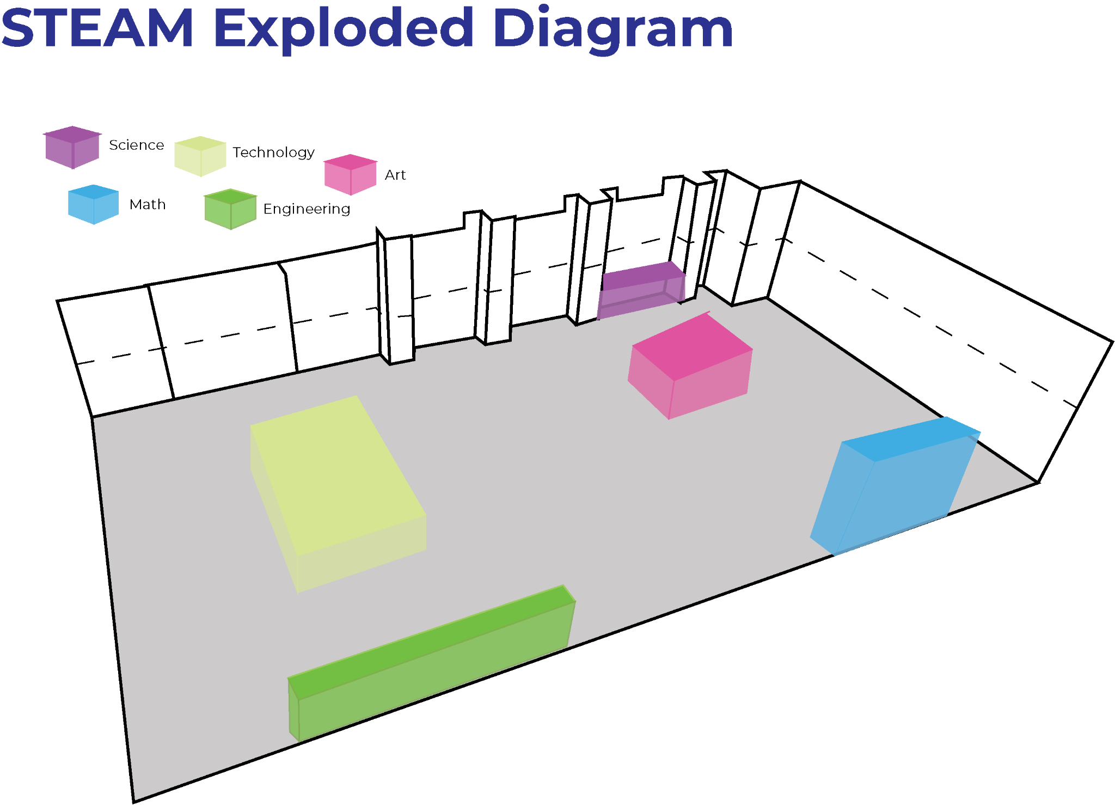

Slide 50
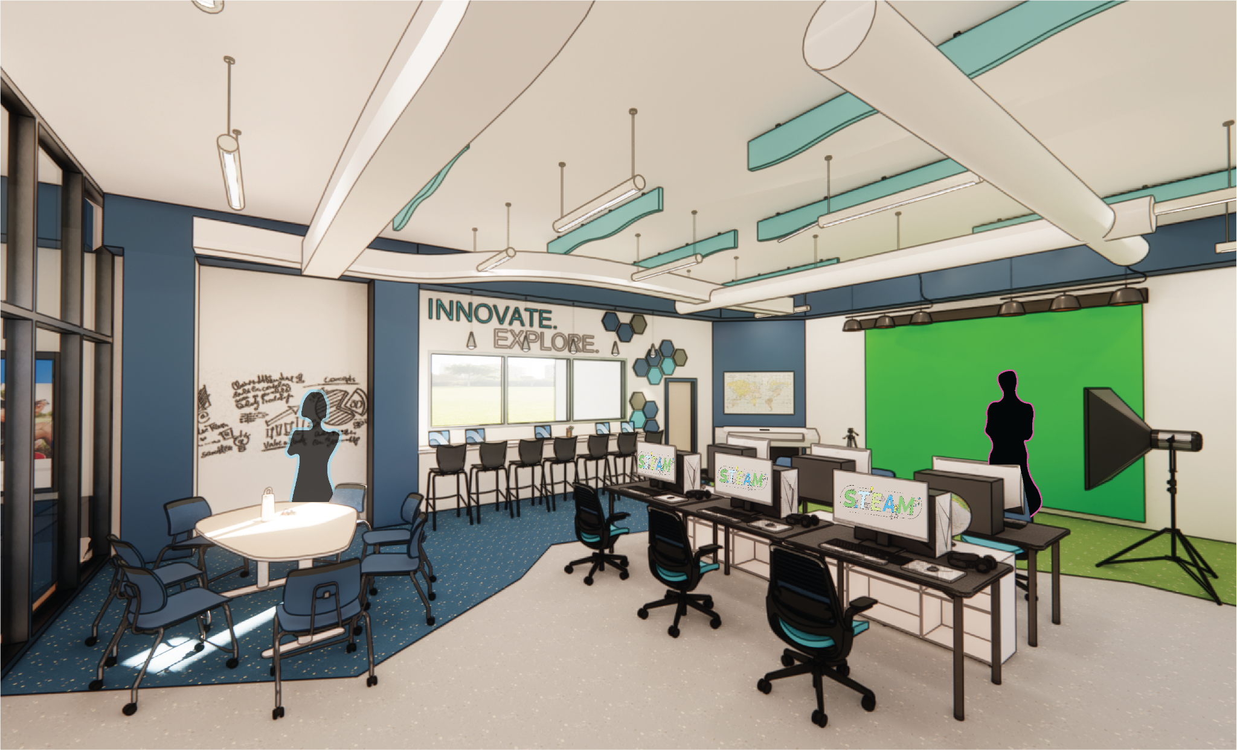
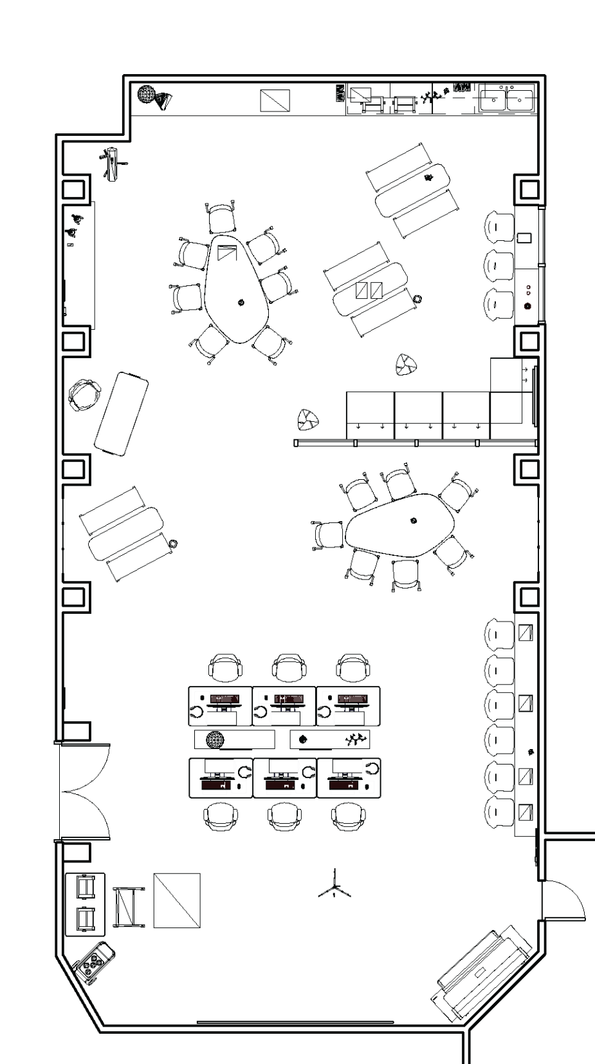
High school STEAM explore side

Slide 51
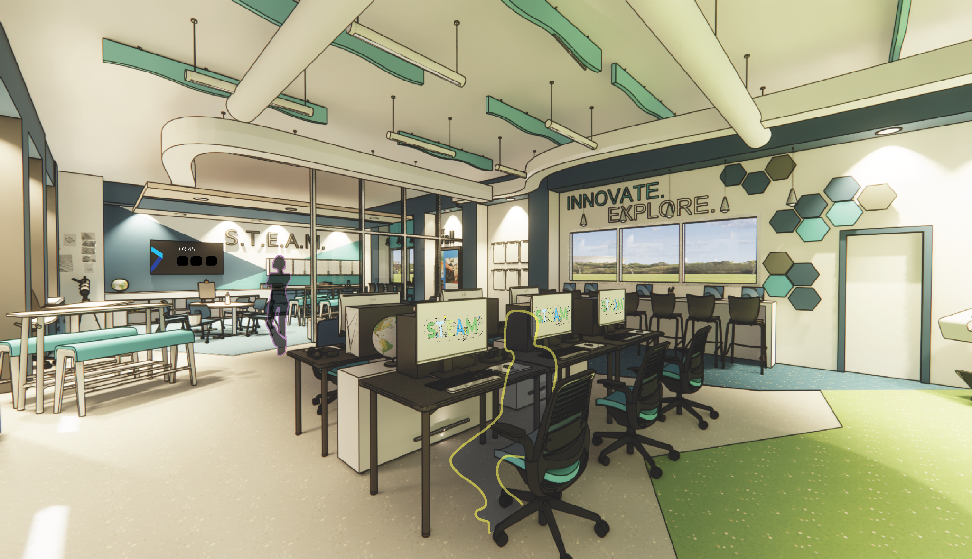
High school overall view

Slide 52
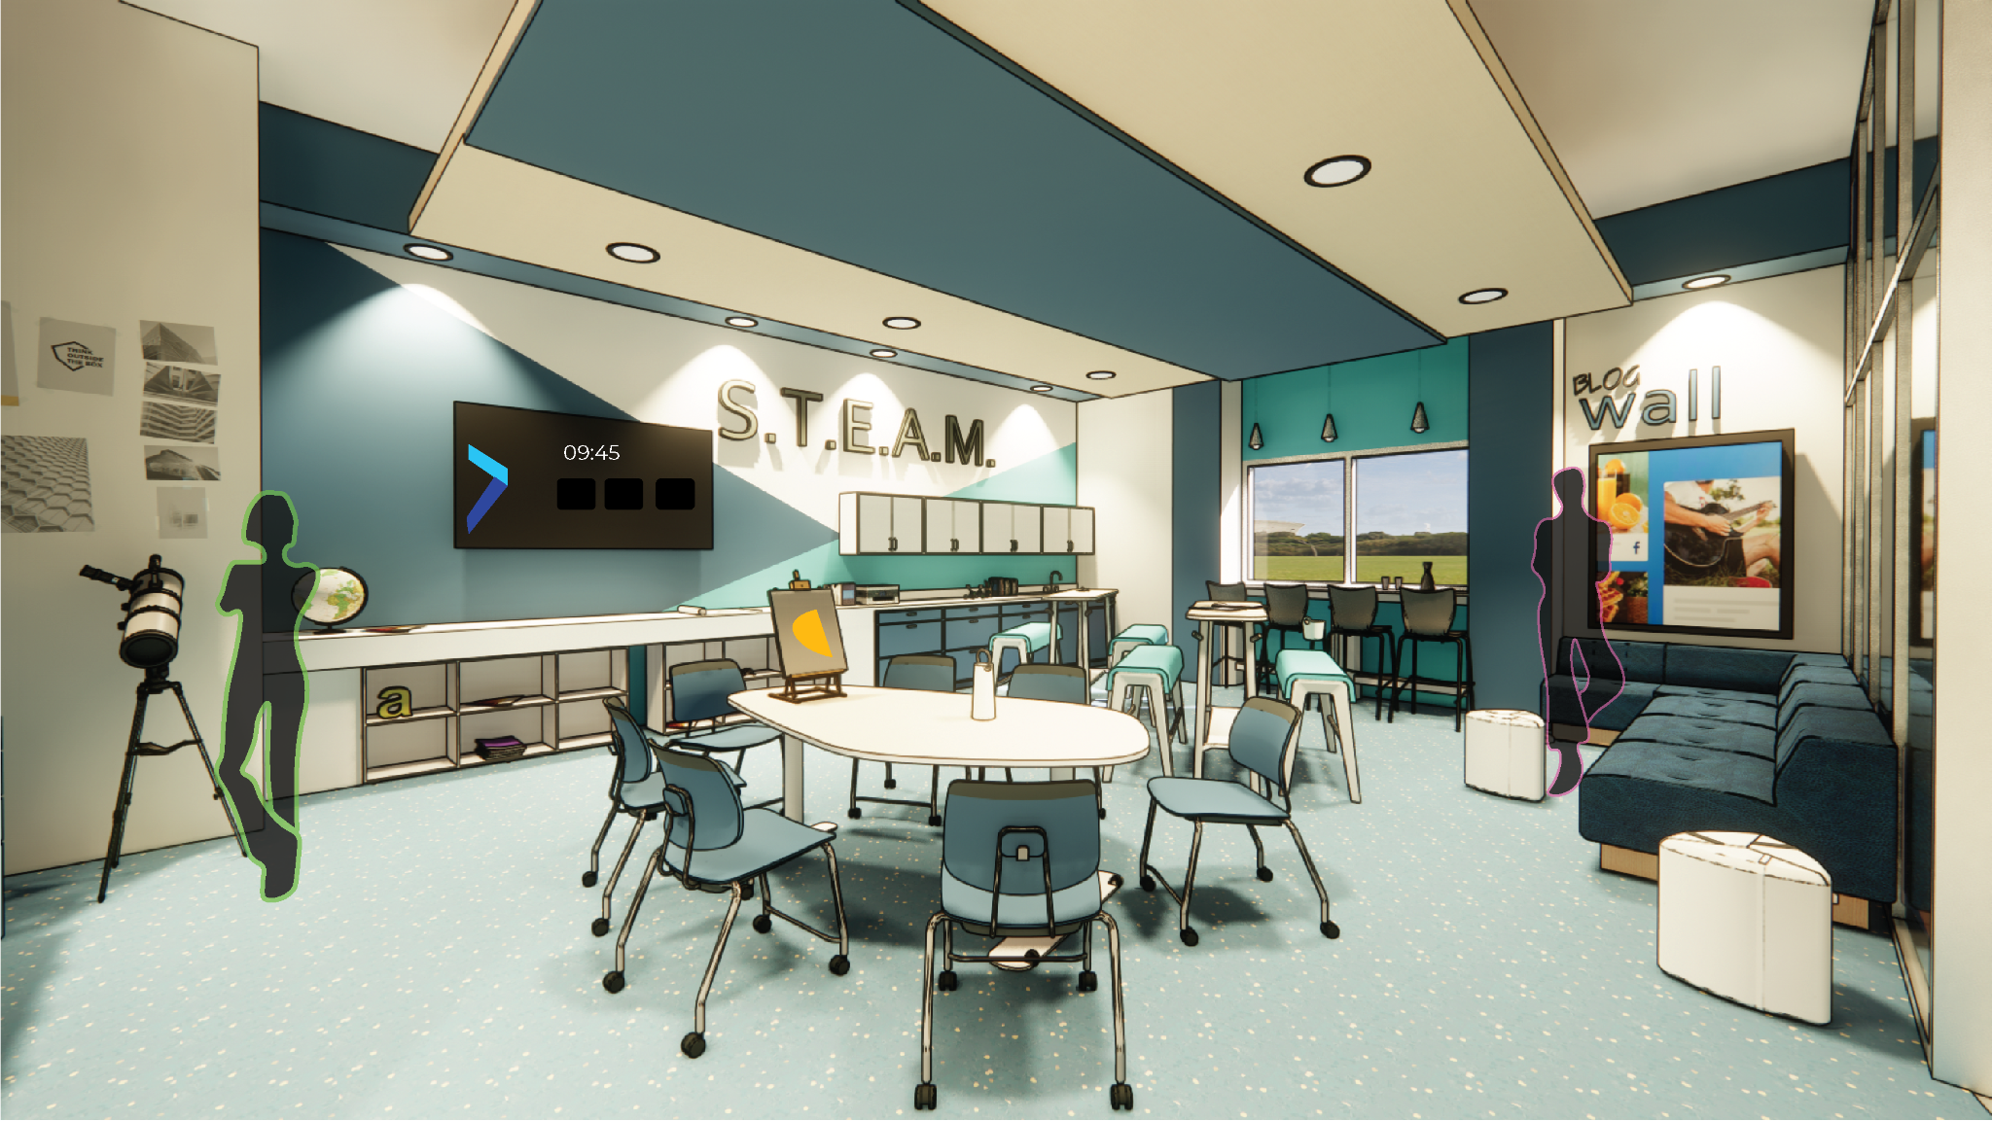
High school lounge STEAM side

Slide 53
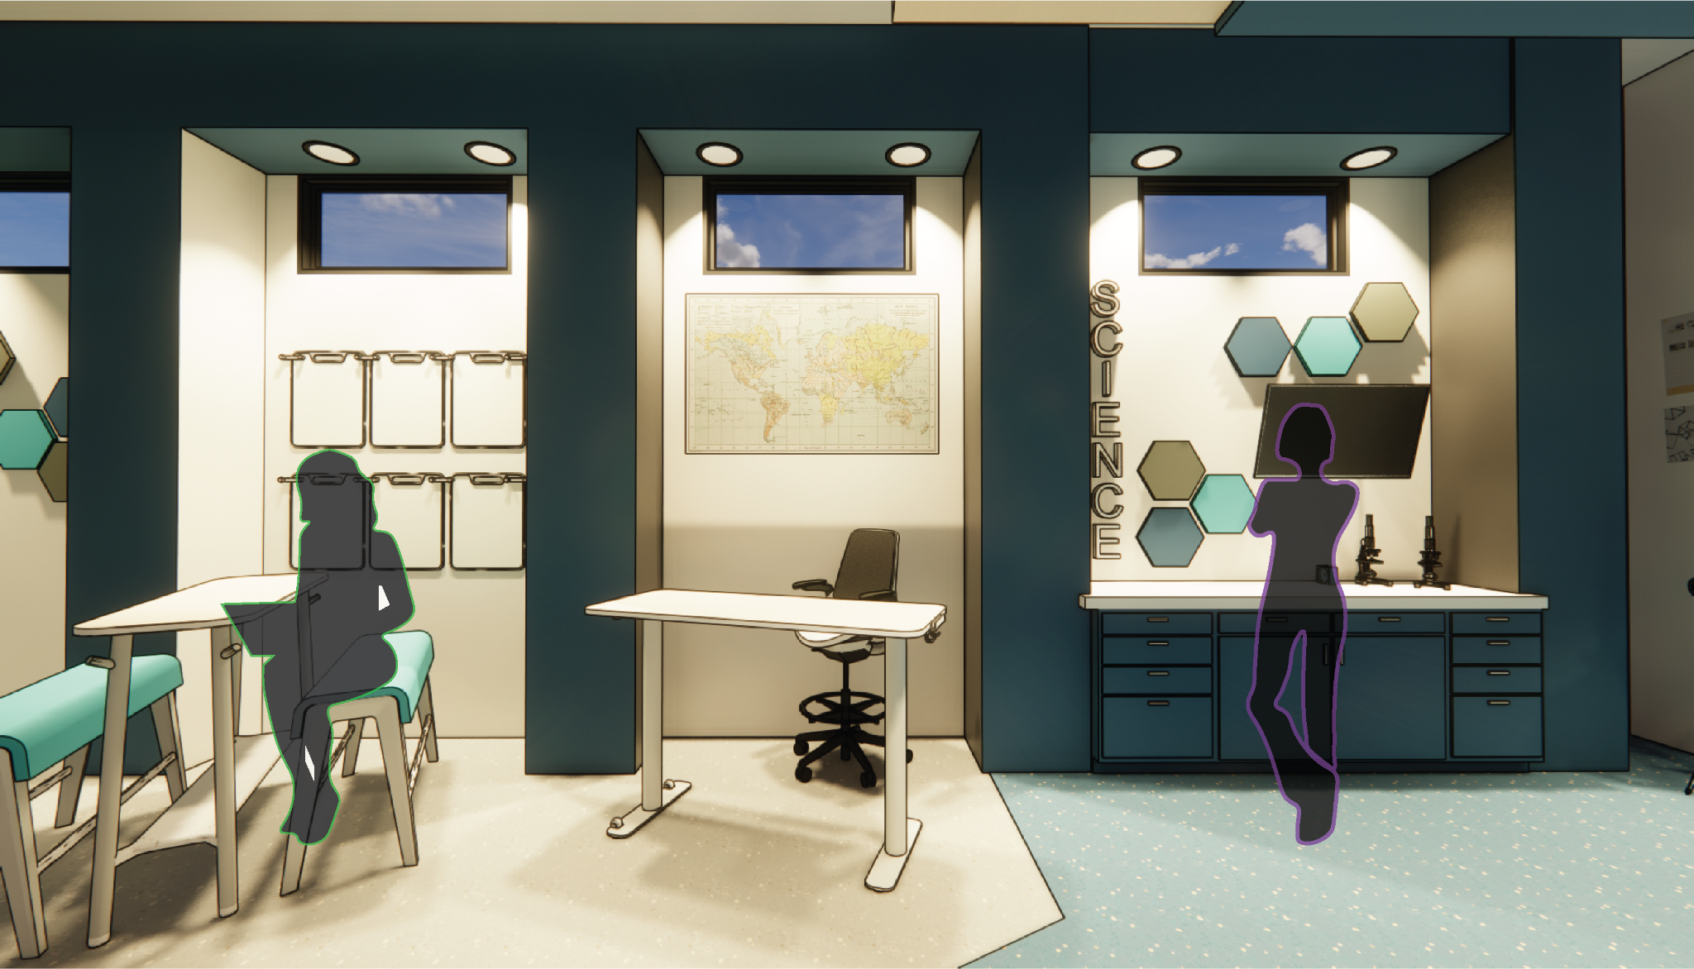
High school 3D elevation

Slide 54
Conclusions

Slide 55
Oral Defense
Capstone

Slide 56
Thank you!
Any comments or questions?
Oral Defense
Capstone

