Slide 1
Interior Perspective into Prototypical Hurricane Resistant Housing
Final Defense
Gillian Kostek

Slide 2
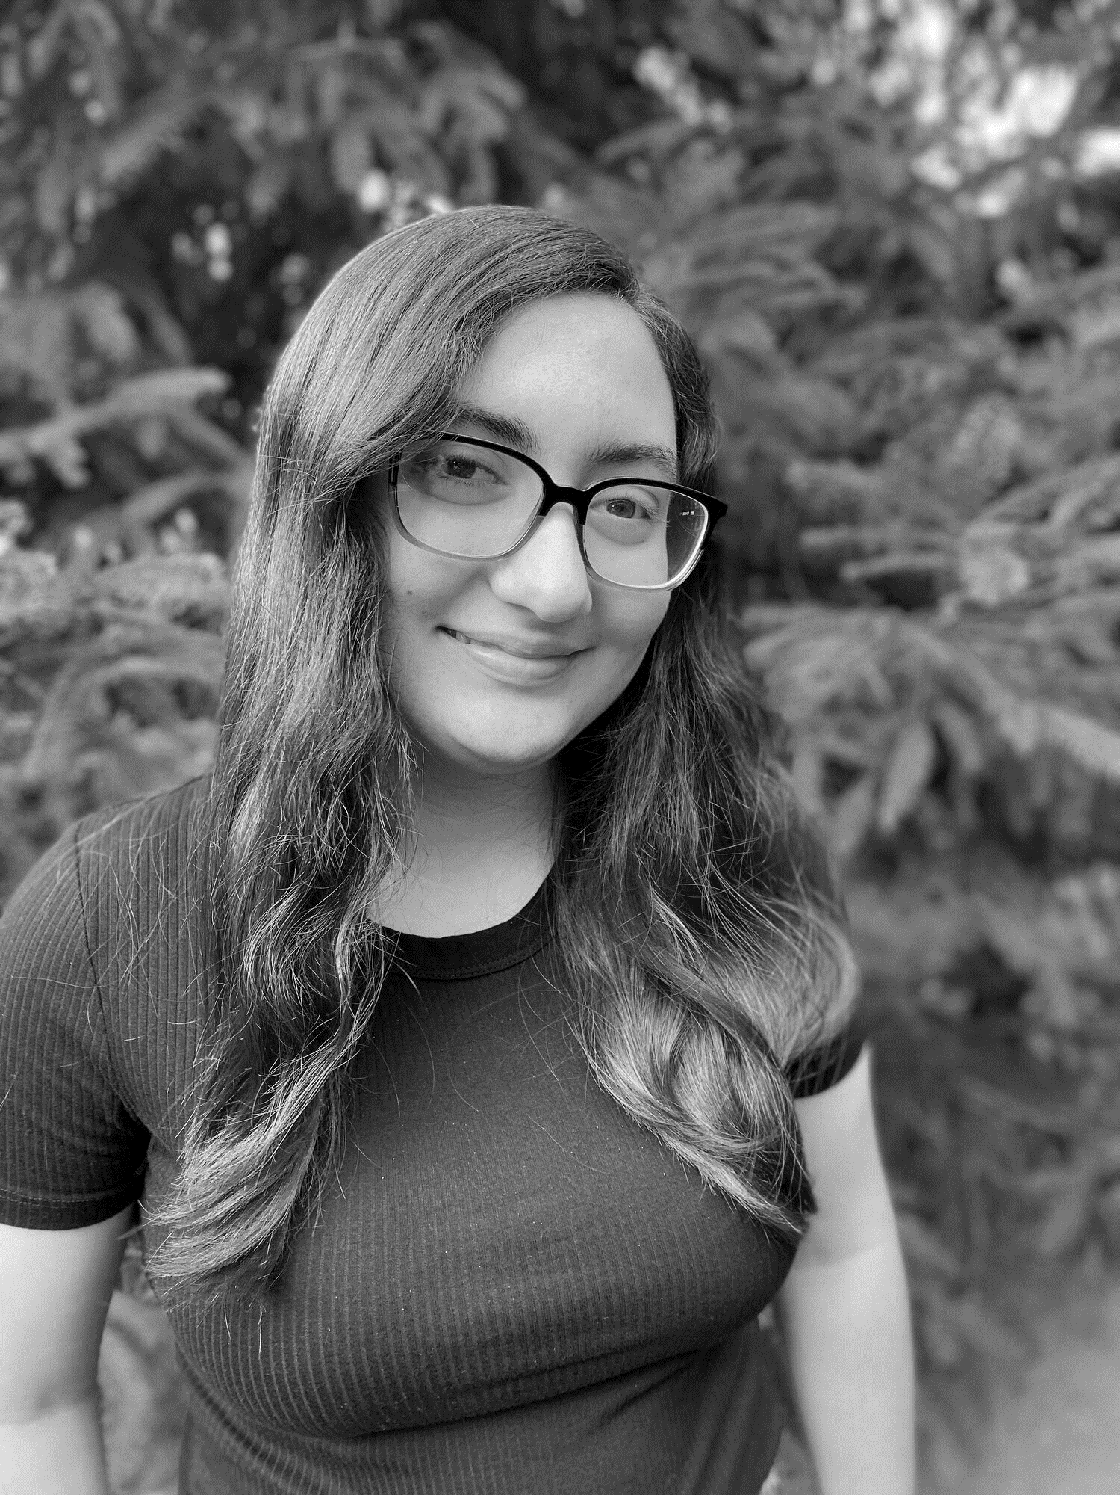
Gillian Kostek
4th Year Interior Design Student
Rochester Institute of Technology
Class of 2023

Slide 3
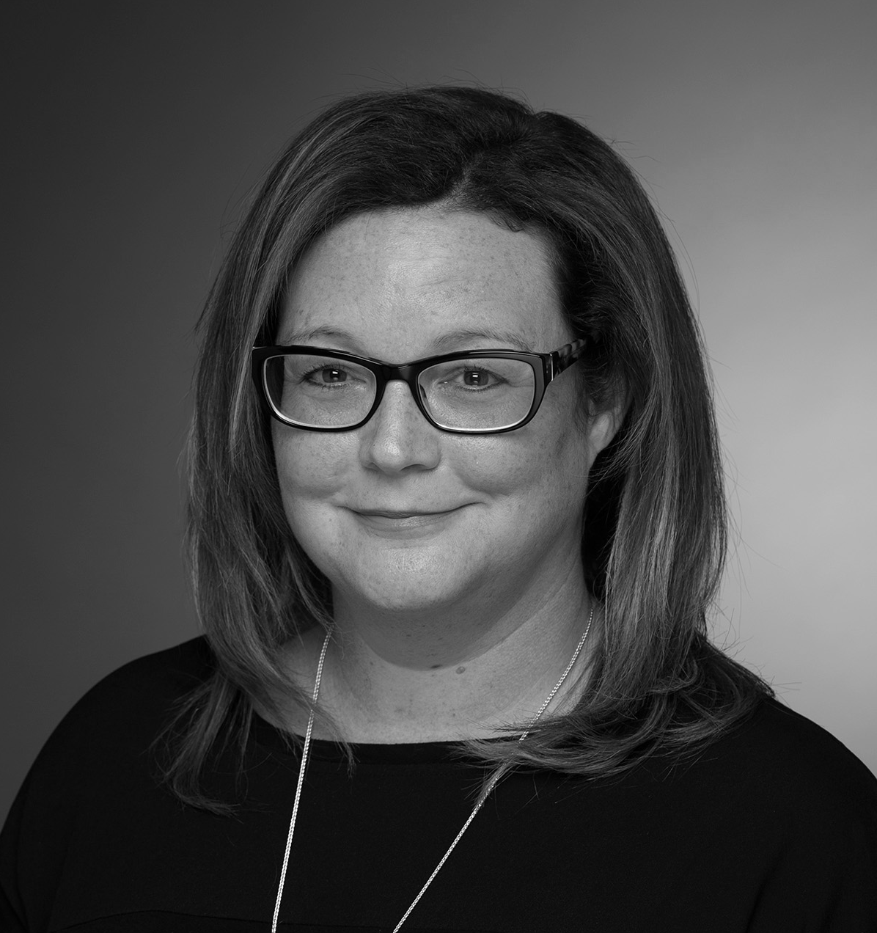
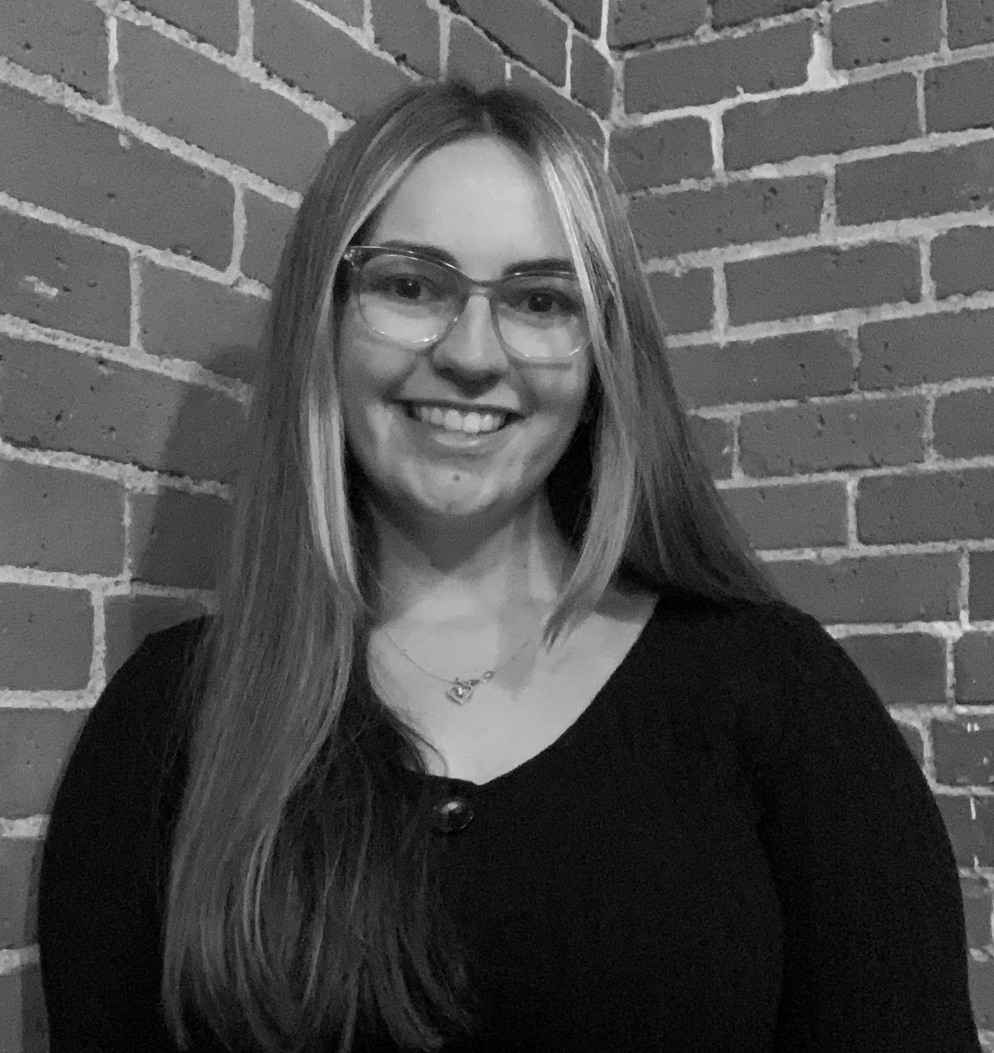
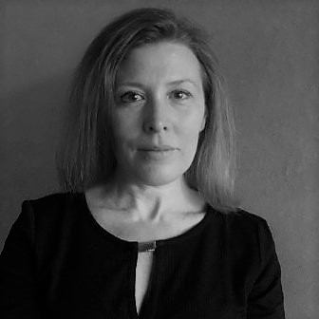
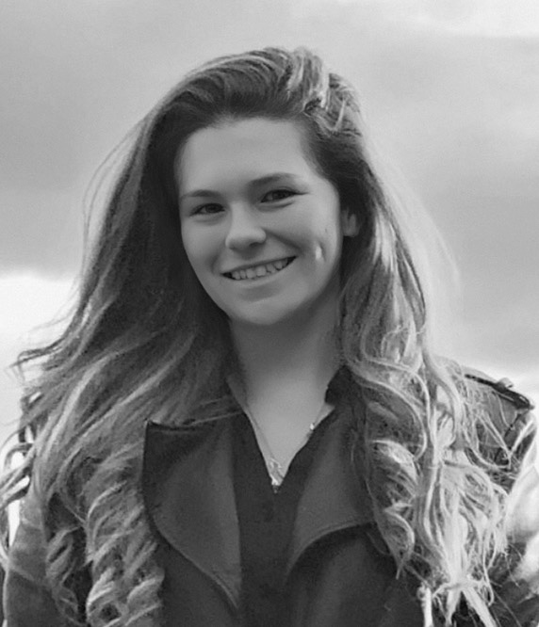
Committee Members
Kelly Jahn, NCARB, LEED AP
Committee Chair
Visiting Lecturer Interior Design
Rochester Institute of Technology
Meghan Strevig
Committee Member
Junior Architectural Designer
T.Y. Lin International
Mary Golden, NCIDQ
Committee Chair
Associate Professor
Rochester Institute of Technology
Becca Dolgas
Committee Member
Junior Interior Architectural Designer
Tremblay Maison

Slide 4
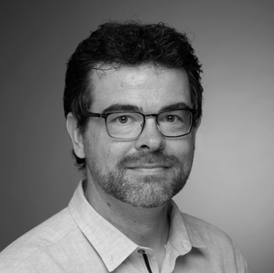
Reviewer
Seth Holmes, R.A. LEED AP BD+C
Reviewer
Associate Professor, Department of Architecture
RIT Golisano Institute of Sustainability

Slide 5
Introduction

Slide 6
Capstone Question
How Can Prototypical Hurricane Resistant Housing be Rethought to Consider Human Factors in Design?

Slide 7
Connection Between Human Factors & Hurricane Resistant Homes
Why is this important?
“Coastal-Living Life”
Hurricanes
Many homes are not accessible and are not designed for the life cycle of a home.
The objective of this capstone is to be able to keep people in their coastal homes while also incorporating human factors and universal design. Therefore, by using an existing hurricane-resistant home to incorporate human factors and universal design more people would be able to stay on the coasts.
Notes:
The focal location for this capstone project is on the coast of Florida specifically, Pompano Beach.
The east coast of Florida has been impacted by many hurricanes throughout the years. Individuals and families will never stop moving to coastal areas because they want to experience the “coastal-living life.”
However, the coasts experience severe weather conditions such as high winds and flooding that could be caused by hurricanes.
The objective of this capstone is to be able to keep people in their coastal homes while also incorporating human factors and universal design. Therefore, by using an existing hurricane-resistant home to incorporate human factors and universal design more people would be able to stay on the coasts.

Slide 8
Literature Review

Slide 9
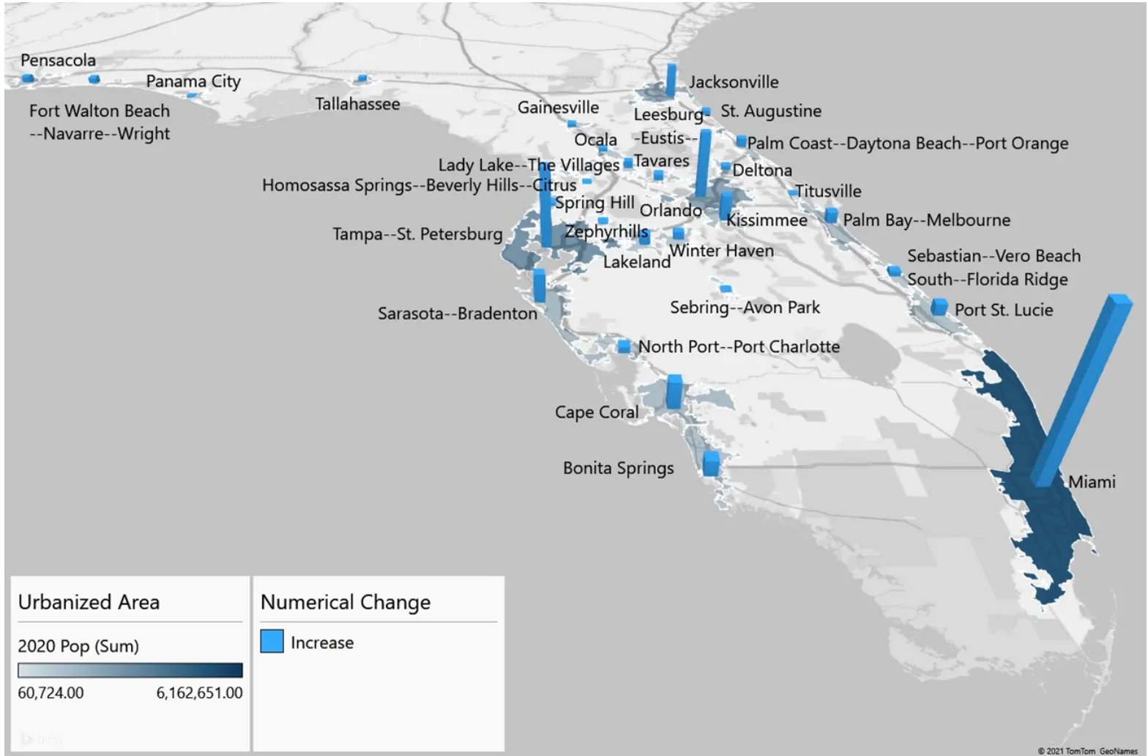
Literature Review
Population increase in Florida
Many more people affected by coastal storms
“Miami gained more than 660,272 people. Tampa-St. Petersburg and Orlando saw their population grow by 365,945 and 312,838 persons, respectively” (Florida Department of Transportation)

Slide 10
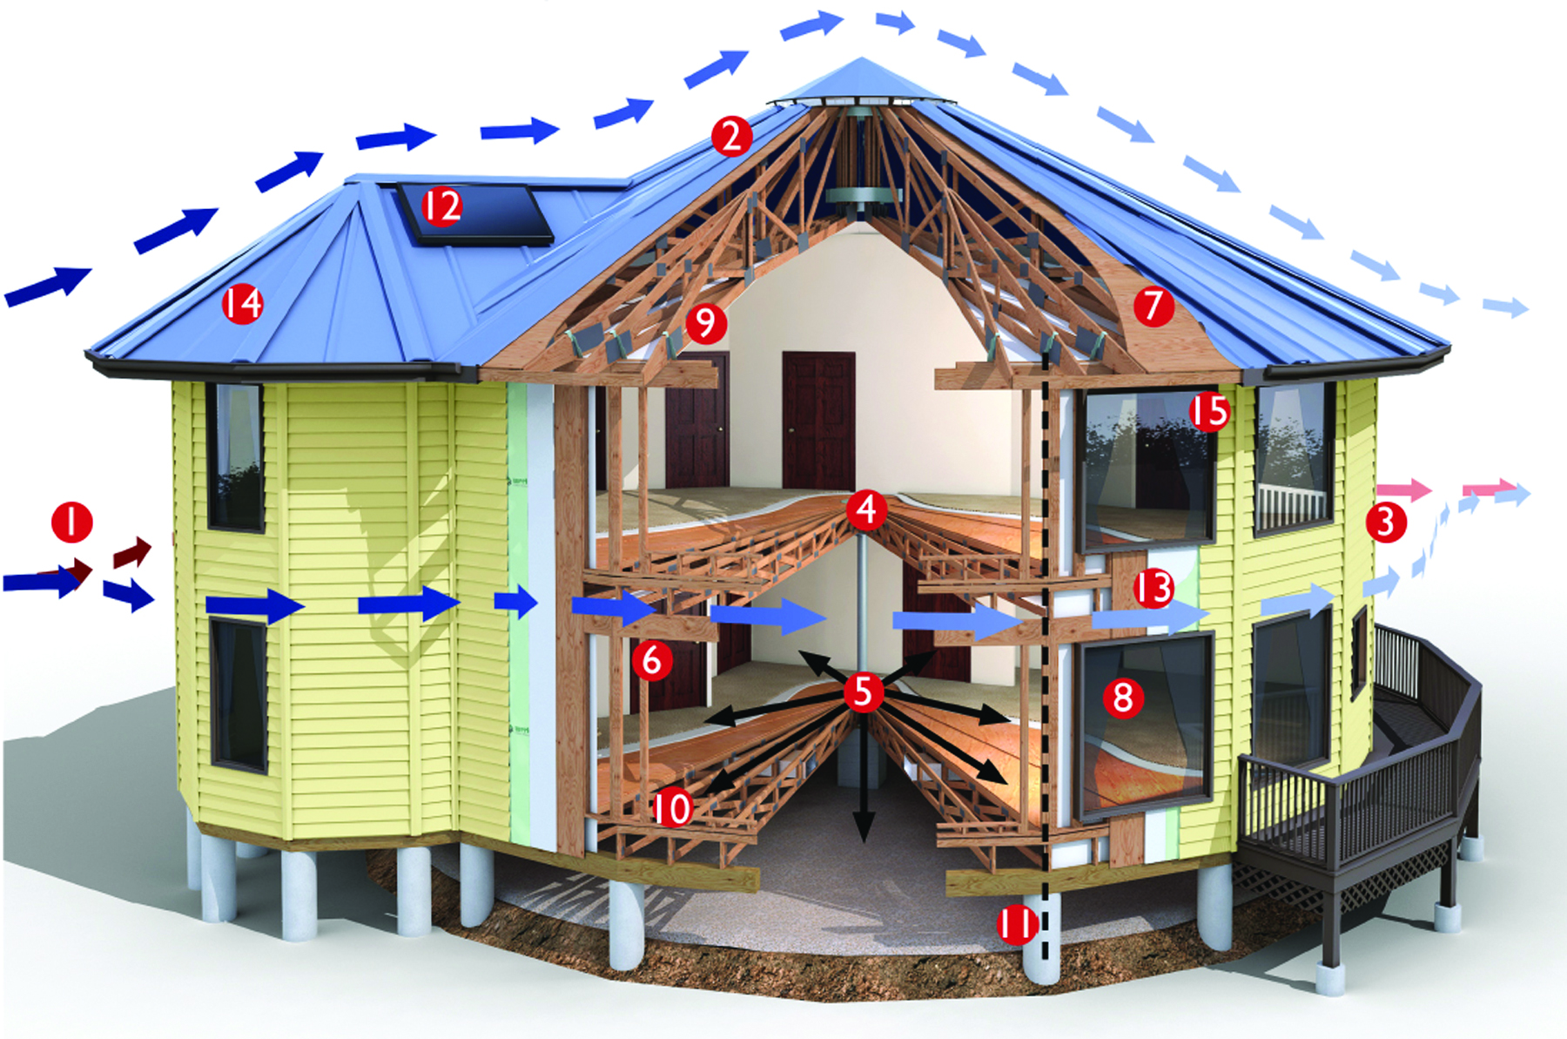
Literature Review
Deltec Homes
Homes have survived severe hurricanes such as Dorian, Irma, Maria, Sandy, Harvey, and Katrina
Most floor plans have a circular shape to redirect wind
Weight is dispersed from the center of the house because of the roof system

Slide 11
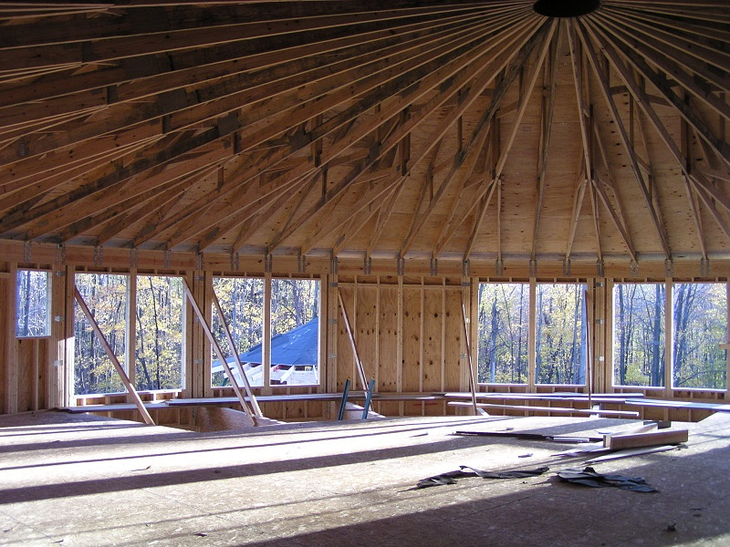
Literature Review
Framing lumber is twice as strong as typical framing material which makes it more structurally sound
“Radial floor & roof trusses which work like spokes on a wheel”
Notes:
One unique structural aspect is the “radial floor & roof trusses which work like spokes on a wheel” . The framing lumber is twice as strong as typical framing material which makes it more structurally sound.

Slide 12
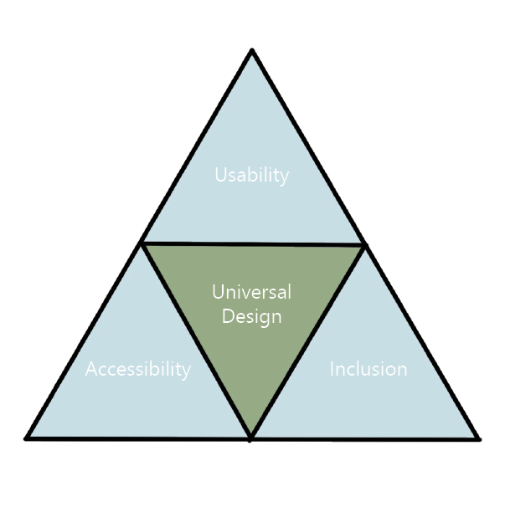
Literature Review
Human Factors
“Human factors is the study of the way humans relate to the world around them and is concerned with improving performance and safety” (Nussbaumer, 6)
Universal Design
Notes:
The universal design definition is the art and practice of design to accommodate the widest variety of number of people throughout their life span

Slide 13
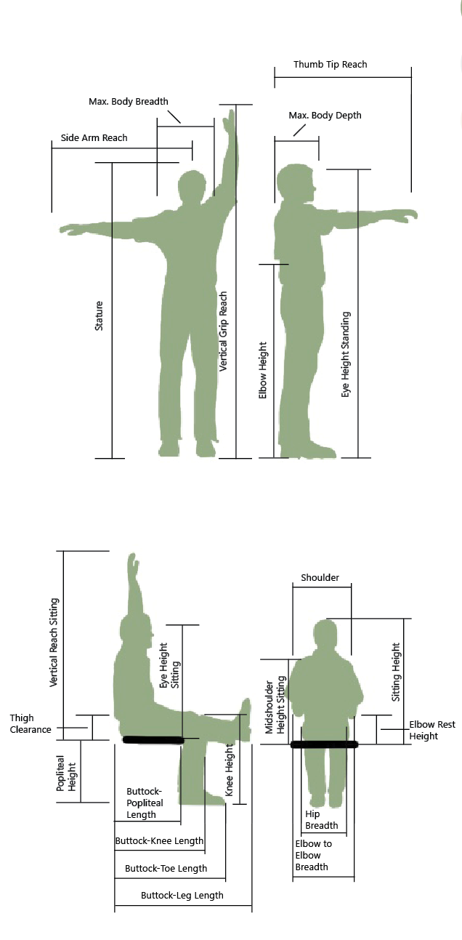
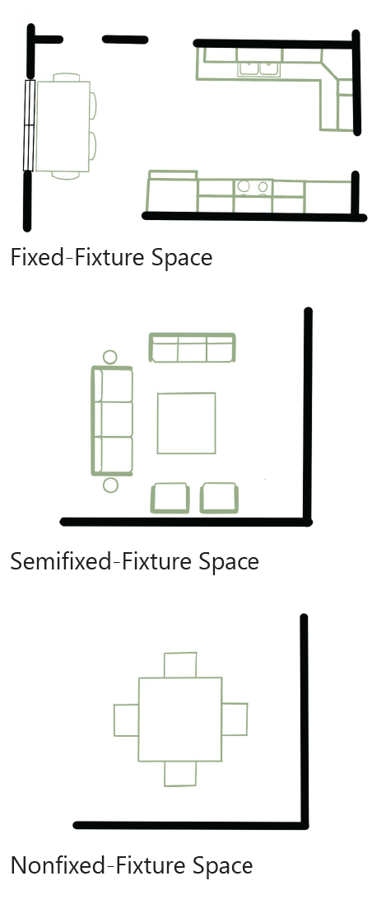
Literature Review
Include proxemics, anthropometrics, ergonomics
Notes:
Proxemics is the study of the relationship between humans in a particular culture and their use and perceptions of space (Nussbaumer, 6). Anthropometrics is defined as the science that is concerned with measurements of the human body; more specifically, it is the science of body measurements and proportions of the human body in various activities (Nussbaumer, 33). “ergonomics is the study of the interaction between people and machines and the factors that affect the interaction.

Slide 14
Literature Review
Notes:
Many residential homes are designed to fit the needs of their first occupants and do not consider the residents after the first residents move out.

Slide 15
Research Agenda

Slide 16
Research Agenda
Interview with Tim Riddle, Business Development Lead, Deltec Homes
Most damage they see on their homes is shingle loss and structural damage due to projectiles thrown into the home
Deltec Homes work directly with clients, so the design of the home meets their needs

Slide 17
Research Agenda
Interview with Krista Macy, Architect, University at Buffalo IDEA Center
She gave information on universal design and how to make a home accessible and inclusive
The IDEA Center’s definition of universal design is a process that enables and empowers a diverse population through human performance, health and wellness, and social participation
“Something that is universally designed, should be accessible”
Notes:
Illuminated stairs, contrasts on doors, non glossy materials

Slide 18
Research Agenda
Interview with Dominique Curle, Interior Designer, Garcia Stromberg
Designer located in Florida
Gave insight on designing in Florida
Florida codes are strict because of hurricanes
All products used in a home need to be approved along with the architectural drawings

Slide 19
Creative Agenda

Slide 20
Creative Agenda: Project Statement
Florida is home to many coastal homes where many hurricanes make landfall. Many homes on the coast are not accessible nor inclusive because of many factors. For example, many homes are on pilings which does not make it accessible for some differently-abled individuals. By looking into how hurricane-resistant housing can be rethought to be more inclusive, many people would be able to stay living on the coast. This also could prevent people whose homes were destroyed by coastal storms from moving inland and disrupting inland communities.

Slide 21
Program Goals & Objectives
Keep people in their coastal homes
Make hurricane resistant housing accessible and inclusive to all
Rethink how interiors of hurricane resistant homes could be universally designed
Include human factors into the design such as universal design, ergonomics, anthropometrics, designing for diverse populations, and demographics
Use Deltec Homes floor plan as a base and redesign the interior to include human factors
Notes:
Pilings

Slide 22
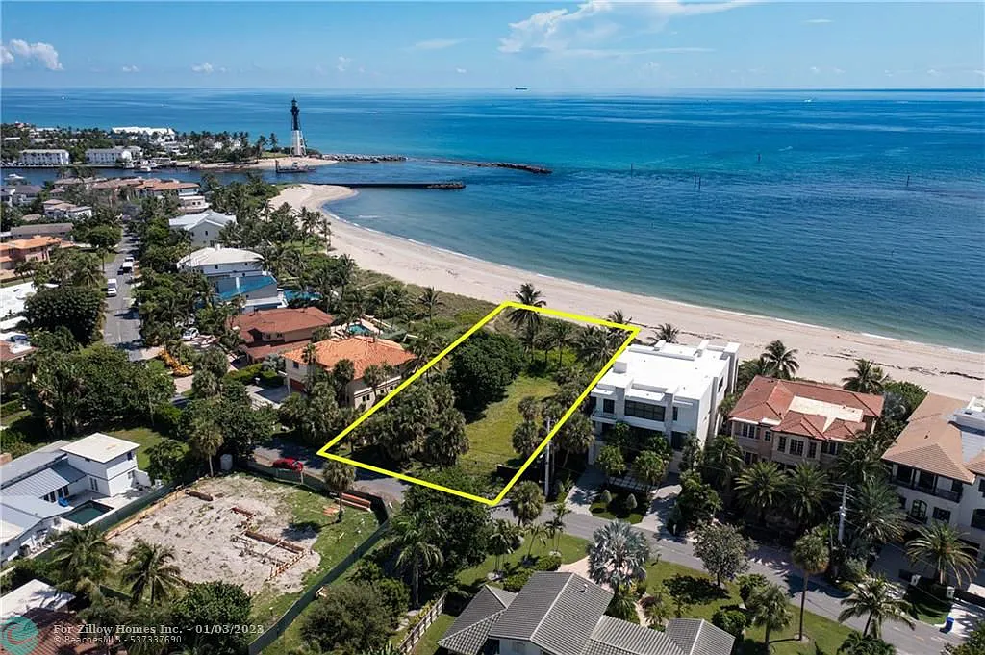
Project Site
2100 Bay Dr, Pompano Beach, FL 33062
Zoning: RS – 2: Single Family Residence
Located on the East Coast of Florida

Slide 23
Major Hurricane Paths (2000 – 2022)

Slide 24
Site Setbacks
Lot size : 17,384 sqft
Lot Coverage Max: 6,953.6 sqft
Pervious Area: 5,215.2 sqft
Footprint of Building: 1,156.69 sqft
Square Footage: 2,487.72 sqft
Front Yard: 2,607.6 sqft

Slide 25
December Sun Path

Slide 26
June Sun Path

Slide 27
Prevailing Southeast Winds

Slide 28
User Profiles
Stacey
Mother
40 years old
Height: 5’-4’’
5th Grade Teacher
Needs Corrective Lenses
Diagnosed with Arthritis

Slide 29
User Profiles
Mark
Father
43 years old
Height: 6’-2’’
Accountant
Has back pain from working at a desk

Slide 30
User Profiles
Chris
Kid
11 years old
Height: 4’-8’’
6th Grade Student
Plays Soccer
Had surgery on his ACL
Needs crutches and a wheelchair

Slide 31
Deltec Home Existing Floor Plan

Slide 32
Existing Floor Plan Issues - Stacey

Slide 33
Existing Floor Plan Issues - Mark

Slide 34
Existing Floor Plan Issues - Chris

Slide 35
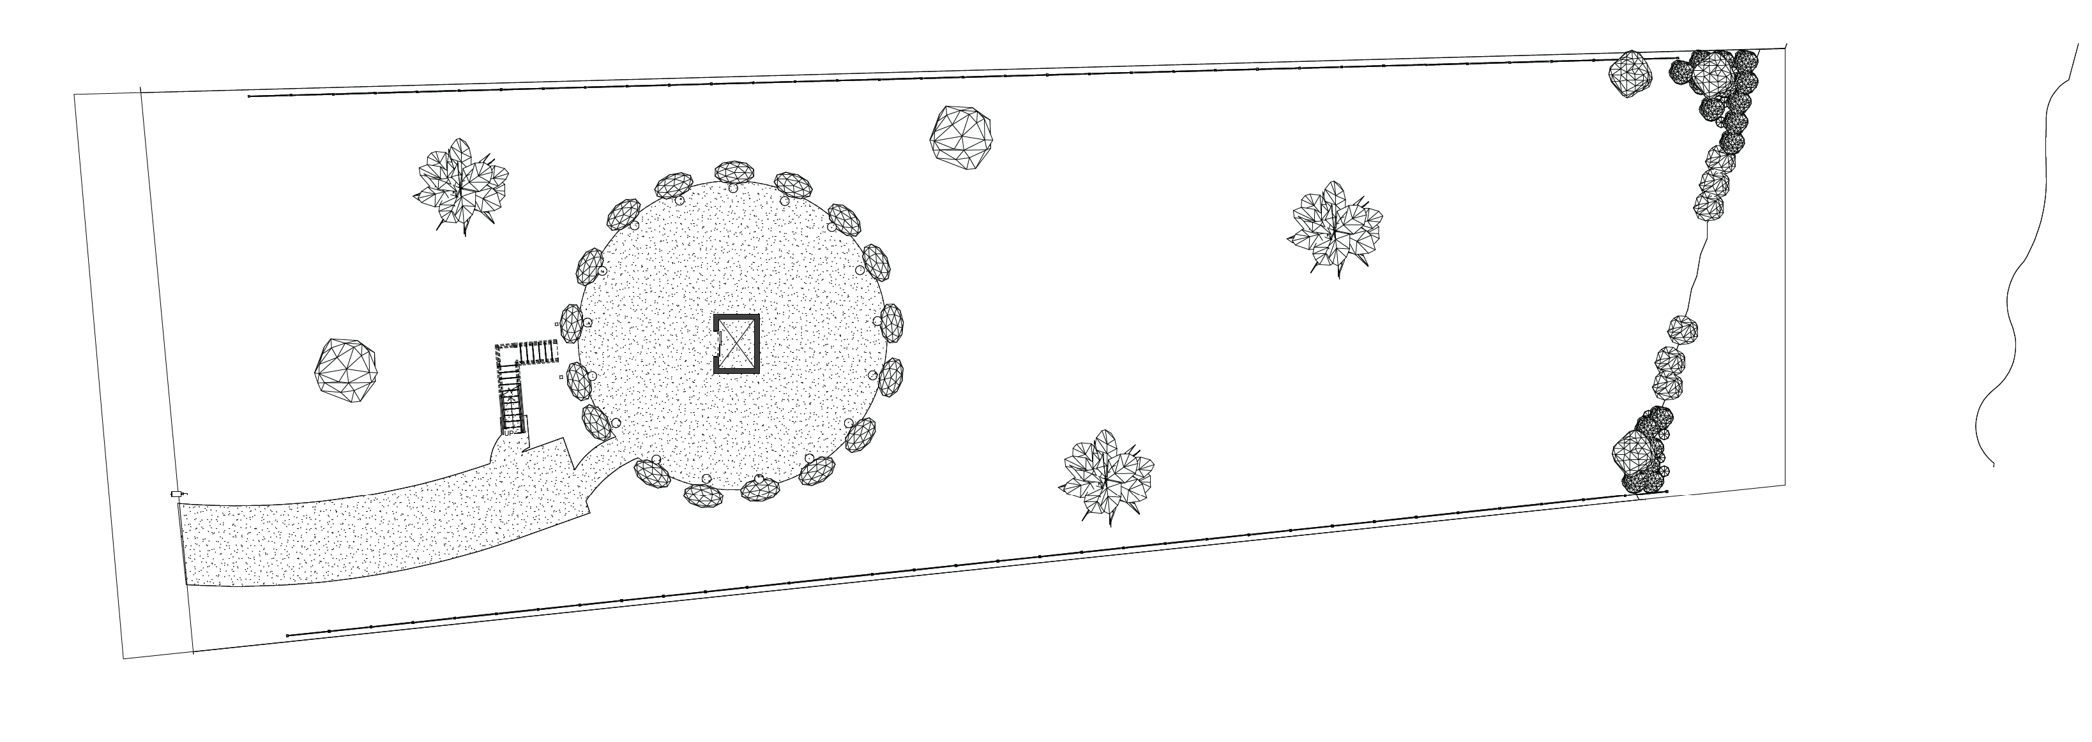
Ground Floor

Slide 36
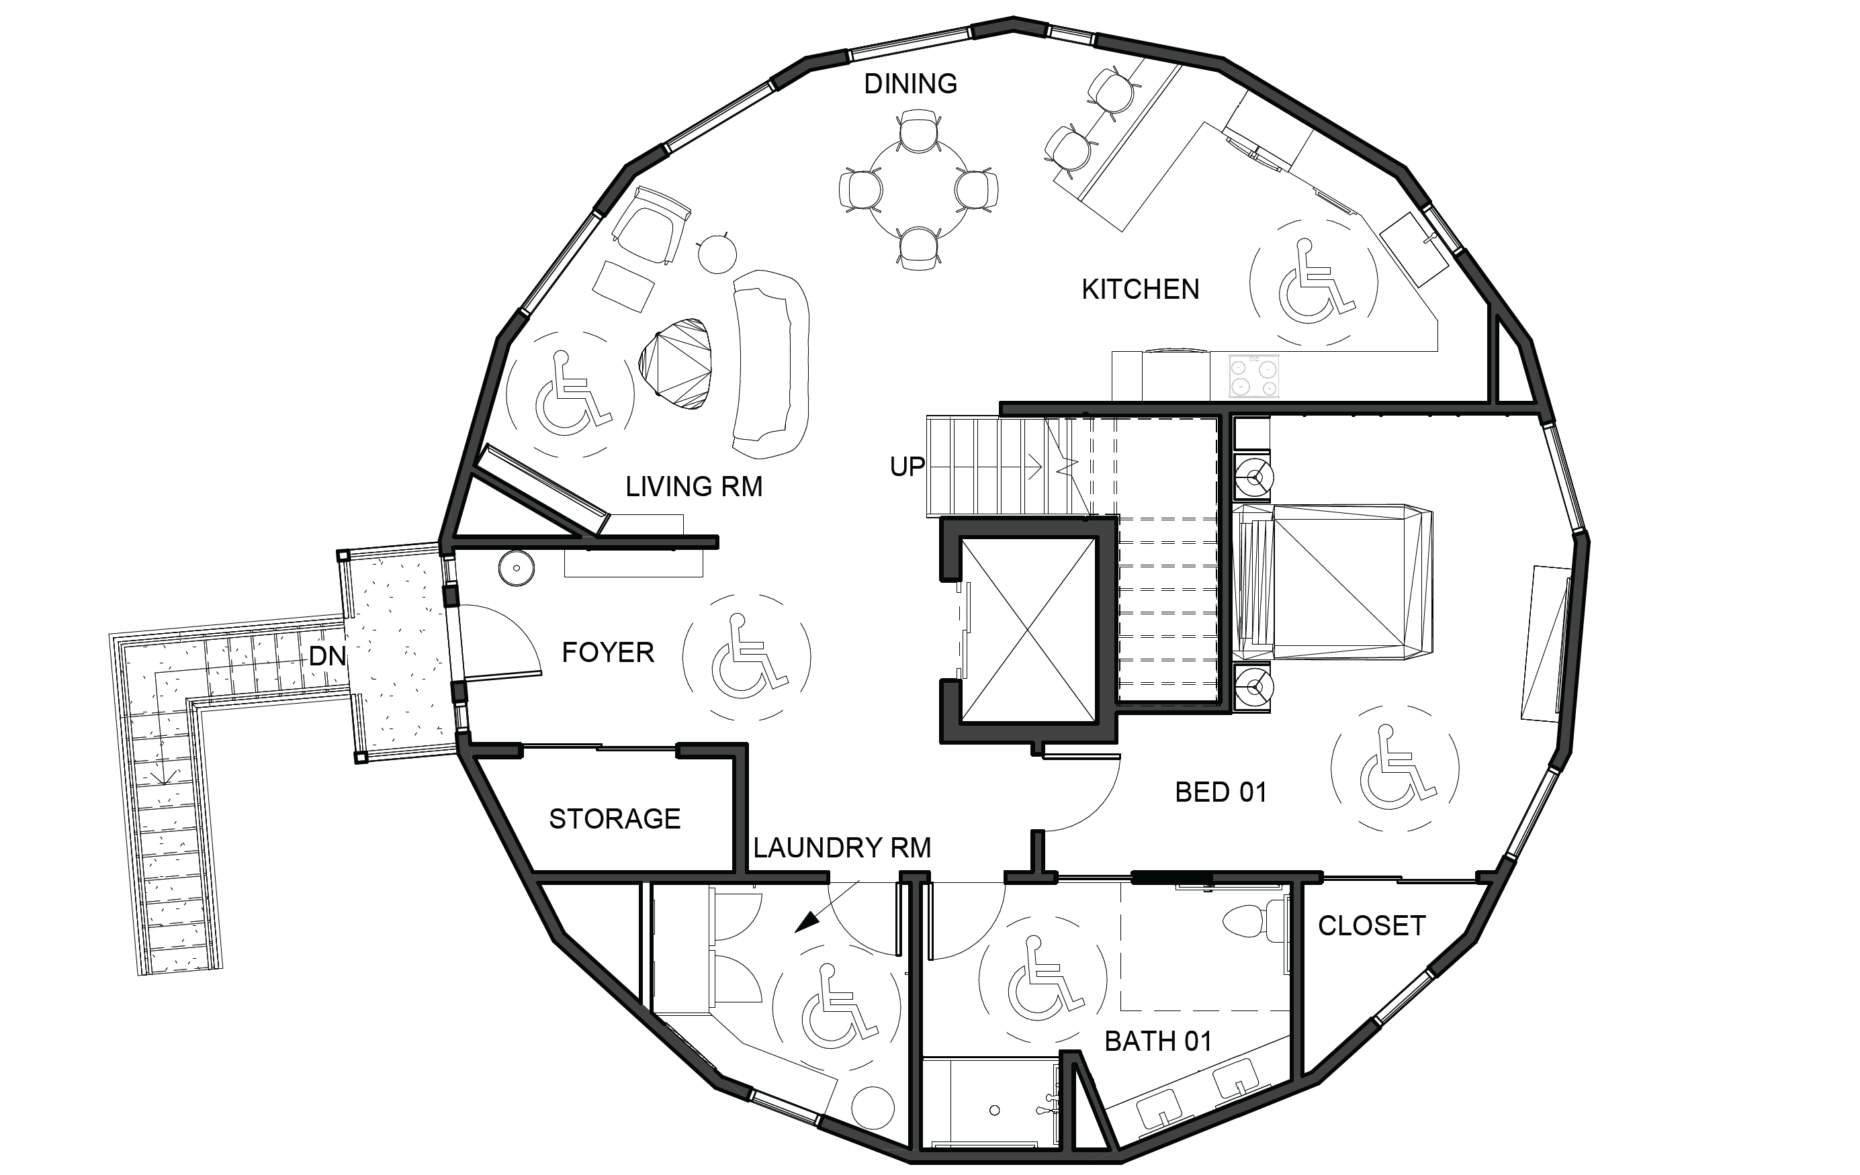
Level 01

Slide 37
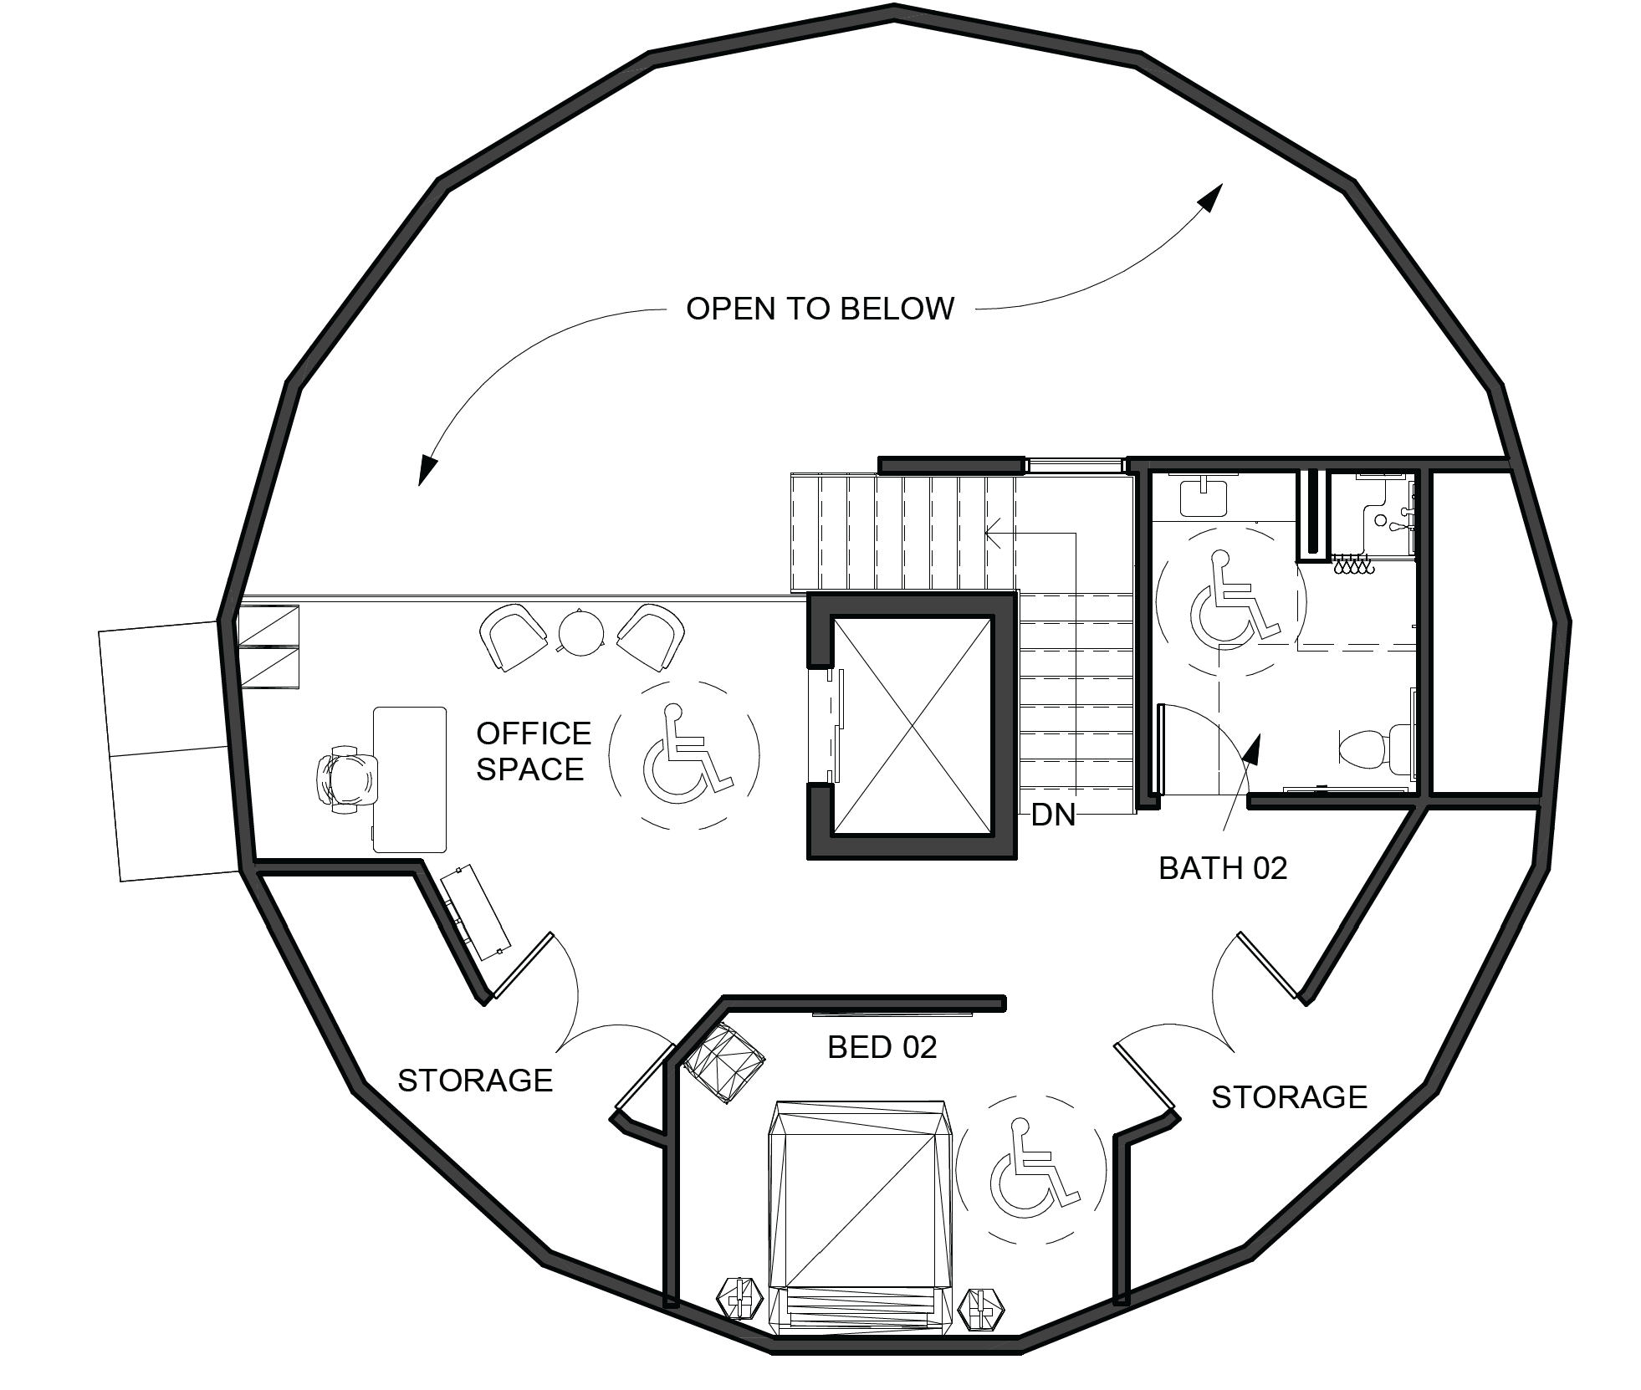
Level 02

Slide 38
Proposed First Floor Plan - Stacey

Slide 39
Proposed Second Floor Plan - Stacey

Slide 40
Proposed First Floor Plan - Mark

Slide 41
Proposed Second Floor Plan - Mark

Slide 42
Proposed First Floor Plan - Chris

Slide 43
Proposed Second Floor Plan - Chris

Slide 44
Elevations
West
East

Slide 45
Elevations
North
South

Slide 46
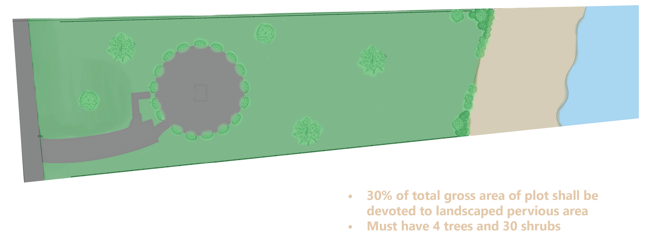
Landscaping

Slide 47
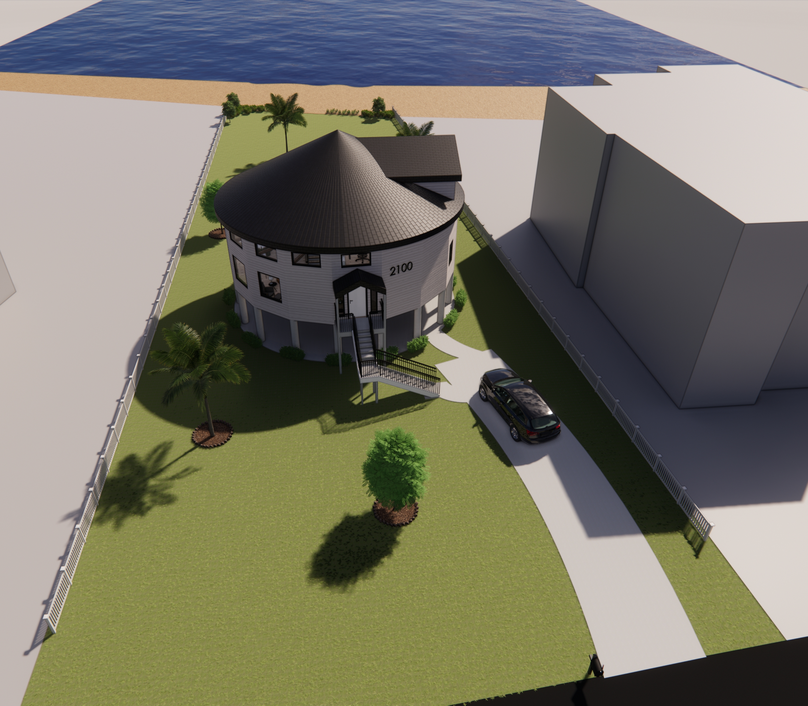
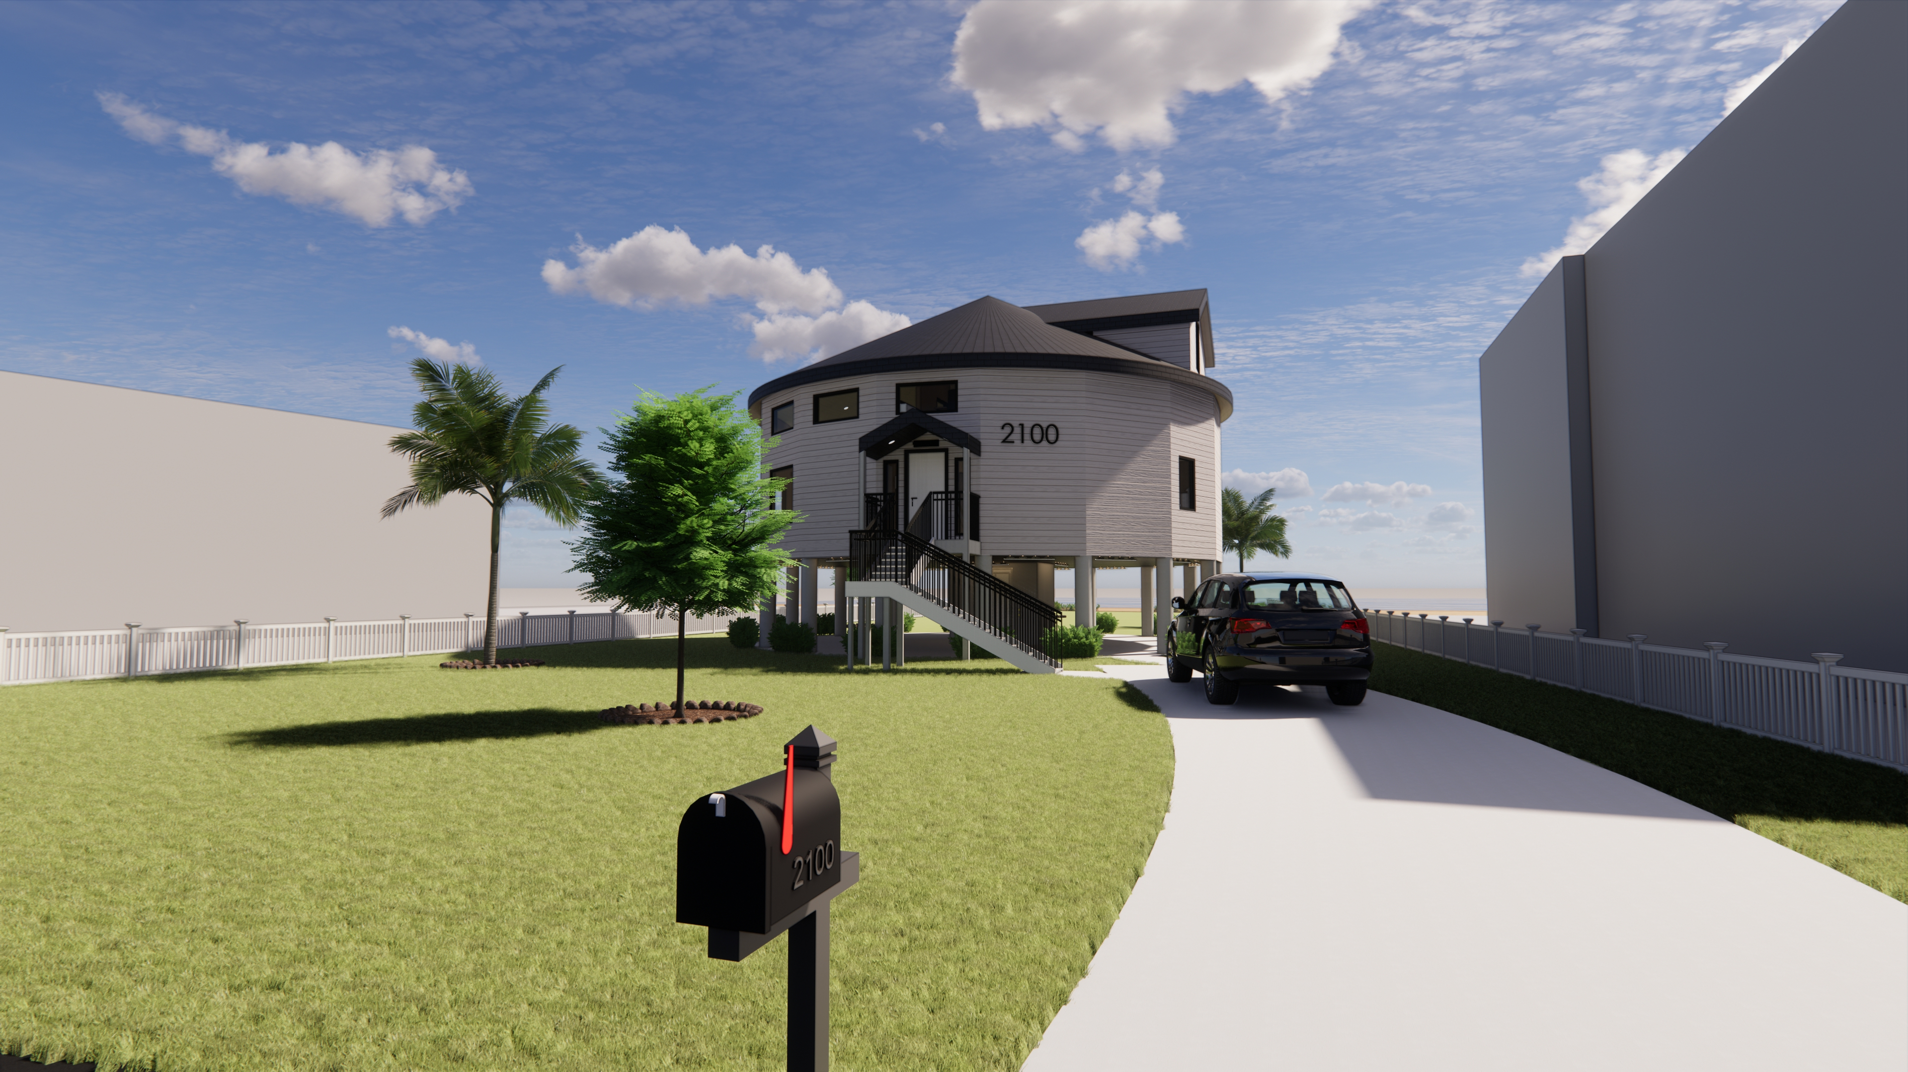
Renders – Exterior
Large Visible House Number

Slide 48
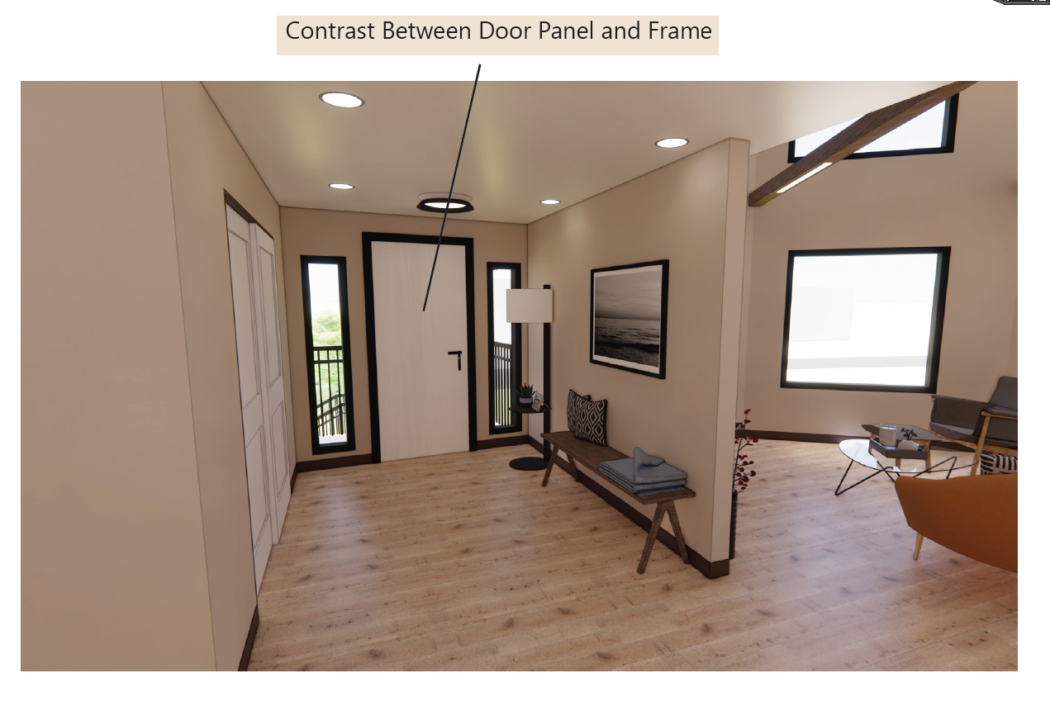
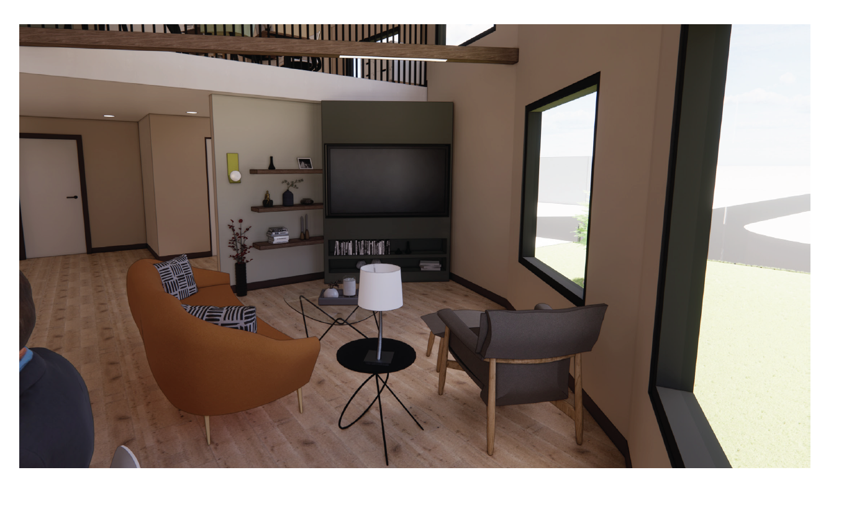
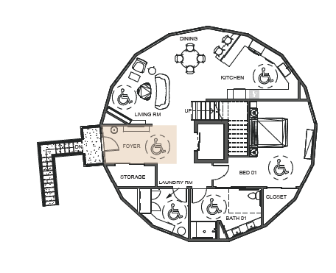
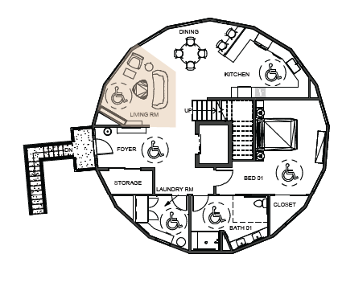
Renders – Foyer & Living Room

Slide 49
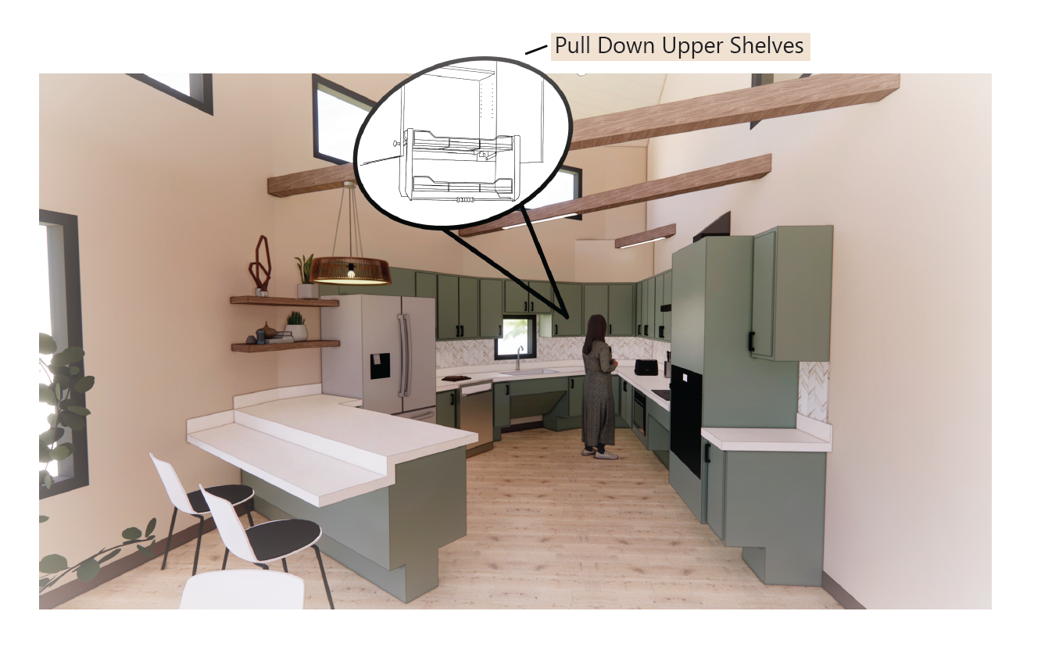
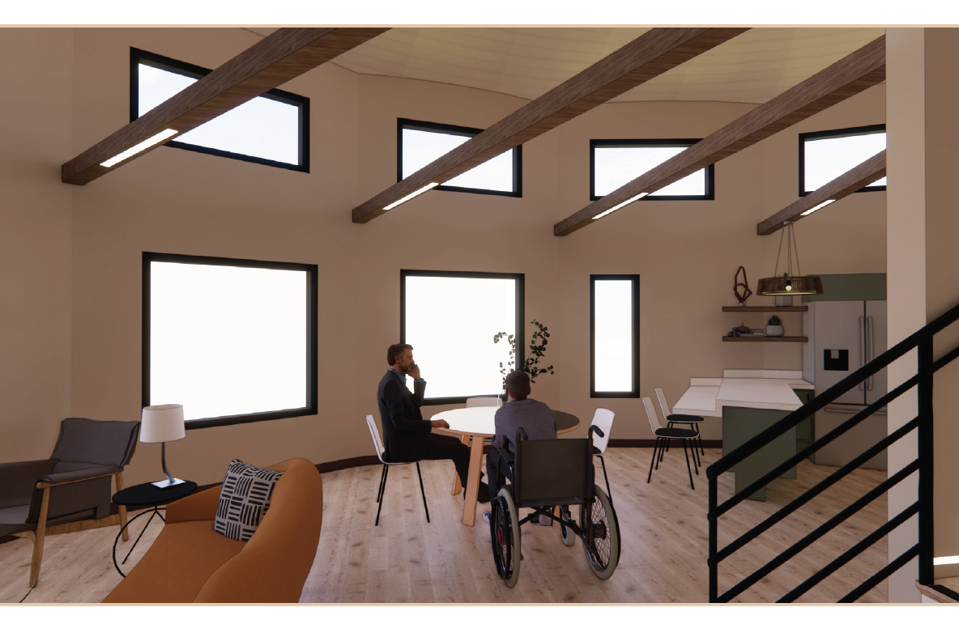
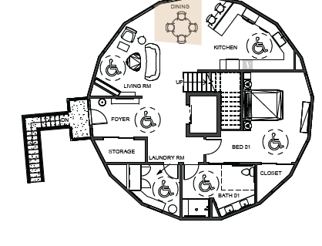
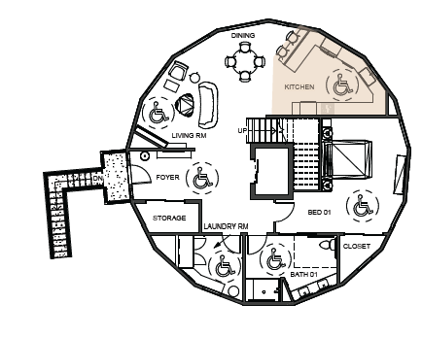
Renders – Dining & Kitchen

Slide 50
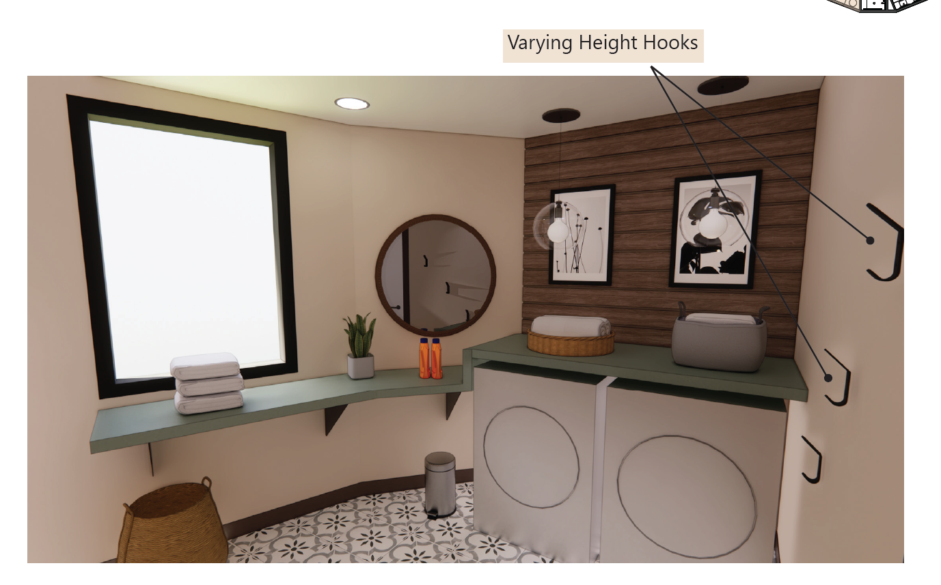
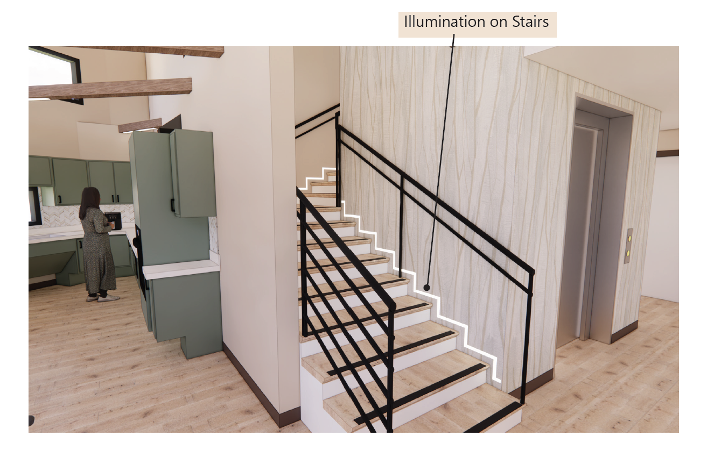
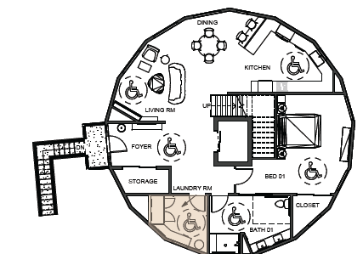
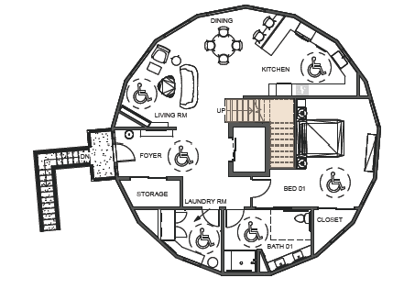
Renders – Laundry Room & Stairs

Slide 51
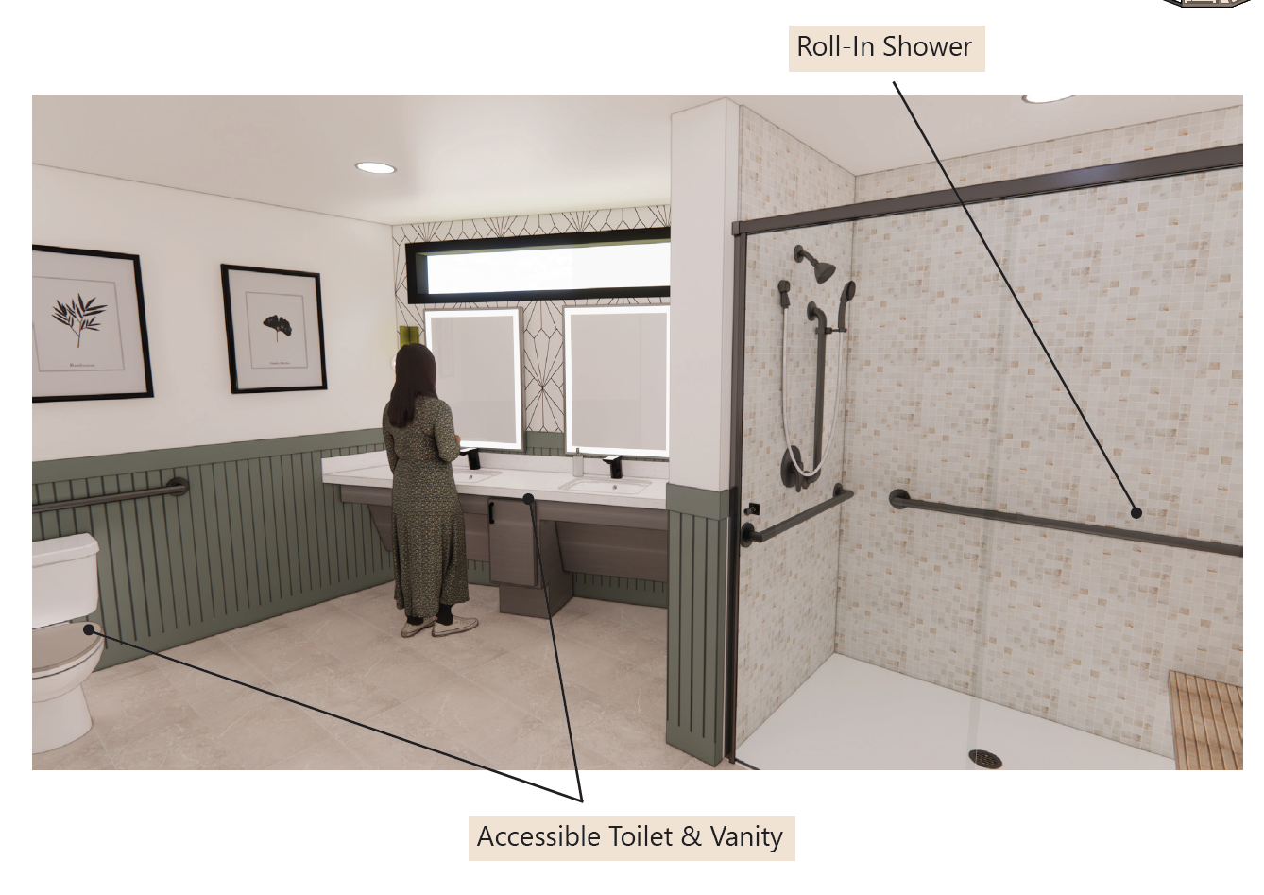
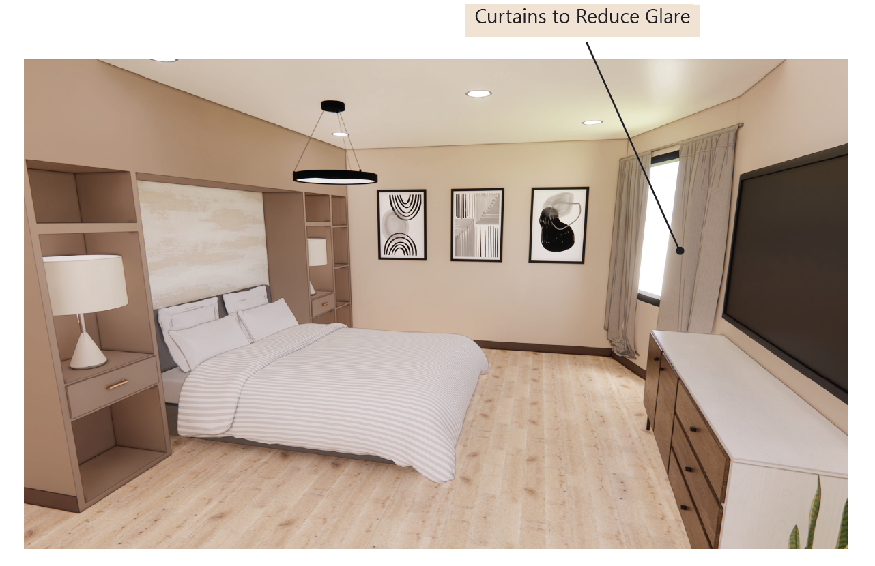
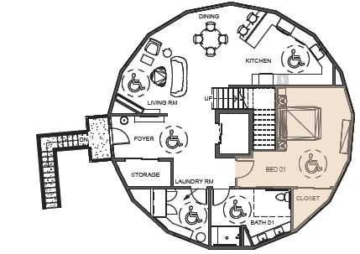
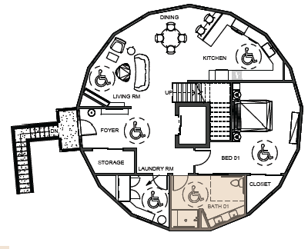
Renders – Bedroom & Bathroom 01

Slide 52
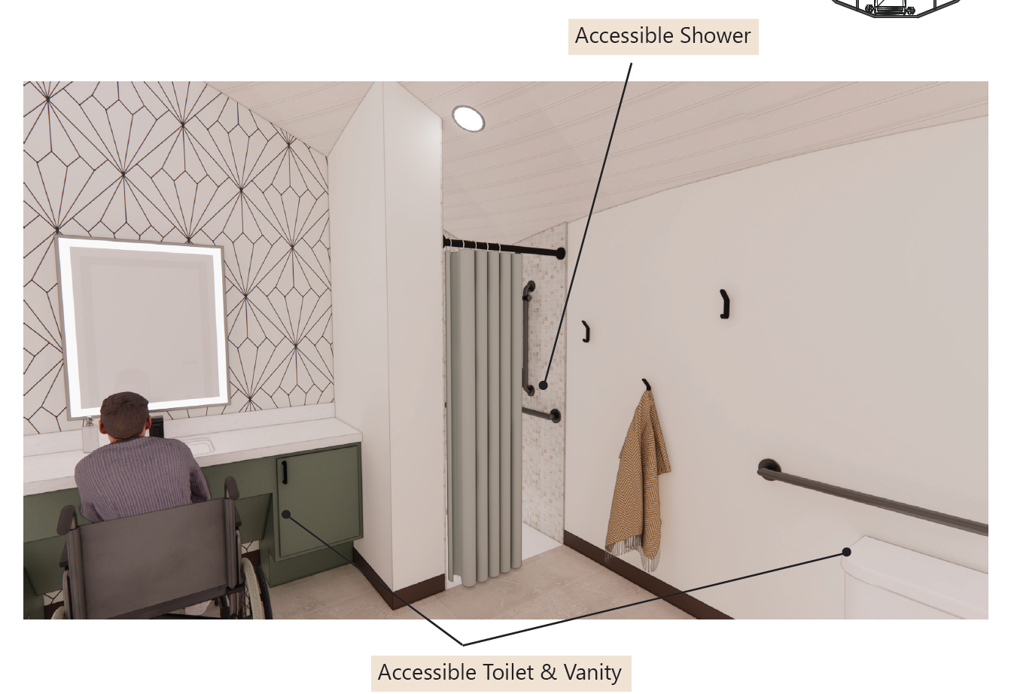
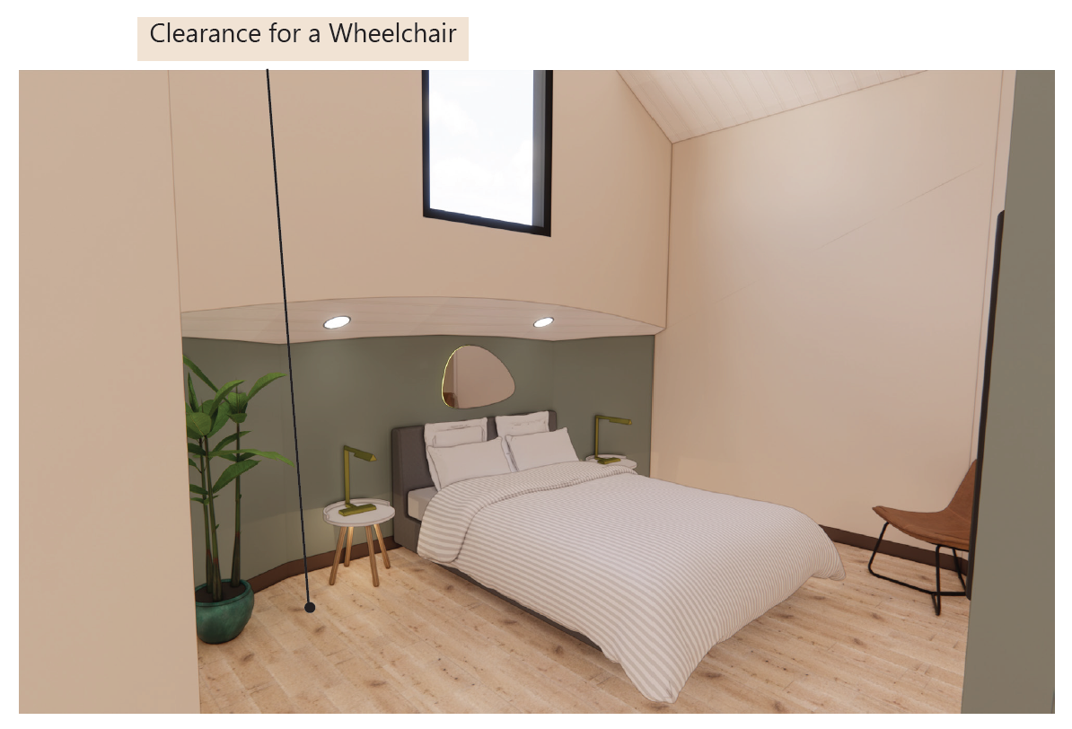
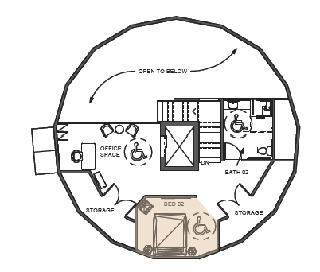
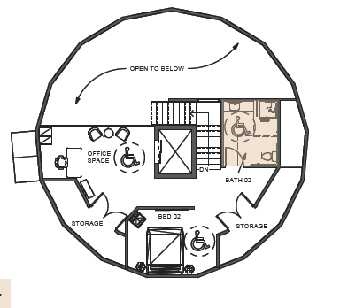
Renders – Bedroom & Bathroom 02

Slide 53
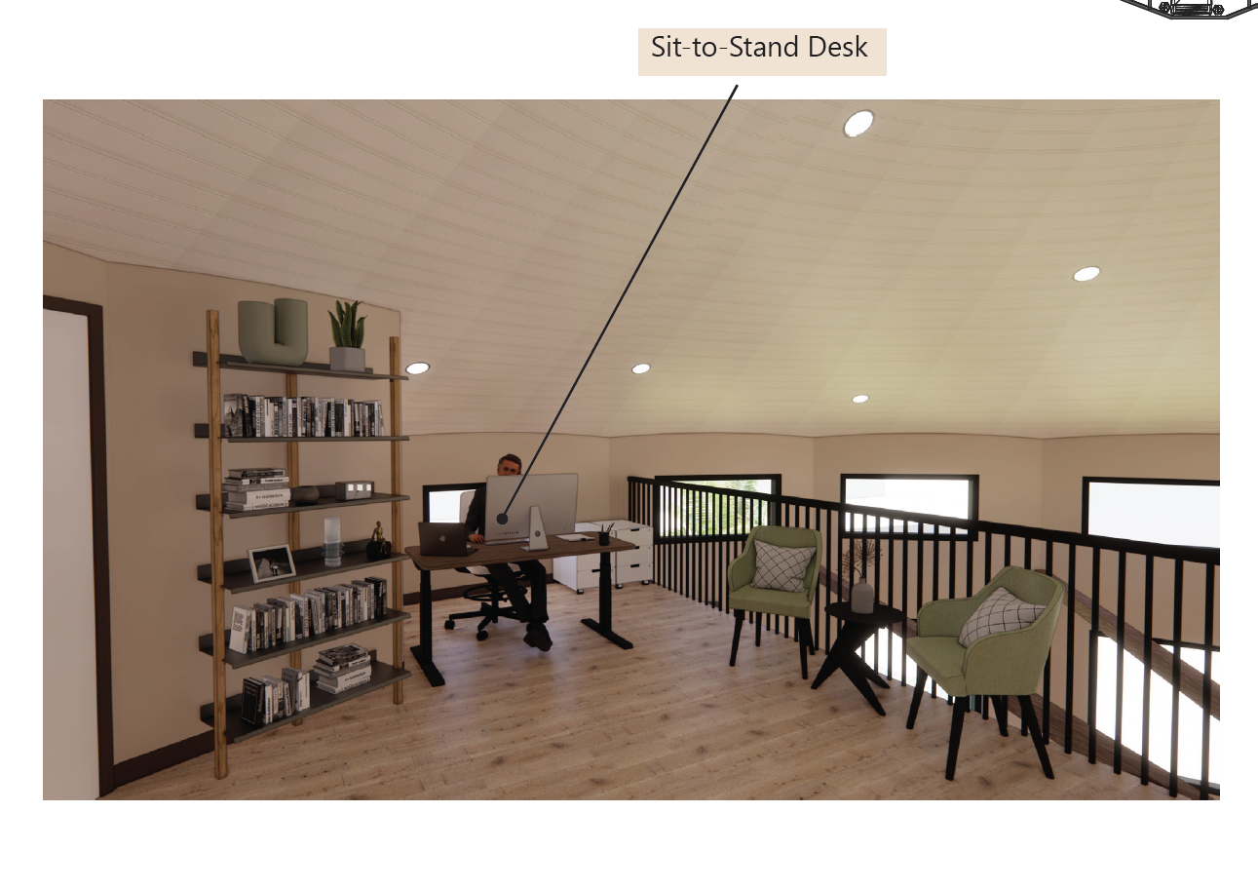
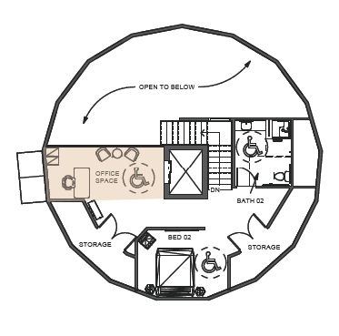
Renders – Office Space

Slide 54
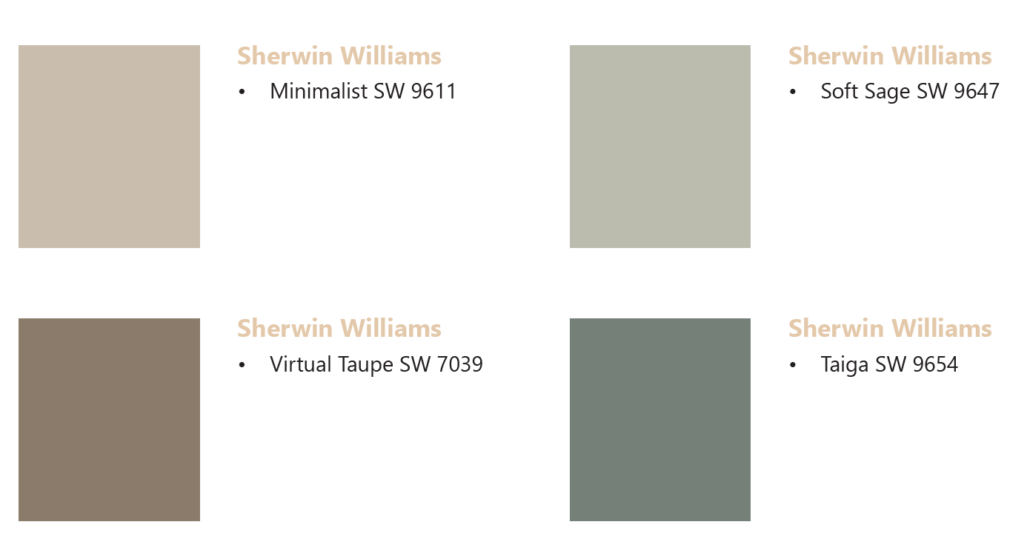
Materials – Paint

Slide 55
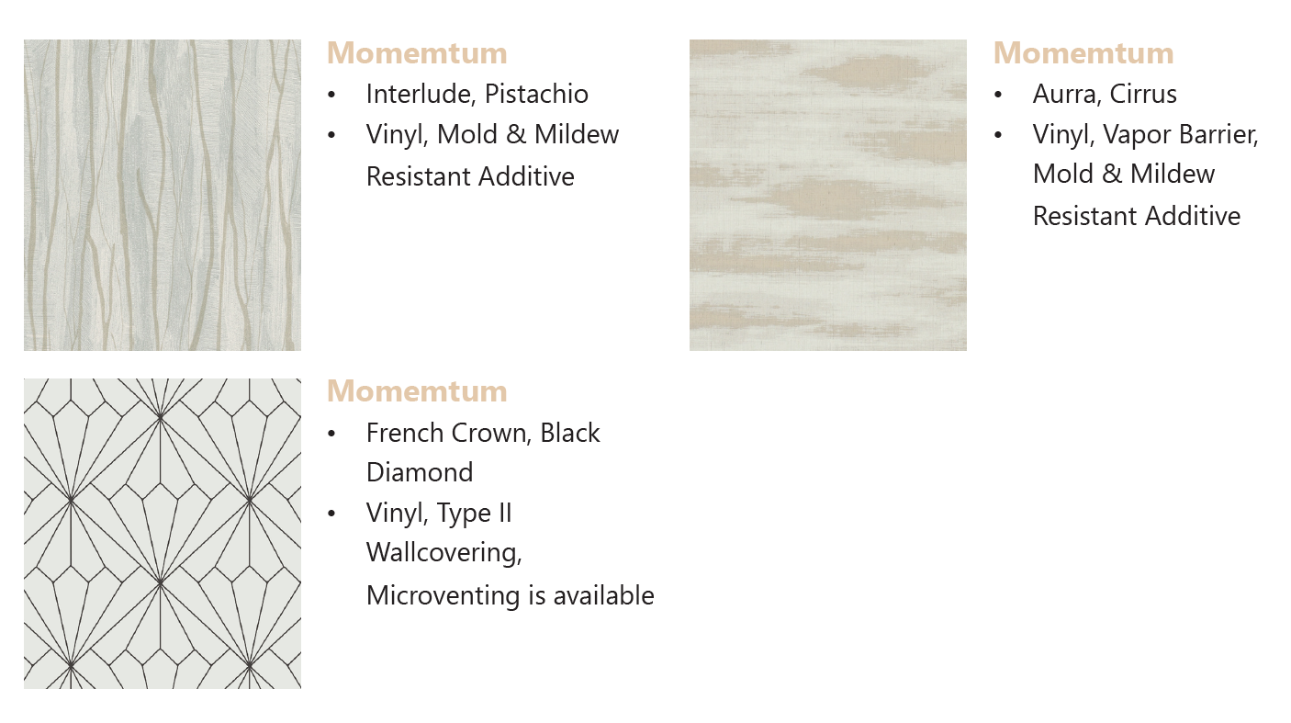
Materials – Wallcoverings

Slide 56
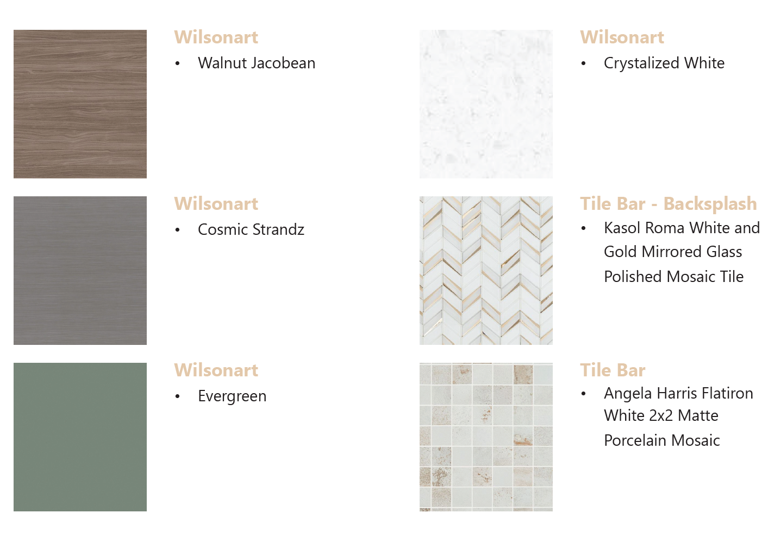
Materials – Laminates & Tile

Slide 57
Materials – Flooring

Slide 58
Walkthrough Video

Slide 59
Bibliography
Administration, National Oceanic and Atmospheric. “Tropical Cyclone Climatology.” n.d. 26 September 2022. <https://www.nhc.noaa.gov/climo/index.php>.
D. Curle, Personal Communication, February 14, 2023
Deltec Homes. n.d. 26 September 2022. <https://www.deltechomes.com/learn-more/about-us/>. Dennis, Vanessa. “MAP: Tracking the Path of Hurricane Ian.” 2022. 16 10 2022.
<https://www.pbs.org/newshour/nation/live-map-track-the-path-of-hurricane-ian>.
Fater, Luke. “The Clever Architectural Feature That Makes Life on Bermuda Possible.” 2021.
<https://www.atlasobscura.com/articles/bermuda-roofs-water>.
Florida Department of Transportation. “2020 Florida Population Growth.” 2021.
<https://fdotwww.blob.core.windows.net/sitefinity/docs/default- source/planning/demographic/2020popsum.pdf?sfvrsn=8c77f8b0_2>.
Irfan, Umair. “Hurrican Ian is About to Crash into a Very Crowded Florida.” 2022. 16 10 2022.
<https://www.vox.com/science-and-health/23372996/hurricane-ian-tampa-florida-miami- storm-surge-flood>.
Jones, Benji and Umair Irfan. “Hurricane Ian’s Rapid Intensification is a Sign of the World to Come.” 2022. 10 10 2022. <https://www.vox.com/science-and-health/2022/9/28/23376761/hurricane- ian-rapid-intensification-climate-change>.
Kasch, Alison. “How Much Does it Cost to Repair Hail, Wind, or Storm Damage?” 2021. 26 September 2022. <https://www.angi.com/articles/how-much-does-repairing-storm-or-wind-damage- cost.htm>.
K. Macy, Personal Communication, February 8, 2023
Neuman, Scott. “One Florida Community Built to Weather Hurricanes Endureed Ian with Barely a Scratch.” 2022. <https://www.npr.org/2022/10/05/1126900340/florida-community-designed- weather-hurricane-ian-babcock-ranch-solar>.
Nussbaumer, Linda L. Human Factors in the Built Environment. Bloomsbury, 2014.
“The Four Most Common Types of Property Damage After a Hurricane.” n.d. 26 September 2022.
<https://www.jansenai.com/newsroom/the-four-most-common-types-of-property-damage- after-a- hurricane#:~:text=According%20to%20the%20NHC’s%20website,poles%20will%20isolate%20res idential%20areas>.
T. Riddle, Personal Communication, February 1, 2023
United States Environmental Protection Agency. “Climate Impacts in the Southeast.” n.d. 26 September 2022. <https://climatechange.chicago.gov/climate-impacts/climate-impacts-southeast>.

Slide 60
Any Questions or Comments?
Thank You!
Feel free to contact me via email: gak6740@rit.edu

Slide 61
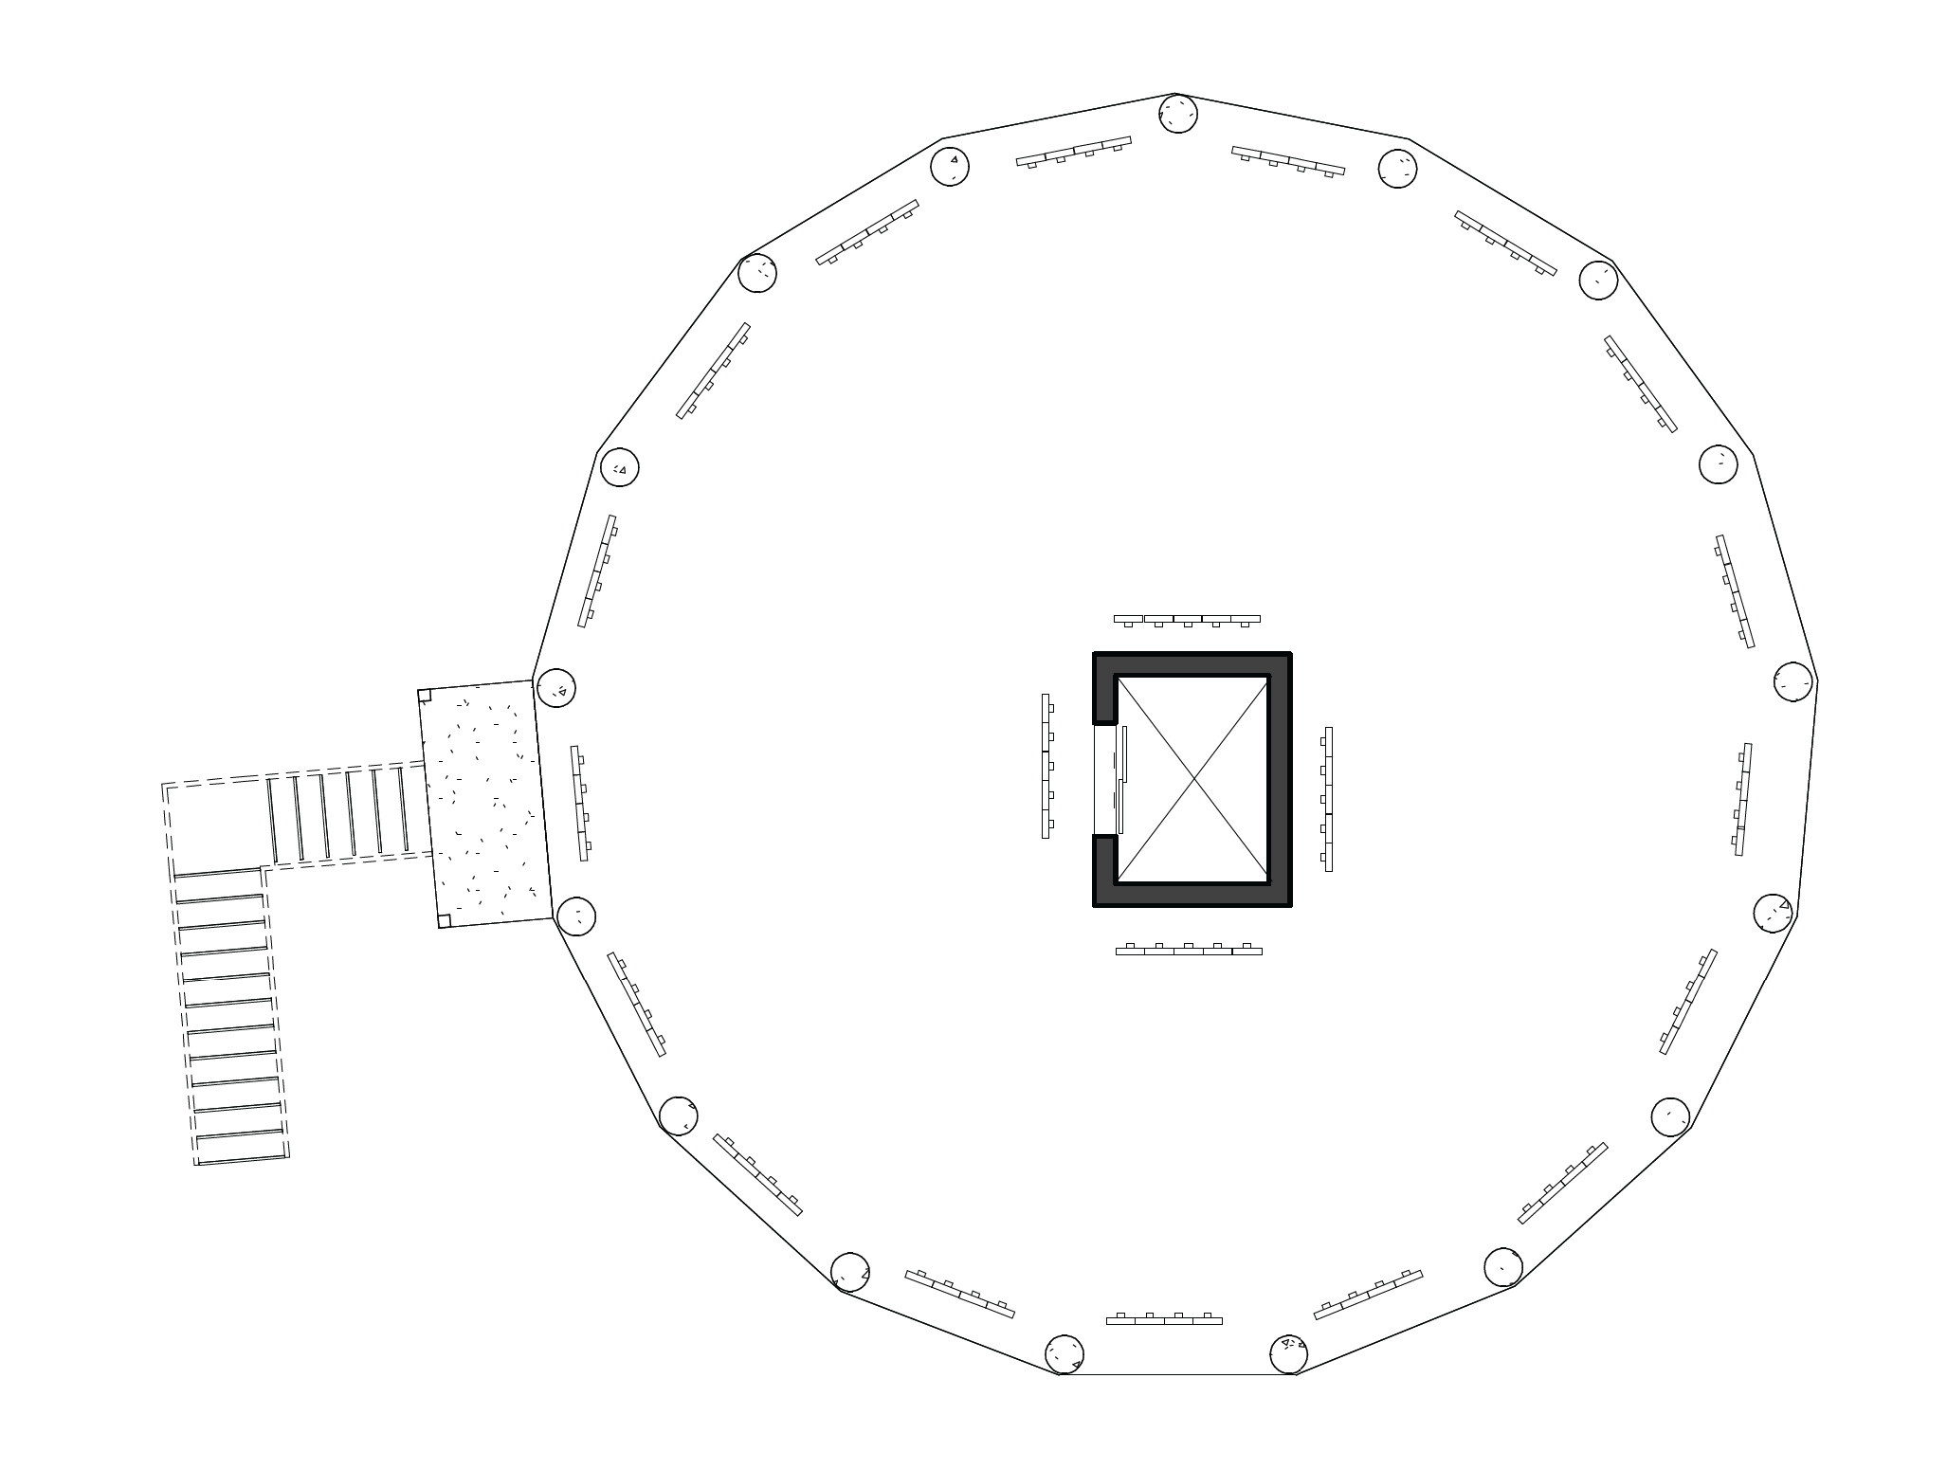
Ground Floor RCP

Slide 62
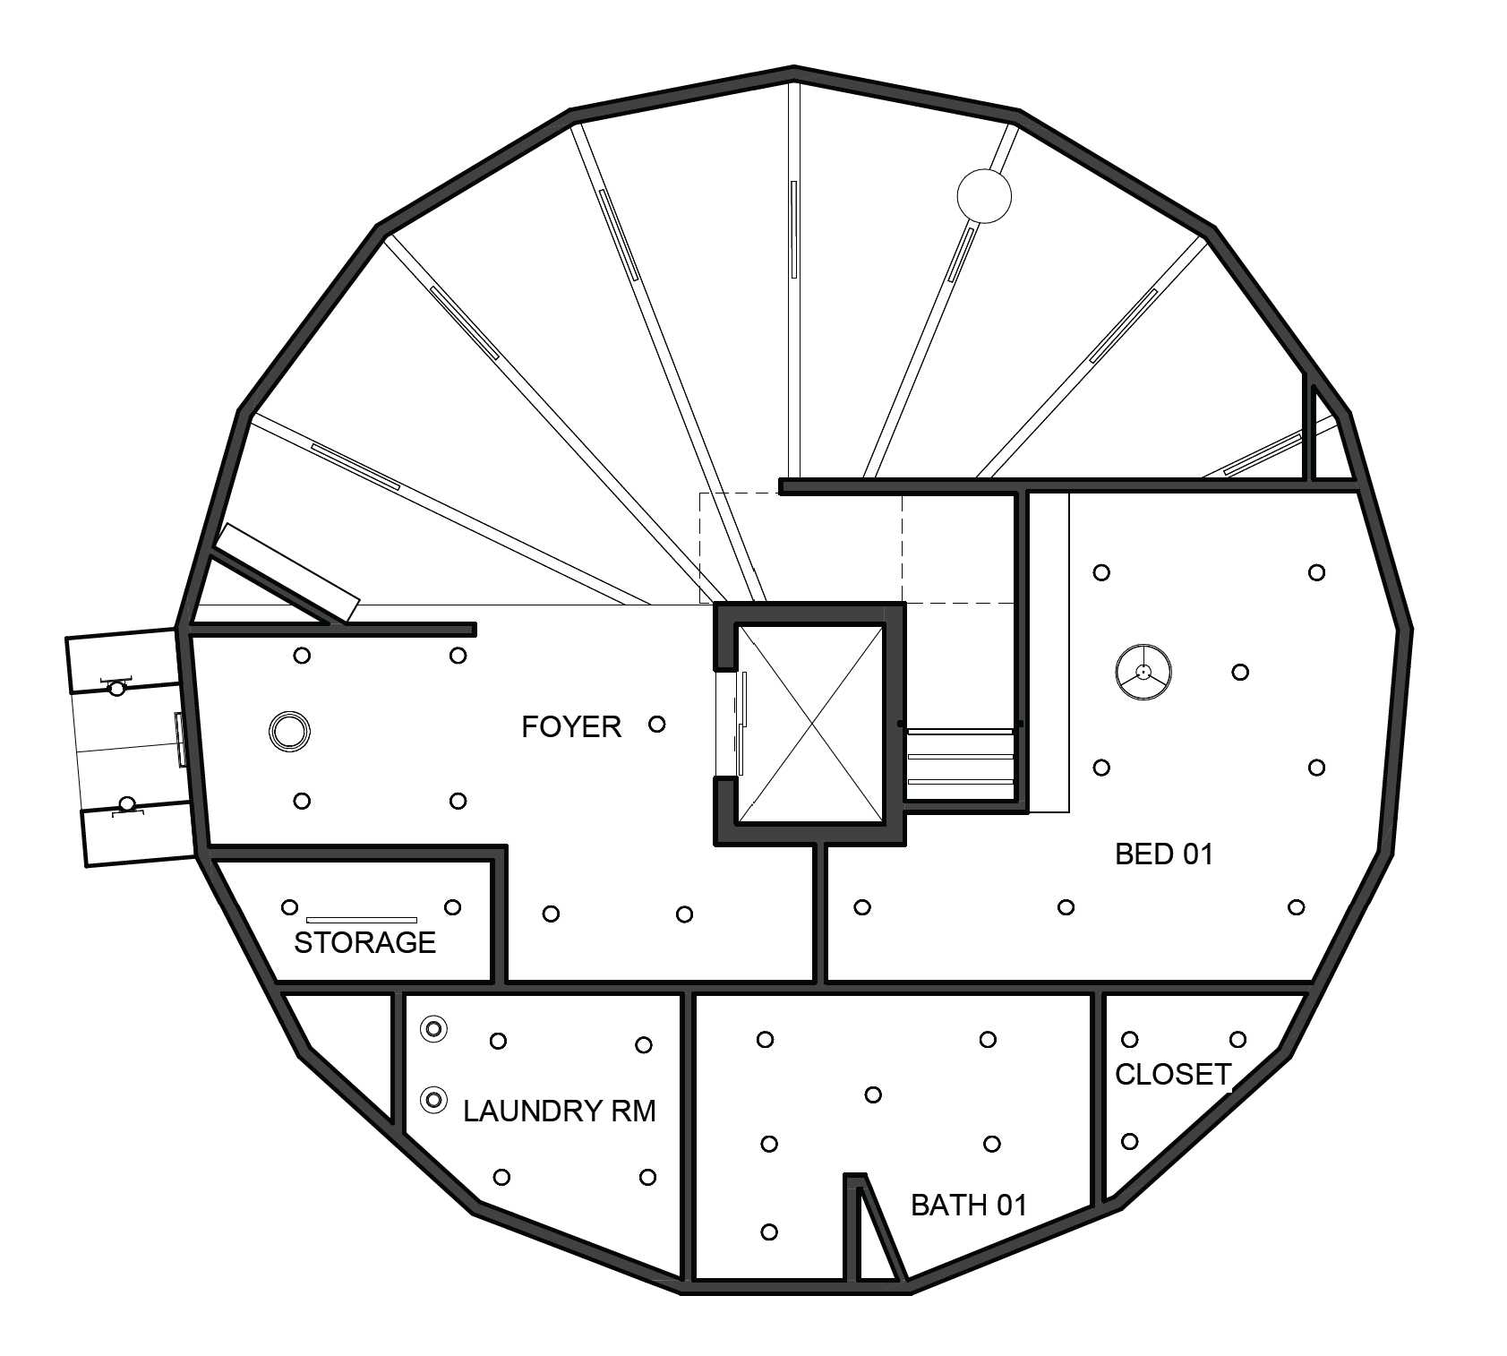
Level 01 RCP

Slide 63
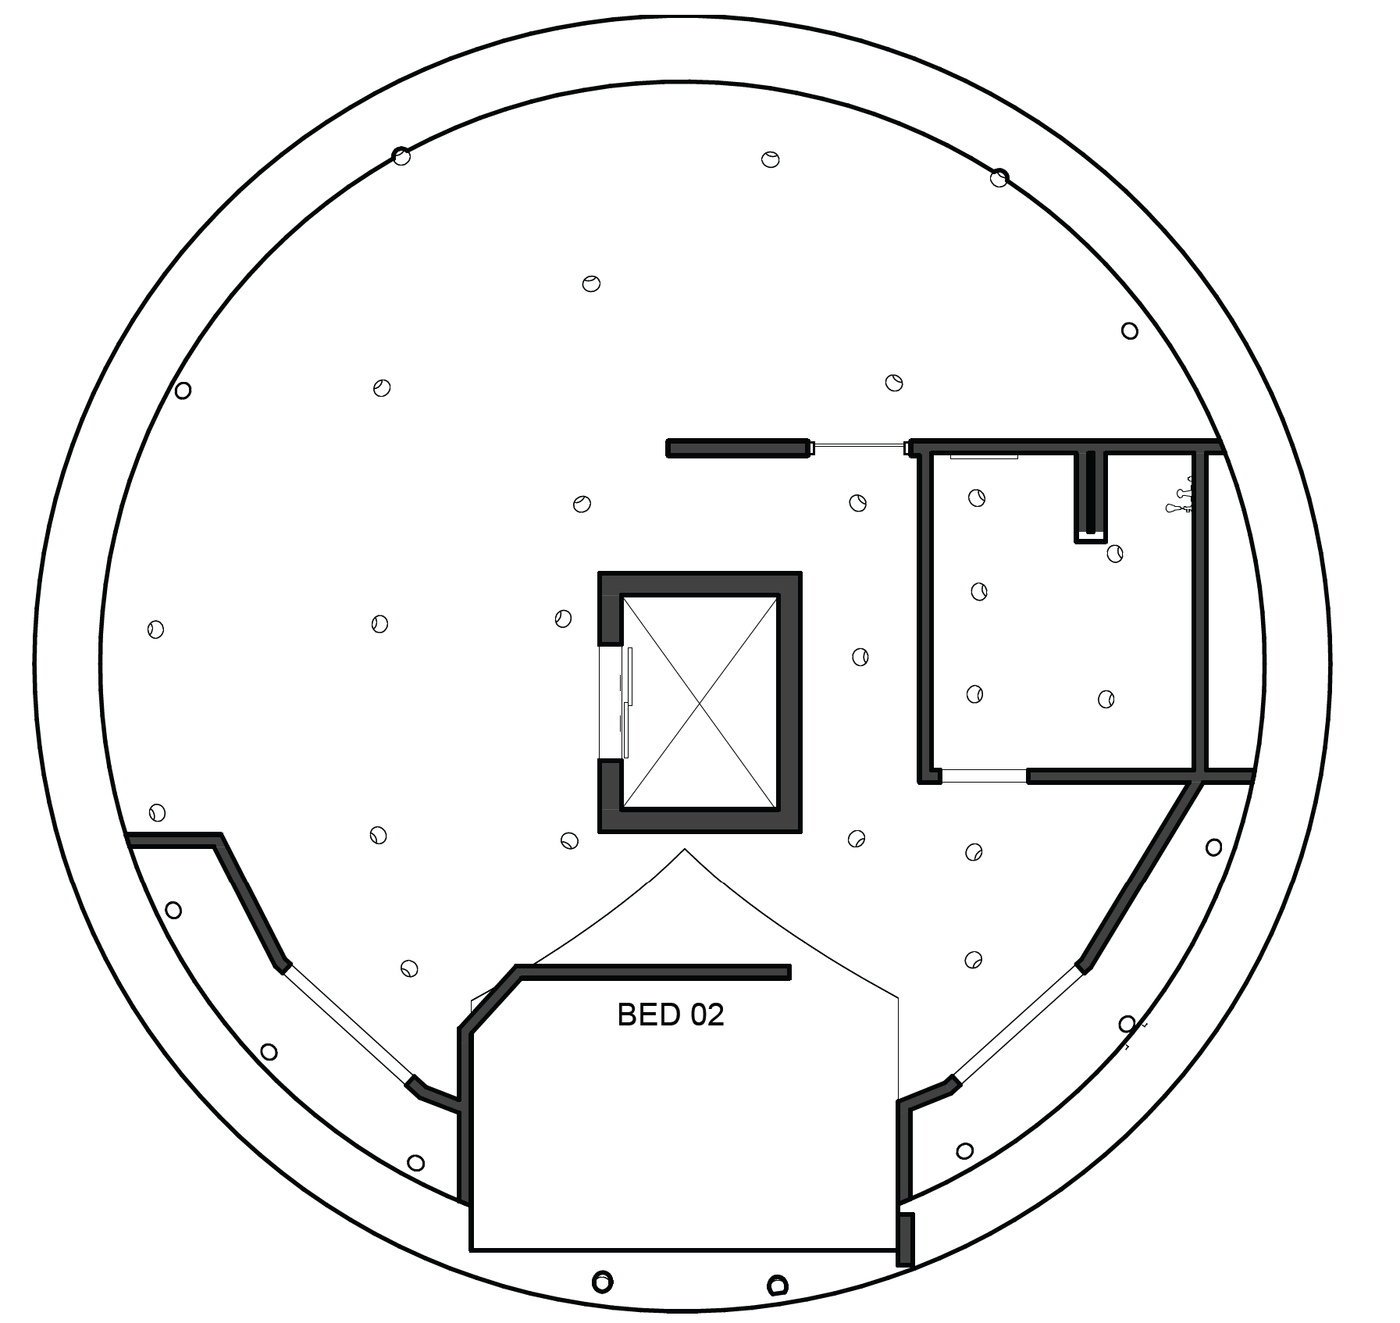
Level 02 RCP

