Slide 1
Investigating Equitable Office Design:
Addressing Women’s Wellness in the Corporate Office through Human-Centered Design to Improve the Quality of Life for all Employees
Final Defense
Jacqueline Collins
Rochester Institute of Technology
INDE 2023
Notes:
Hello everyone, my name is Jacqueline Collins and today I will be presenting my final defense for my capstone project, which is focused on investigating equitable office design: addressing women’s wellness in the corporate office through human-centered design to improve the quality of life for all employees

Slide 2
Committee Members
Isabella Trindade
Courtney Ter-Velde
Kelley Yates
Lecturer at the Rochester Institute of Technology
B.Arch, M.Arch, Ph.D
Senior Interior Designer at LaBella Associates
CID, NCIDQ
Director of Design at Sedgwick Business Interiors
NCIDQ, WELL AP
Notes:
I would like to sincerely thank my three committee members, Isabella, Courtney, and Kelley, for their support over these past 9 months. It has been an honor to work with such an incredible group of women in the design industry.

Slide 3
Contents
01
04
Research Question & Topic Importance
Literature Review Summary
13
22
Creative Agenda
Research Agenda Summary
Notes:
Here is a brief summary of everything I will be presenting today, starting with an explanation of my research question, before delving into the three sections of this capstone: the literature review, research agenda, and creative agenda.

Slide 4
How can human-centered design improve the equity of corporate offices, through the lens of womens’ wellbeing?
1
Notes:
The question I’m investigating is: How can human-centered design improve the equity of corporate offices, through the lens of womens’ wellbeing?

Slide 5
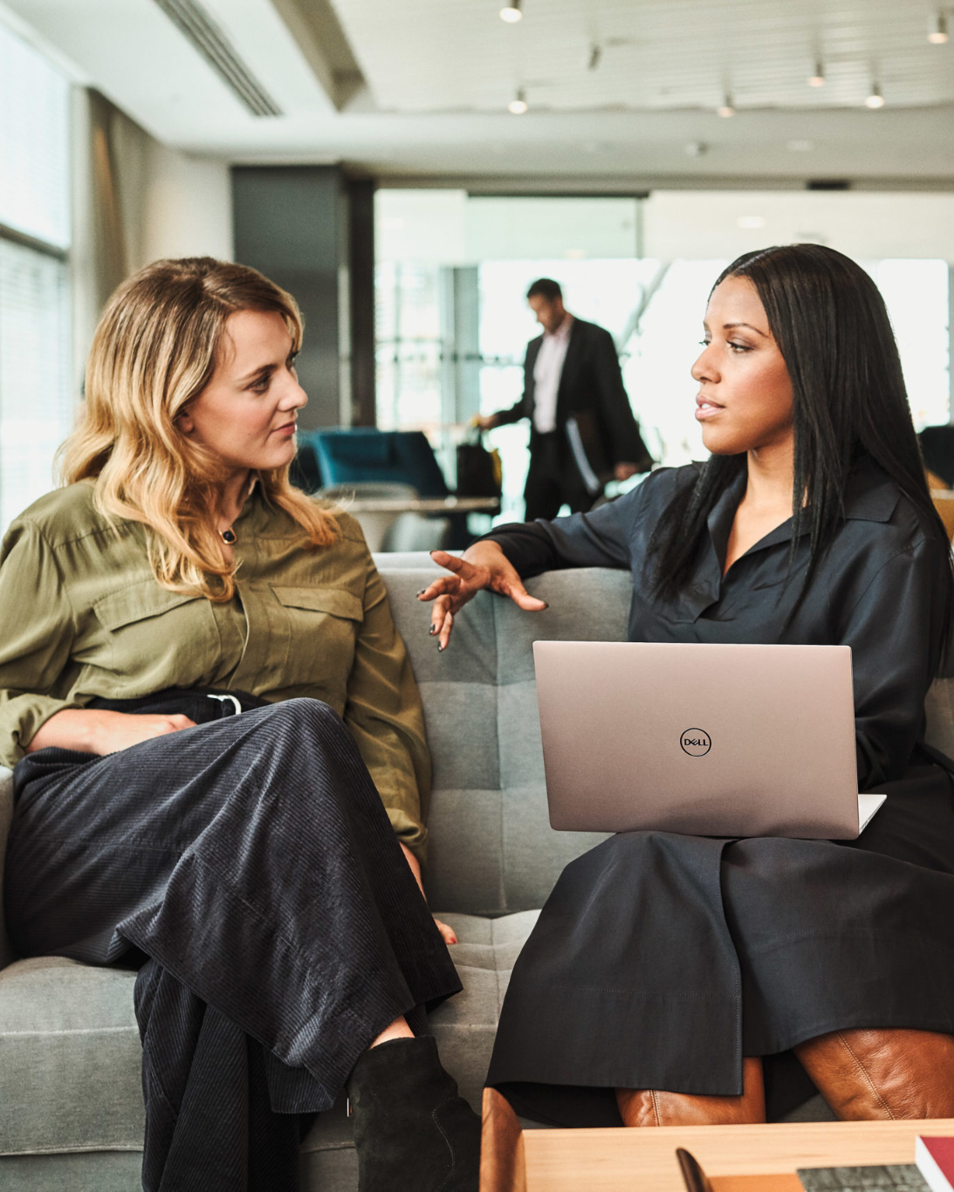
Why is this Important?
More Women Working
Post-COVID Recovery
Universal Design
2
Notes:
My topic and research is significant, especially now, because there are more women working than ever before, and there are more women-owned businesses and female CEOs. It’s also important regarding companies who are trying to get employees back into the office after COVID-19. People are less likely to want to work in person if their office is not comfortable or well designed. Lastly, universal design, which is a concept in design about how to make spaces accessible to all people, no matter their age, gender, disability, or other factors, includes a principle regarding equitable use and how spaces should be able to be used by all people equally.

Slide 6
Hypothesis
Open office plans may be the least beneficial for women
Poor design may impact women more than men
Using human centered design may improve the experiences of women in the workplace
3
Notes:
As I began the research for my topic, it became clear that open office layouts were the main contributors to the discomfort and distractions that women face in the office. My hypothesis was that women are more greatly impacted by the negative effects of office design than men are, and that using human centered design will help mitigate these issues.

Slide 7
Literature Review
History of Open Office Design
Forms and Sizes of Open Offices
Spatial Organization and Aesthetics
Mothers and Menstruating Women
Sick Leave Rates
Acoustical Control
Visual Privacy and Social Interaction
Temperature Control
Furniture Design
4
Notes:
Due to time constraints, I will be focusing on the literature review topics that are in bold, as they are the most impactful in my final creative agenda proposal.

Slide 8
What is an Open Office?
A workplace where all or most employees work together in one open space, with low or no partitions separating the workstations.
5
Notes:
In order to give some context, I am studying open offices, which is a type of office layout that places all or most employees in an open area with or without partitions.

Slide 9
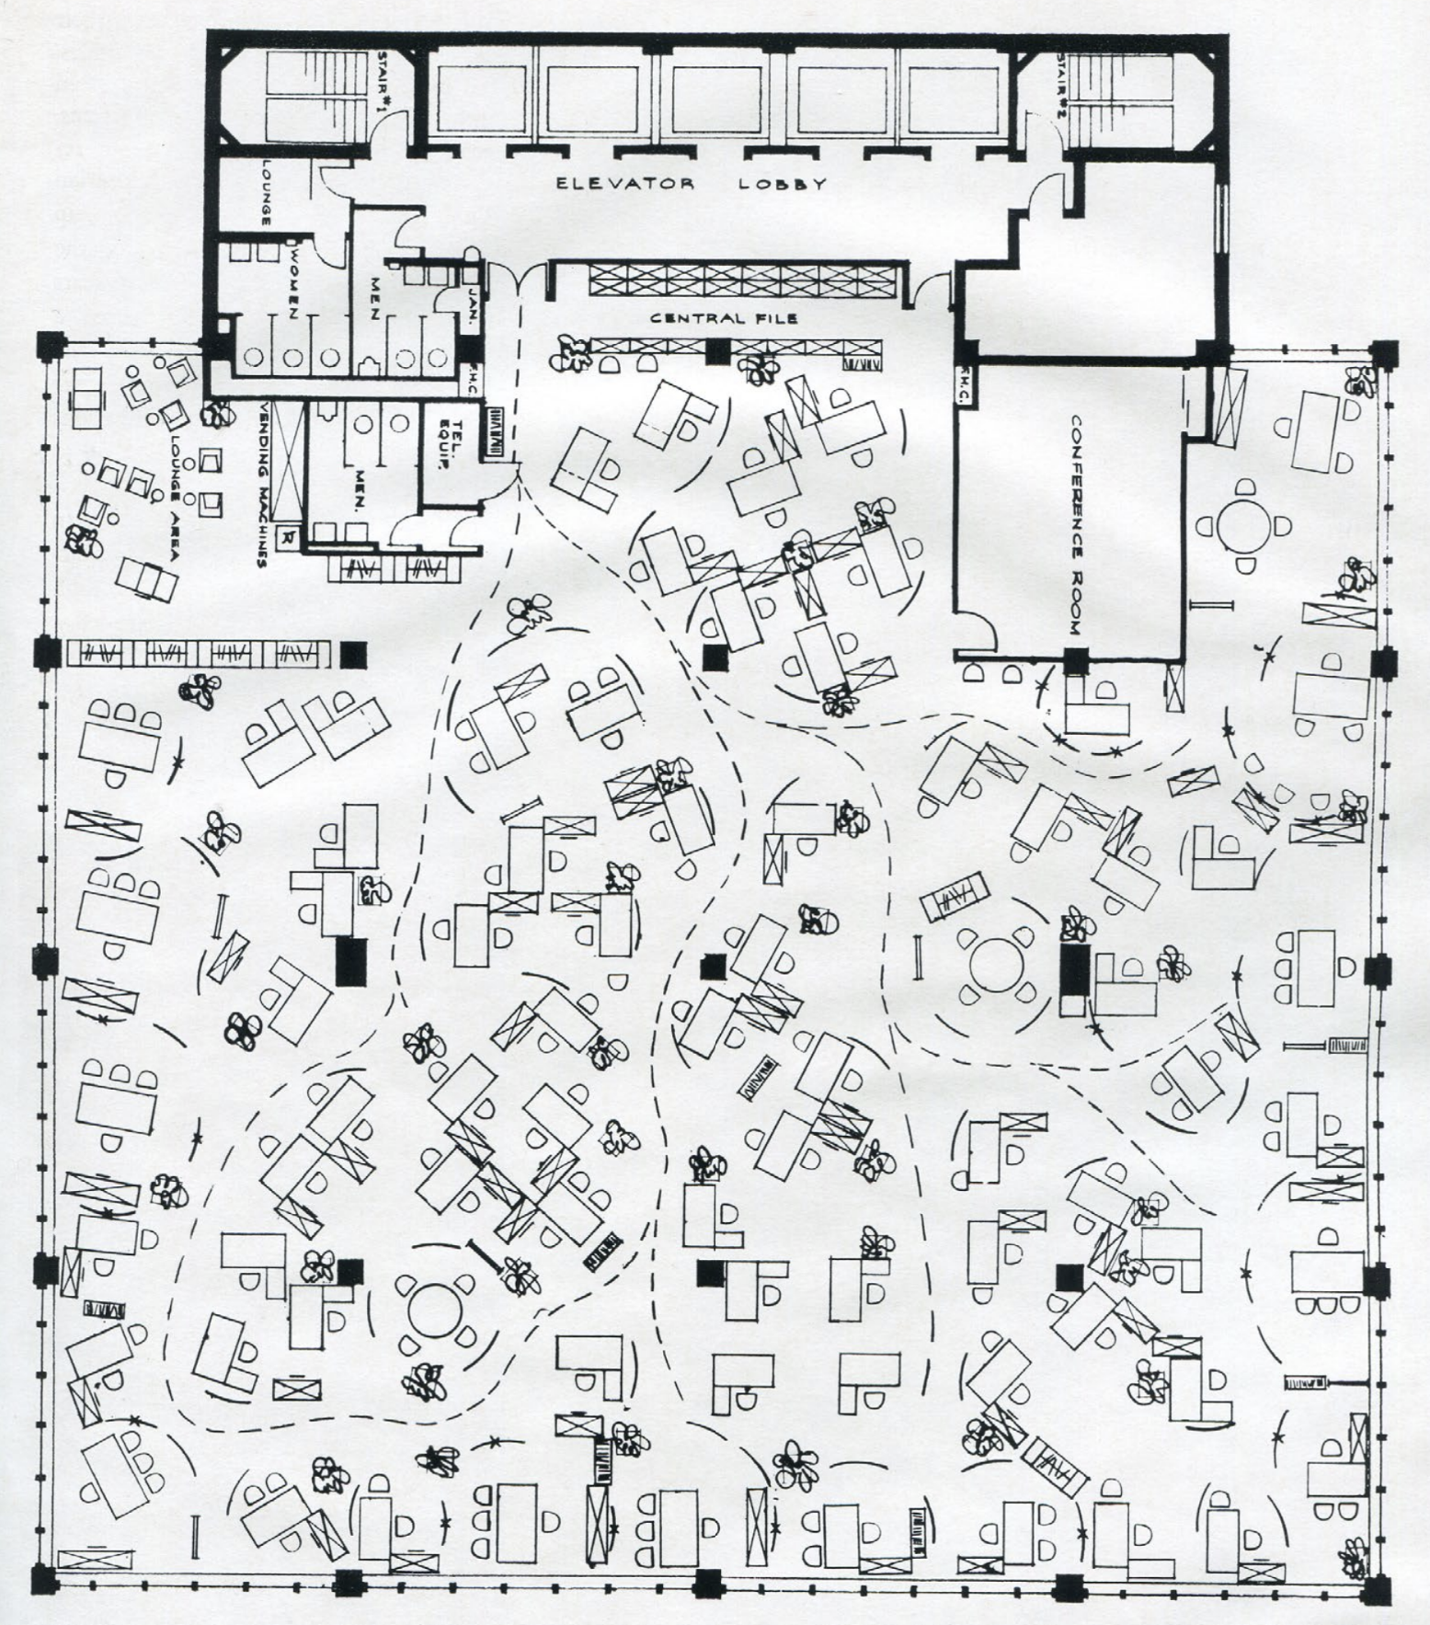
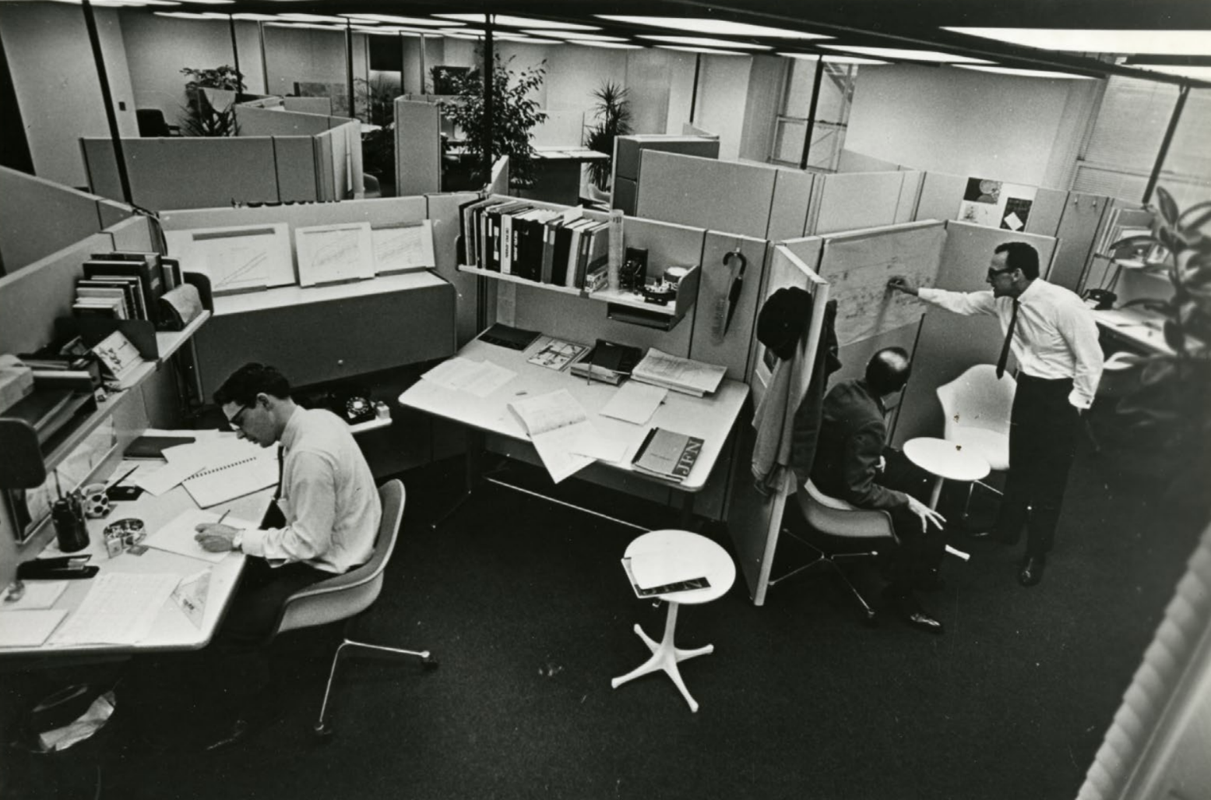
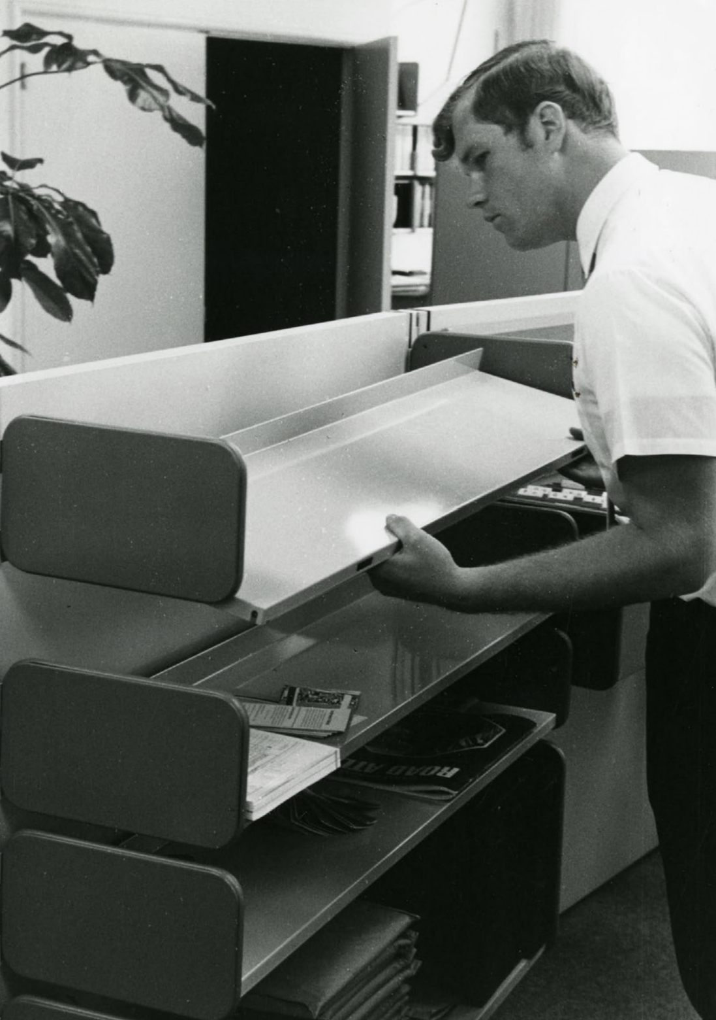
Kaufmann-Buhler, “Progressive Partitions”
History of Open Office Design
Office Landscaping
Herman Miller Action Office
Modular Furniture
6
Notes:
Open offices developed from two different styles of office layout: office landscaping and the Herman Miller action office. Office landscaping involved an irregular layout based on the communication patterns in the office, with teams being paired together in pods. The Herman Miller action office employed a more uniform layout, with modular workstations that allowed employees to customize how they worked. When these two concepts were combined, open offices were more efficient, did not use a traditional hierarchical layout, and allowed for greater collaboration. Unfortunately, open offices began to be used to save money, and executives continued to demand private offices. The use of technology also diminished many of the modular aspects of the workstations. Currently, open offices do not follow the original goal of the layout, which was to give every worker, no matter their status, an equal workspace.

Slide 10
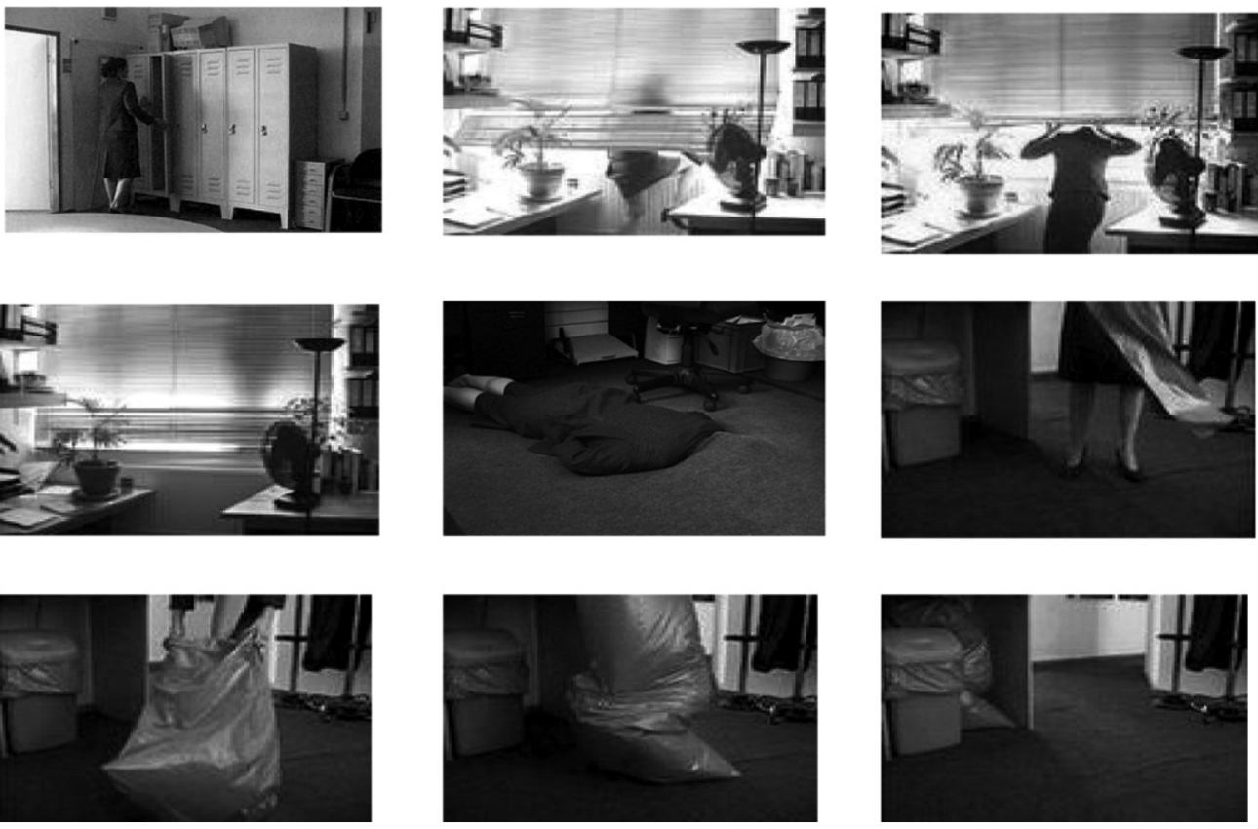
Tyler and Cohen
Wasserman
Spatial Organization and Aesthetics
Stills from “Grey Area”
7
Notes:
Because open offices currently use a hierarchical layout, with executives and leaders having private offices, and lower level employees working in an open office, there is often a gender segregation, as most executives and leaders are men and most lower level employees are women. This then exposes more women to the issues related to open offices. Women also often face a lack of personal space and a sense of place in their office when sharing space with men. A study done in university offices used stills from a short film titled “Grey Area” to compare women’s experiences in their offices. Many reported male coworkers invading their space and privacy, and consequently feeling like they are not important to the company and do not have ownership of their own workspaces. Studies have also shown that, while men tend to prefer a hierarchical office layout with finishes that reflect status and power - such as dark natural woods and leathers, women tend to prefer an equal divide of space and an office that is bright and homey.

Slide 11
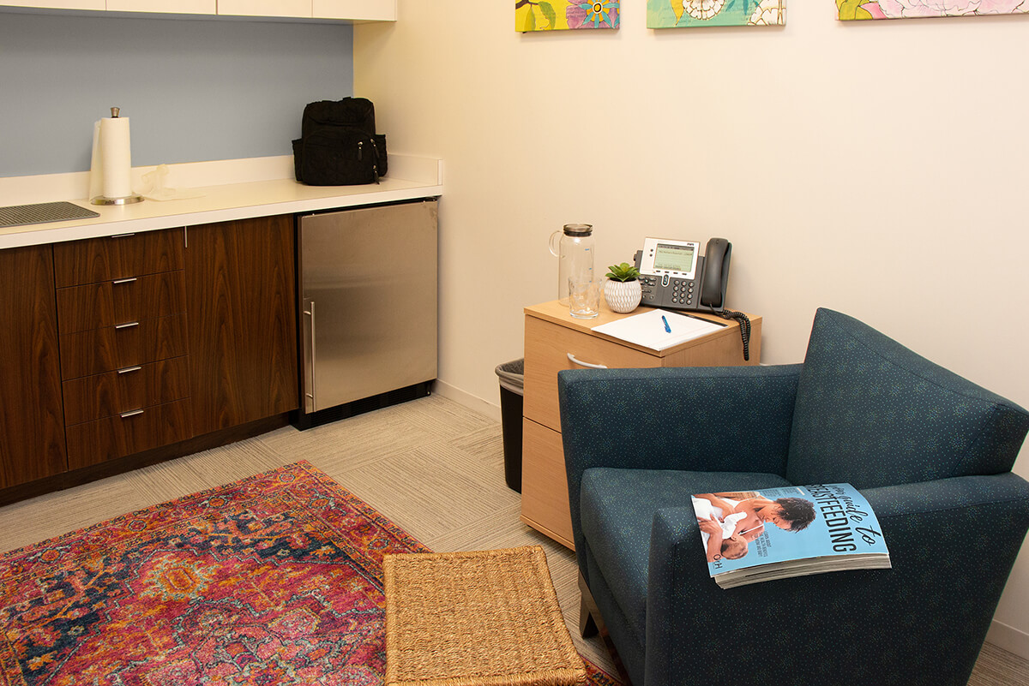
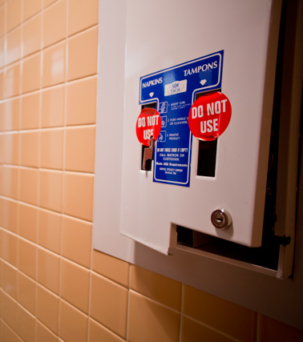
Hirst and Schwabenland
Johnson and Salpini
Mothers and Menstruating Women
Lactation Rooms
Sanitary Dispensers
8
Notes:
Another issue that is faced by women is a lack of accommodations for menstruation and pumping breast milk after child birth. The US still allows for unpaid maternity leave, which often forces women to return to work earlier than expected after child birth. If they plan to breastfeed, they have to pump on a schedule in order to avoid their milk supply drying up. If lactation rooms are not provided, or if they are difficult to access and use, women have to find an alternative place to pump, which often means that they have to take time off work. For women who are menstruating, not all companies have a proper dispenser for sanitary products. In one study done in 2017, a company had provided free condoms in the men’s restroom, but did not provide a tampon dispenser until a petition was sent around the office. Afterwards, a paid dispenser was installed.

Slide 12
Bos et al.
Bodin Danielsson et al., “Office Type and Workplace Conflict”
Fried et al.
Acoustical Control
9
Notes:
Distractions in the office can take a major toll on employees, and are thought to be one of the main reasons women take more sick leave than men. This aligns with research that shows that overtime, noise distractions can actually lead to adverse health effects such as cardiovascular disease. It has also been found that women report more noise distractions than men do, meaning they may be more likely to suffer from these health issues. They have also reported a lack of acoustical privacy for important phone calls and sensitive meetings with staff.

Slide 13
Hirst and Schwabenland
Visual Privacy and Social Interaction
10
Notes:
In terms of visual privacy, women tend to feel more watched in their offices than men. This causes them to be more aware of their appearance, often choosing to change how they dress to be more feminine and less visible in their environments. Women have also noted feeling insecure and uncomfortable walking into different rooms and work spaces, because they notice men looking up from their work, or pointing them out loud as they pass. Women also tend to be more aware of their position and status in the office, and what that implies for how they should present themselves and interact with others.

Slide 14
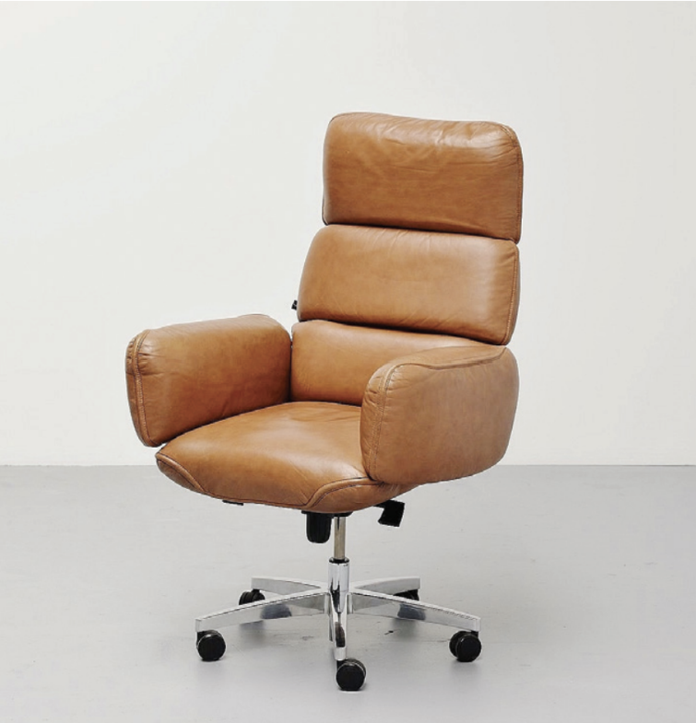
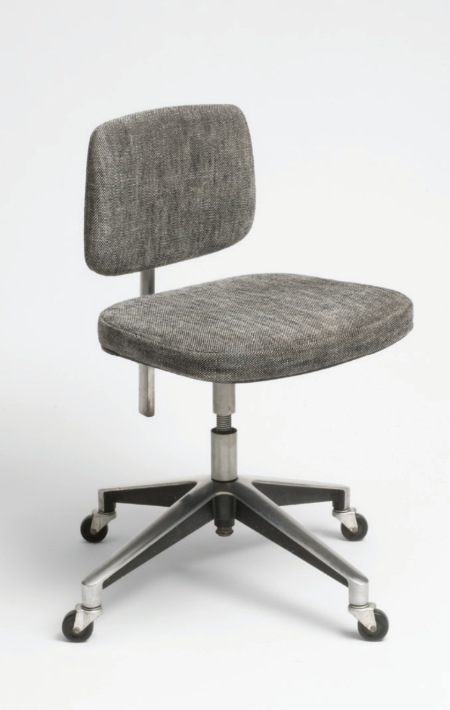
Kaufmann-Buhler, “American Office Furniture”
Furniture Design
Zapf Executive Chair
Model 46 Secretary Chair
11
Notes:
Lastly for my literature review, I explored how furniture design has been gendered. Modern furniture is more universal and ergonomic, but many famous pieces of furniture from the 20th century are still in production today, and older pieces of furniture are passed down from company to company. Chairs and typing desks were gendered in their size and shape because women were expected to be secretaries, and be typing for most of the day, whereas men were expected to be executives. These archetypes can be seen in the design of the Zapf executive chair compared to the Model 46 secretary chair. The Zapf is larger and allows the user to relax and lean back, whereas the Model 46 reveals more of the users body and is designed to be perched on rather than relaxed into. If a woman tried to sit in the Zapf chair, it would likely be uncomfortably large, which is in many ways a reflection of the discomfort that many women face in leadership roles.

Slide 15
Literature Review Conclusion
Office Landscaping and Action Office
Increased privacy
Proper accommodations
12
Notes:
The literature review highlights that the original goal of the open office was successful, but what is needed is more accessible and flexible areas of privacy for all employees and proper accommodations for women and their bodies.

Slide 16
Research Methods
Survey - 74 responses
Interviews with women
Observation of open office
13
Notes:
For my research agenda, I released a survey that received 74 responses, I conducted interviews with three women from the CPL office, and did an observation of the CPL office

Slide 17
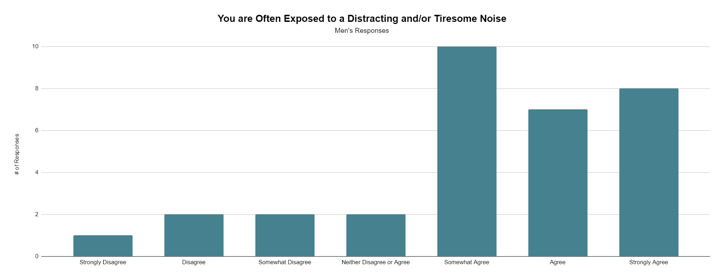
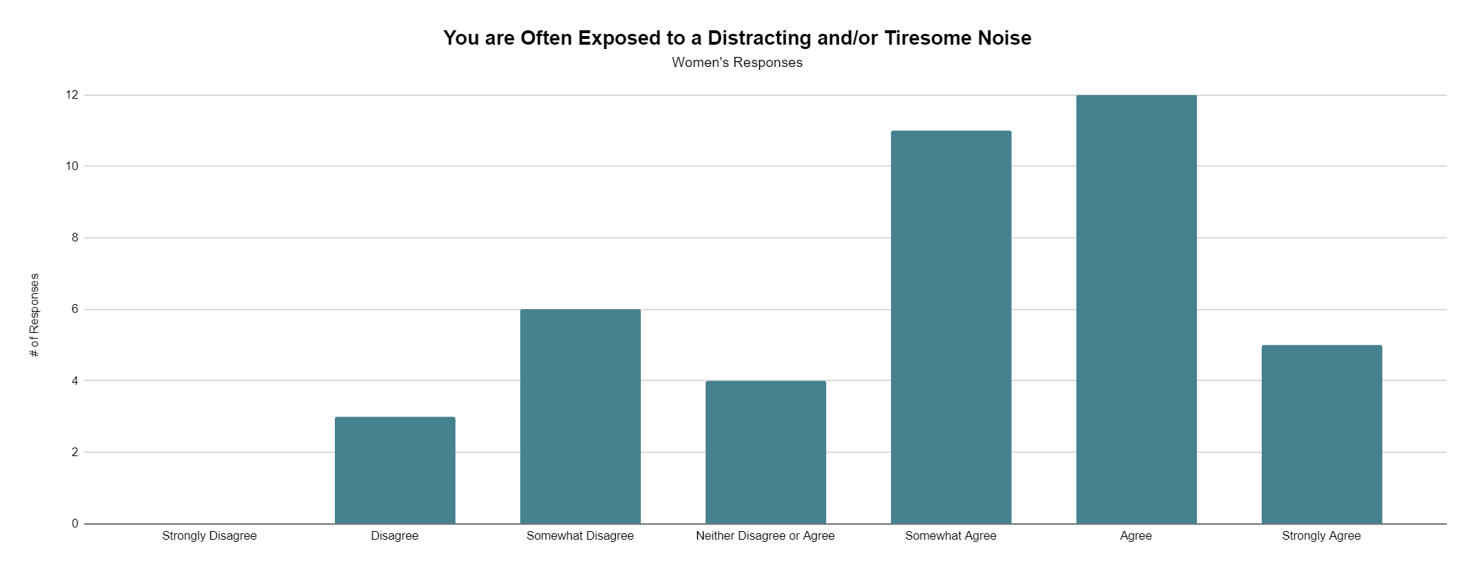
Survey Findings
14
Notes:
Based on the responses from the survey, both women and men reported being exposed to excess noise in the office that is distracting. It is very clear that acoustics are a large concern for everyone in open offices.

Slide 18
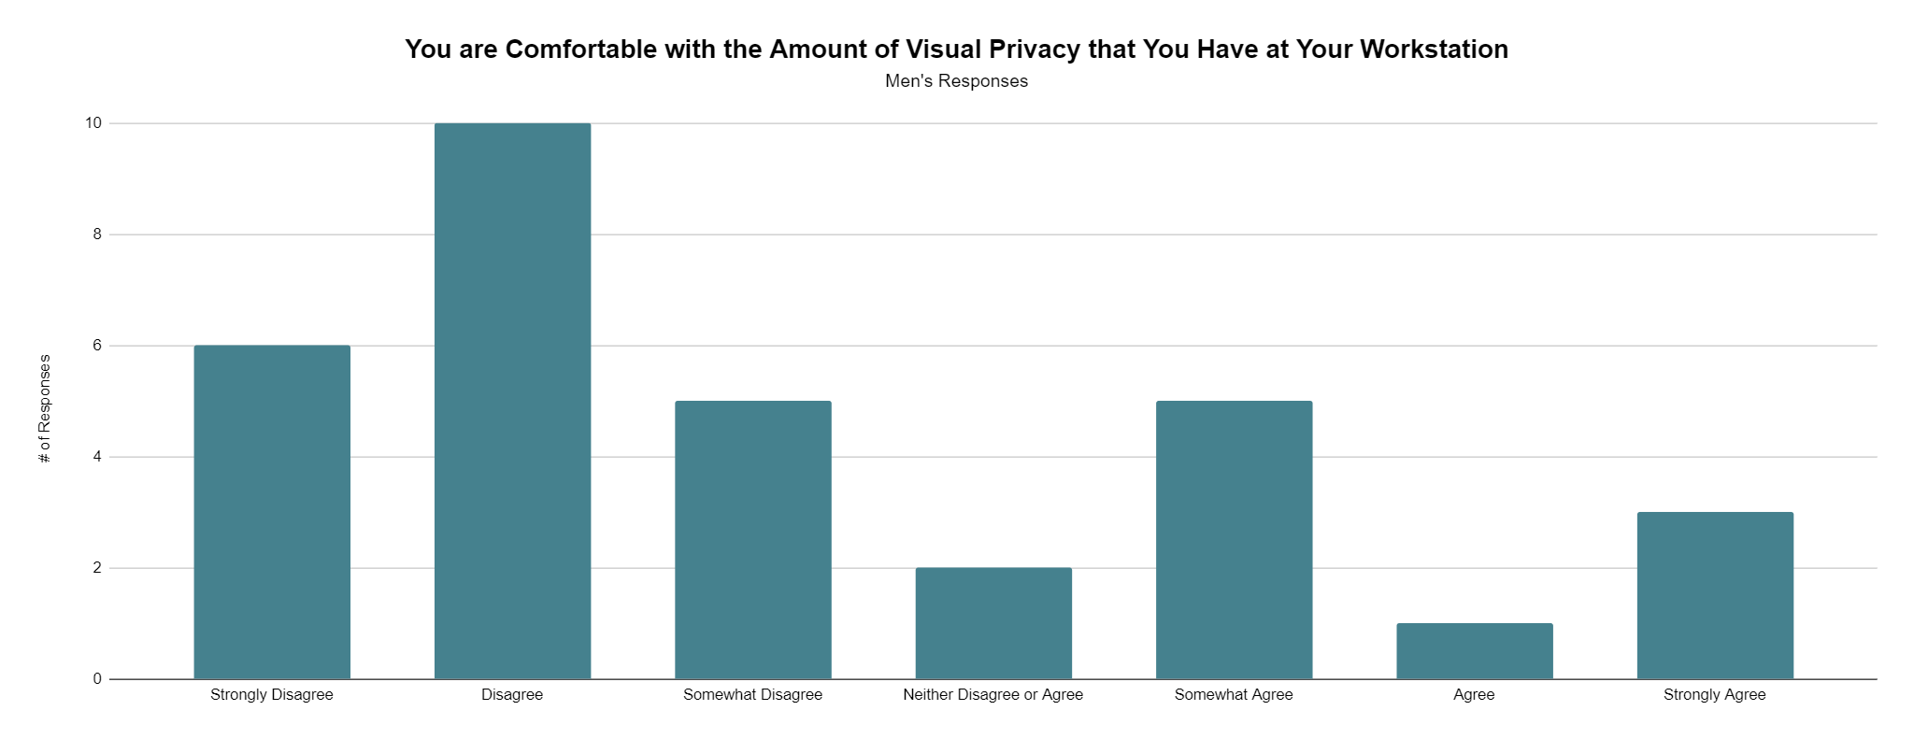
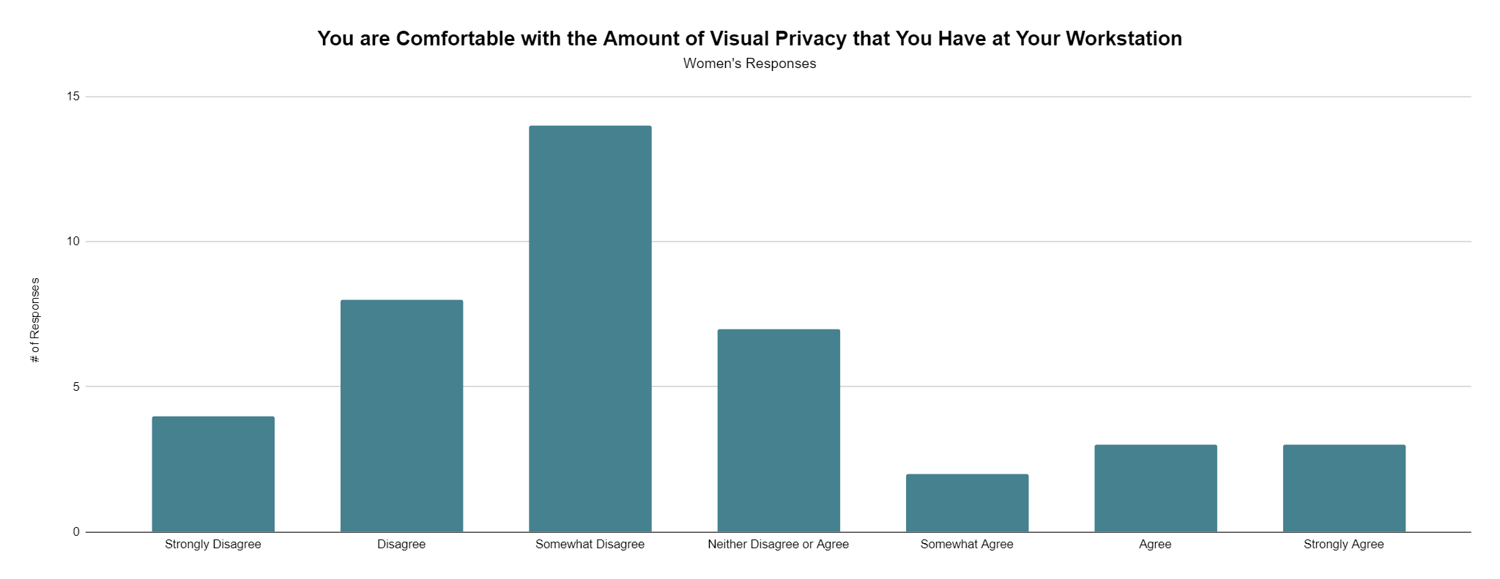
Survey Findings
15
Notes:
Interestingly, men more strongly disagreed with the statement regarding their visual privacy at their workstations. This differs from research that shows that women are more likely to be aware of their lack of visual privacy in all areas of the open office. However, both men and women indicated that they lack visual privacy in their workstations.

Slide 19
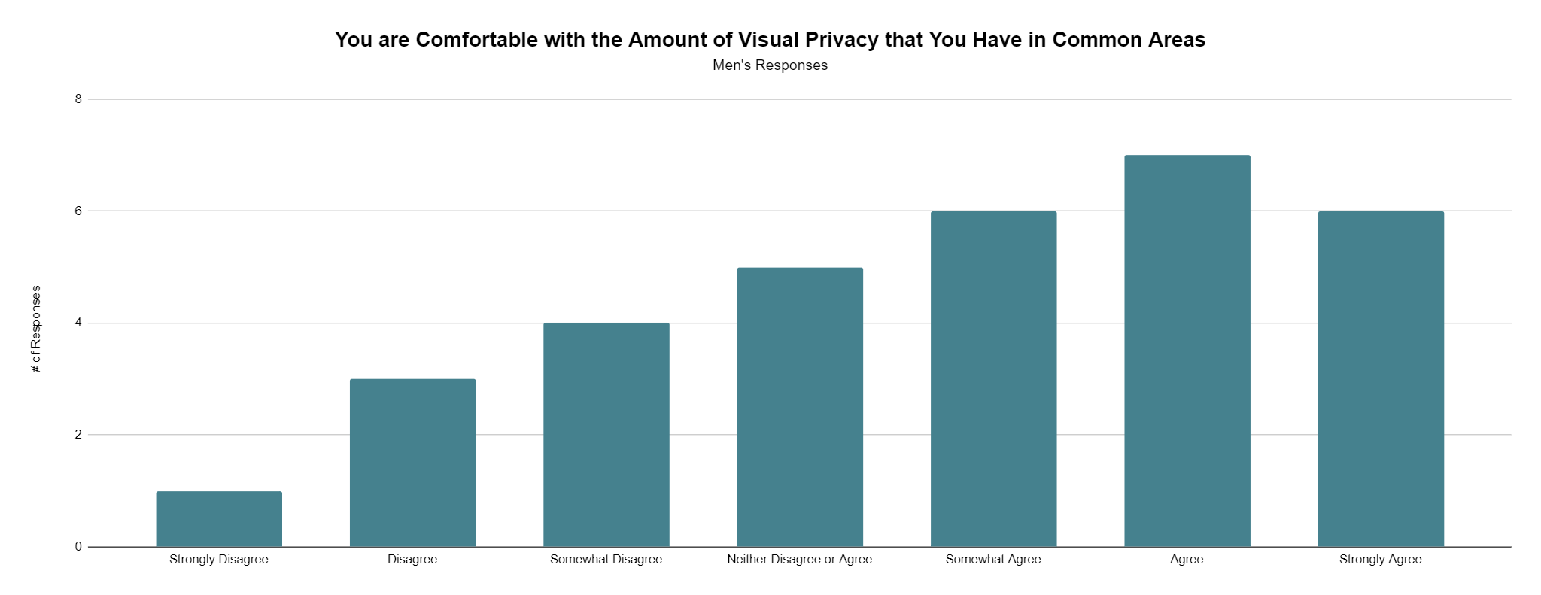
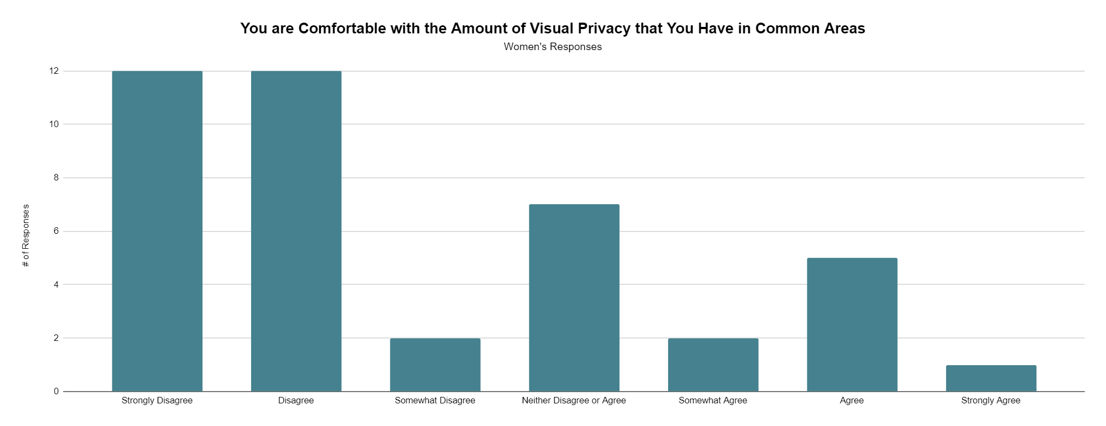
Survey Findings
16
Notes:
Contrastingly, women strongly disagreed that they have enough privacy in common areas, whereas men tended to agree. This does align with research regarding women’s privacy in open offices, which indicates that women tend to be watched by men in the office as they walk main paths of travel and up and down stairs.

Slide 20
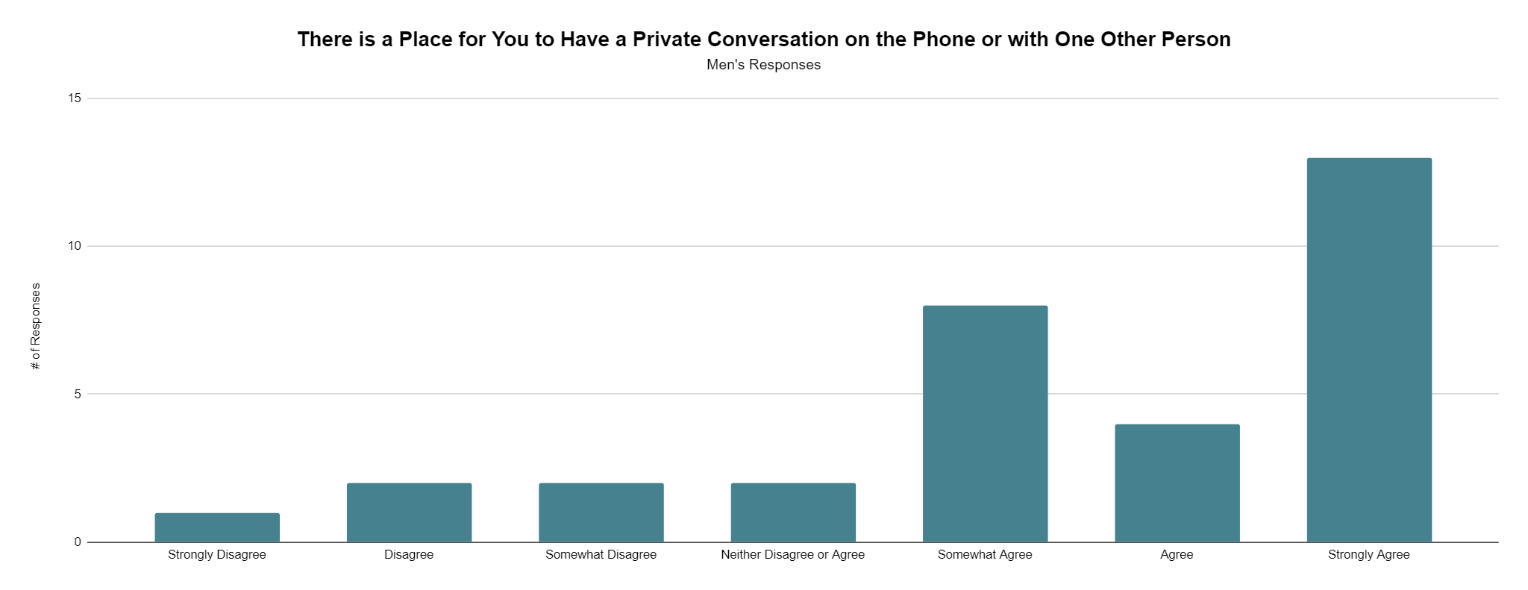
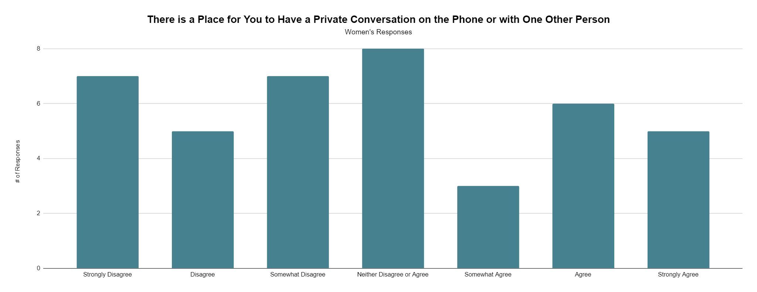
Survey Findings
17
Notes:
Lastly, women were more likely to disagree that they have enough private areas to take phone calls, whereas men tended to agree. This aligns with research that shows that women are less comfortable taking private phone calls in an open area, and would prefer to have private phone rooms or pods.

Slide 21
Interview Findings
Personality and time with company
Social distractions
Need for more privacy
18
Notes:
While conducting interviews, I found that the responses I received often depended on the personality of the woman, and how long they had been working at CPL. A woman who had spent her whole career with the company, and who seemed to be more of an extrovert, felt very comfortable and happy in the open office, whereas a newer, more introverted woman noted the significant social distractions that she faced. The third interviewee was somewhere in between the first two, as she did not feel as though she needed visual privacy in order to do her work, but acknowledged that she often experiences high stress levels and wishes she could escape from distractions from technology and the neighbors of her workstation.

Slide 22
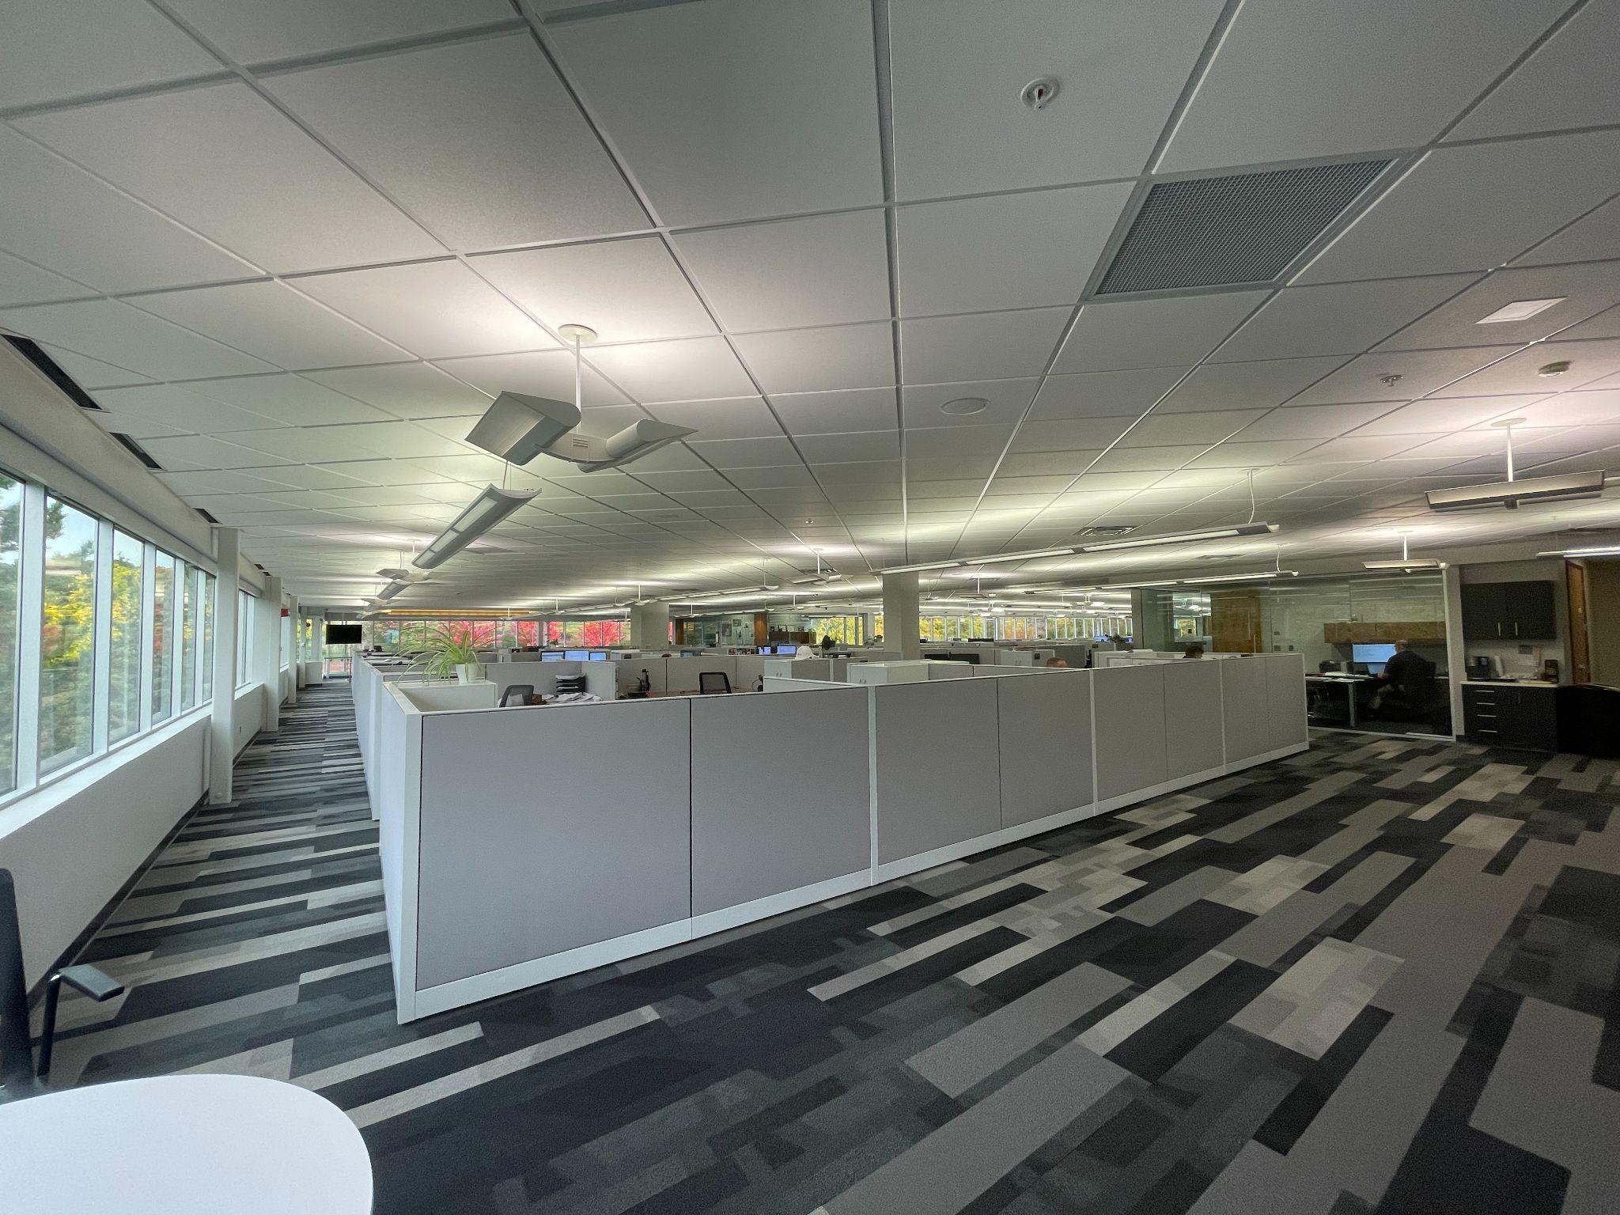
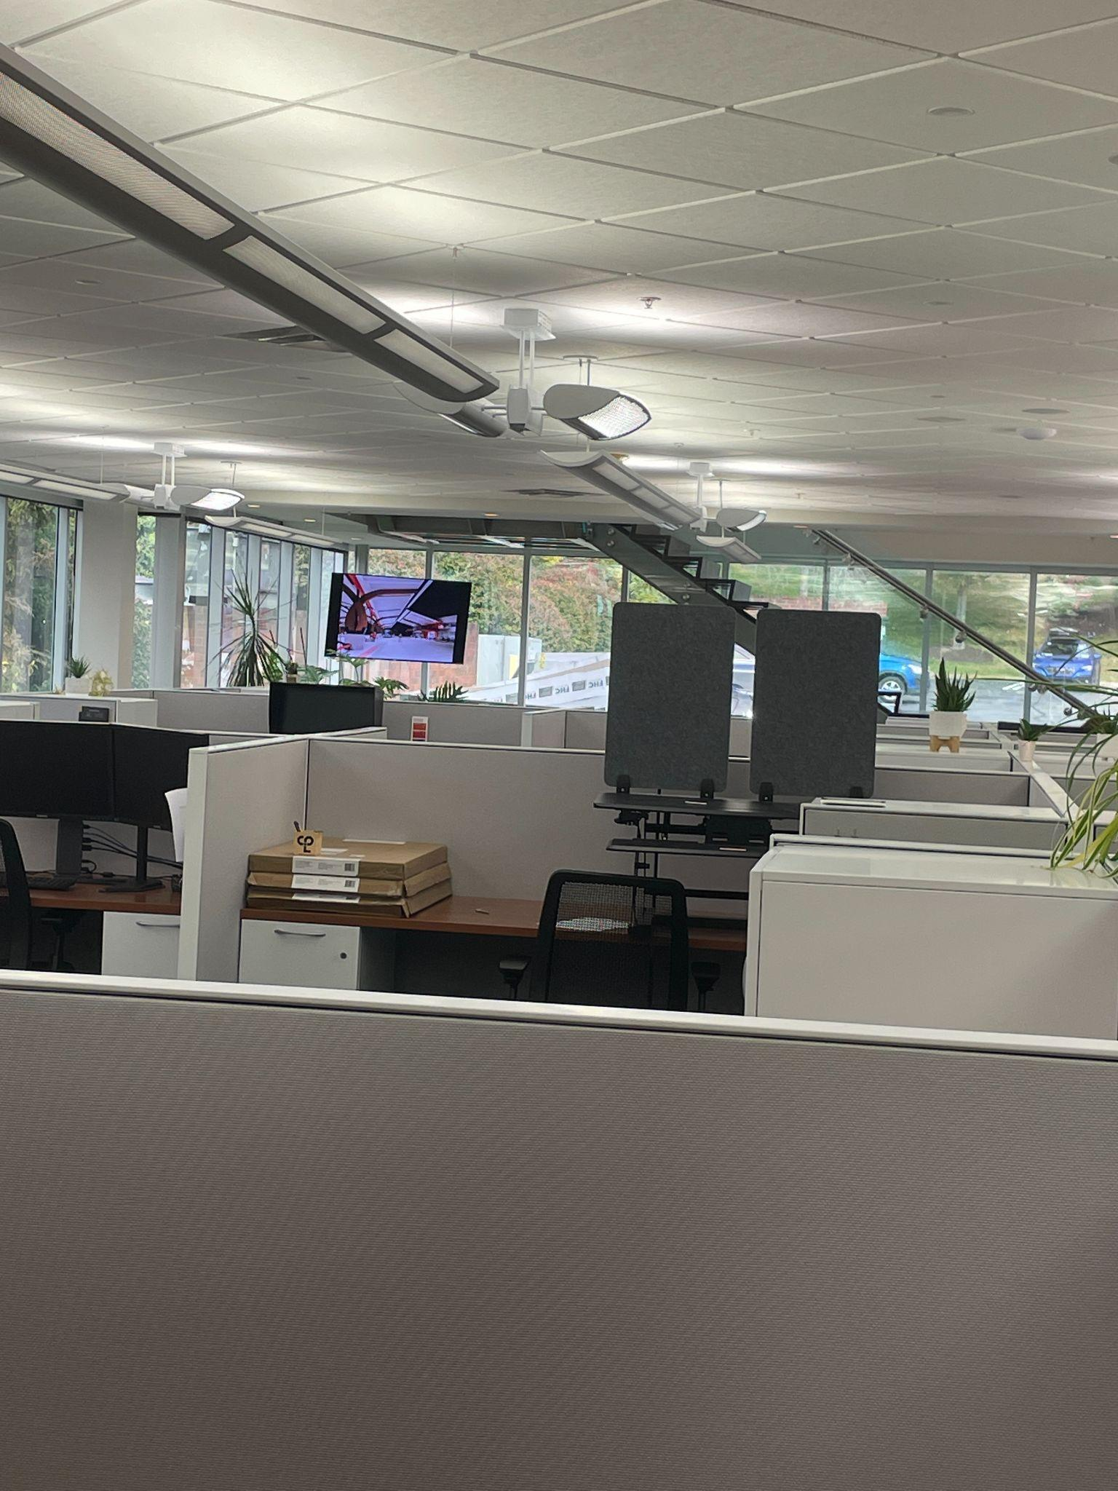
Observation Findings
19
Notes:
During my observation of the CPL office, I found that the office was very quiet, which employees seemed to be acutely aware of, as people would talk in low voices when having conversations with the people nearby them. Additionally, ambient noise such as typing, mouse clicking, doors opening, and meetings occurring in the conference rooms could be heard around the office. Visually, the workstations had partitions that were low enough to allow most people to peer over their computer screen to observe their surroundings. I quickly became aware of who was watching as I walked by, with most people looking up from their work to see who was passing.

Slide 23
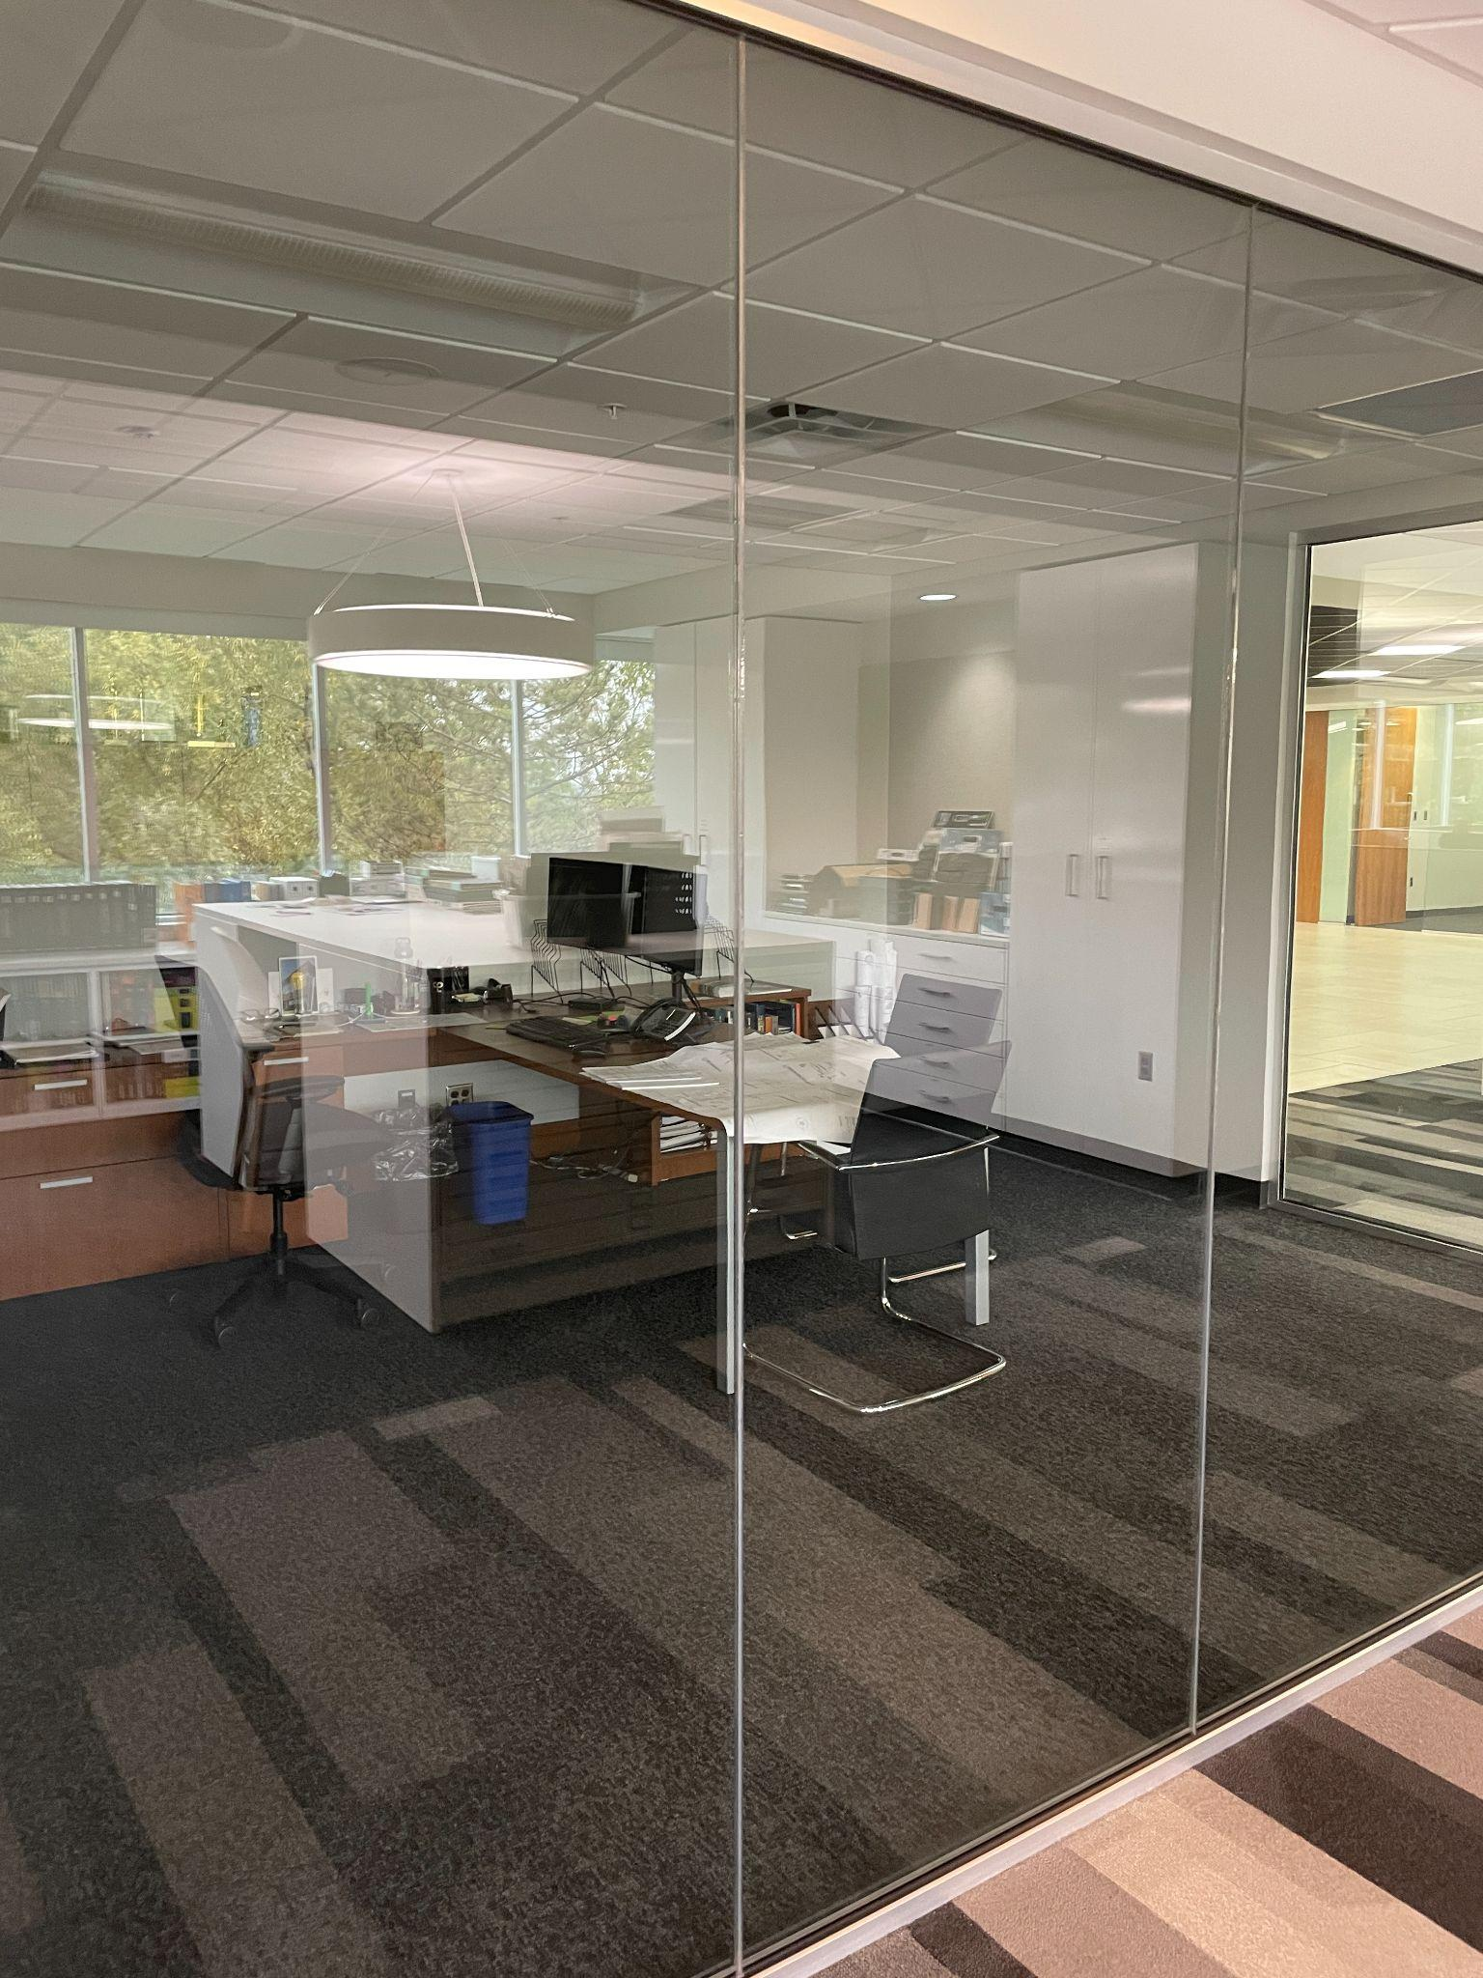
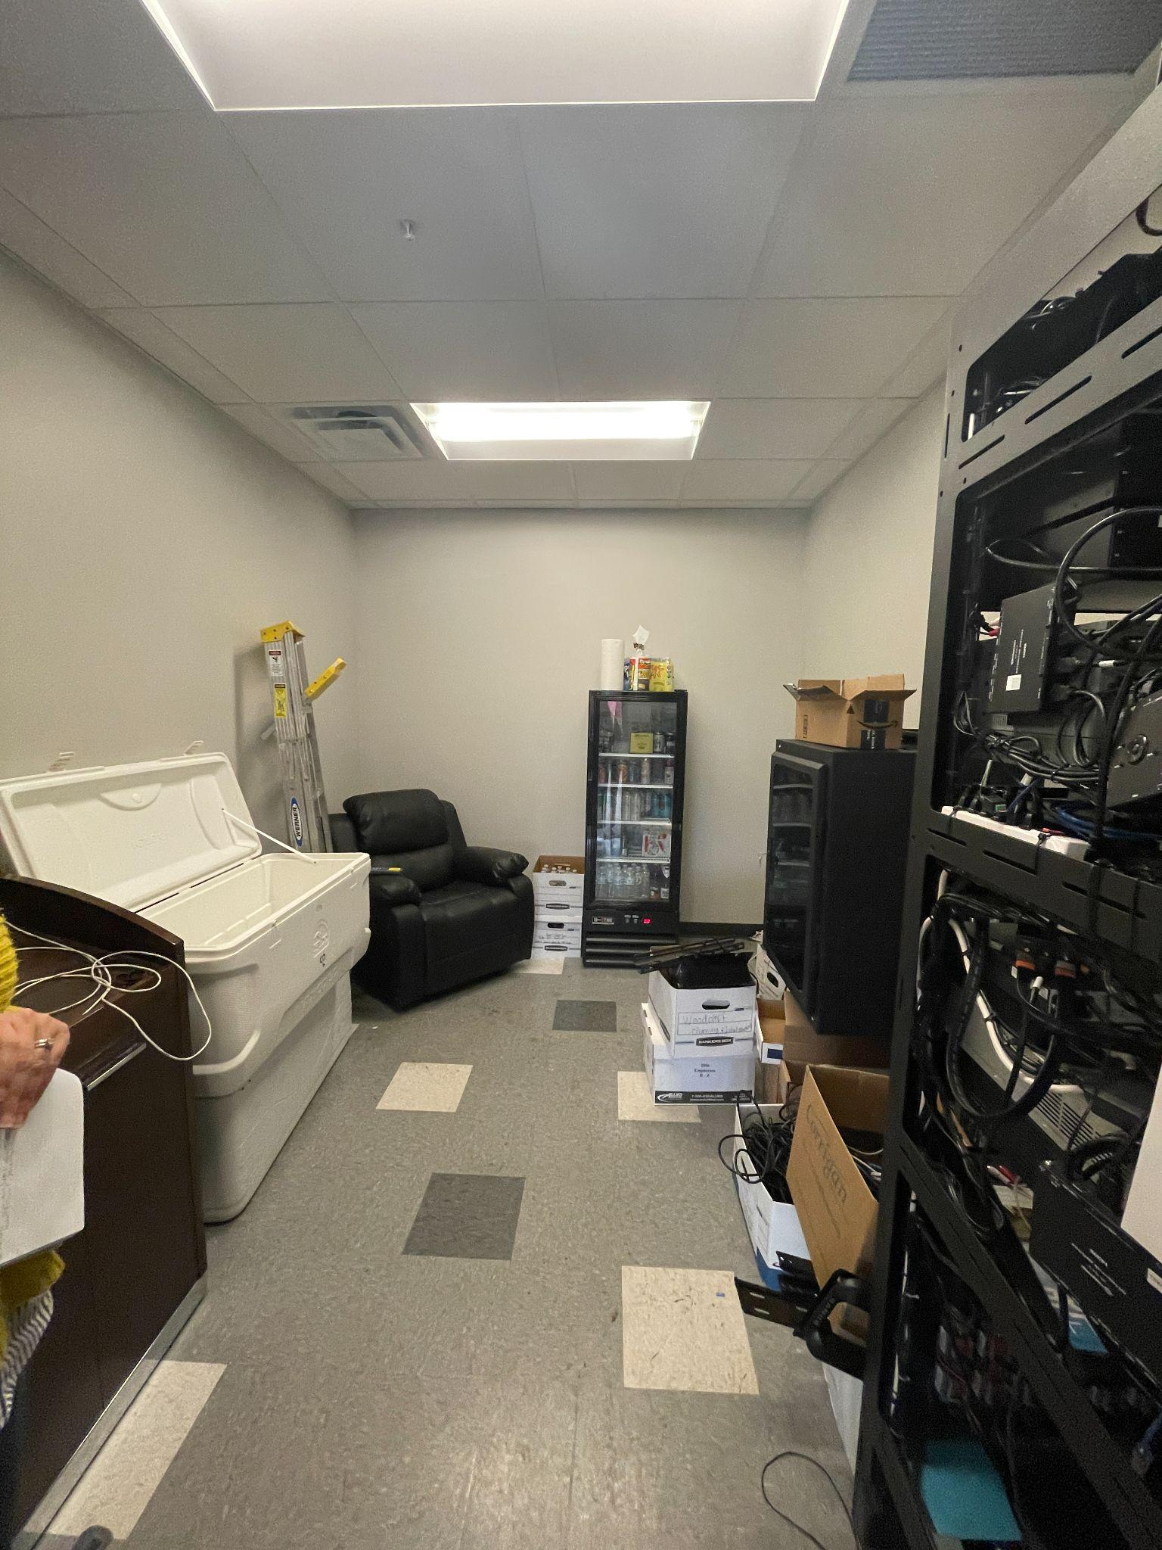
Observation Findings
20
Notes:
When observing all the private offices throughout the building, it was found that nine had men working inside, nine were empty, likely due to hybrid workers, and three had women working inside. This aligns with the hierarchy of the company, as most of the senior leaders, engineers, and architects are men. For those working in the open area, teams were spread out across the building, and people were often grouped together with people from outside their teams. There was often a spillage of personal belongings and papers on the workstations, likely due to a lack of storage for the large sets of documents used by designers, architects, and engineers. One man had begun to spread papers across the floor of his workstation, as he seemed to run out of space on his desk. There were two lactation rooms provided for breastfeeding women, seen in the right image, although they were both used mostly for storage, rather than as a comfortable room to escape and have some privacy.

Slide 24
Research Agenda Conclusion
Both men and women experience stress
Distraction are prevalent in large spans of open office
Corridors are often too public - women feel watched
21
Notes:
To conclude, my research agenda findings emphasized the fact that both men and women experience negative effects from open office layouts, which indicates that addressing the problems that women face would positively affect everyone in the office. My two greatest takeaways from the survey and site visit is the distractions are most prevalent in large spans of open office and that corridors are too public, which causes women to feel watched.

Slide 25
Creative Agenda Scope
Prototypical design
Small architectural firm - 8 people
Activity-based office design inspired by the original concept of open offices
22
Notes:
Moving on to my creative agenda proposal, I decided to design a prototypical office for a small architecture firm with 8 employees. I also decided to employ an activity-based layout, which allows workers to choose where they want to work on any given day, and is designed to support the various functions of an office. This is inspired by the original concept of an open office, which inspired collaboration and flexibility.

Slide 26
Concept Statement
The concept of this creative agenda focuses on transparency, translucency, and opaqueness and the corresponding areas that are public, semi-private, and private.
23
Notes:
My final design is based on the concept of transparency, translucency, and opaqueness and the corresponding areas that are public, semi-private, and private.

Slide 27
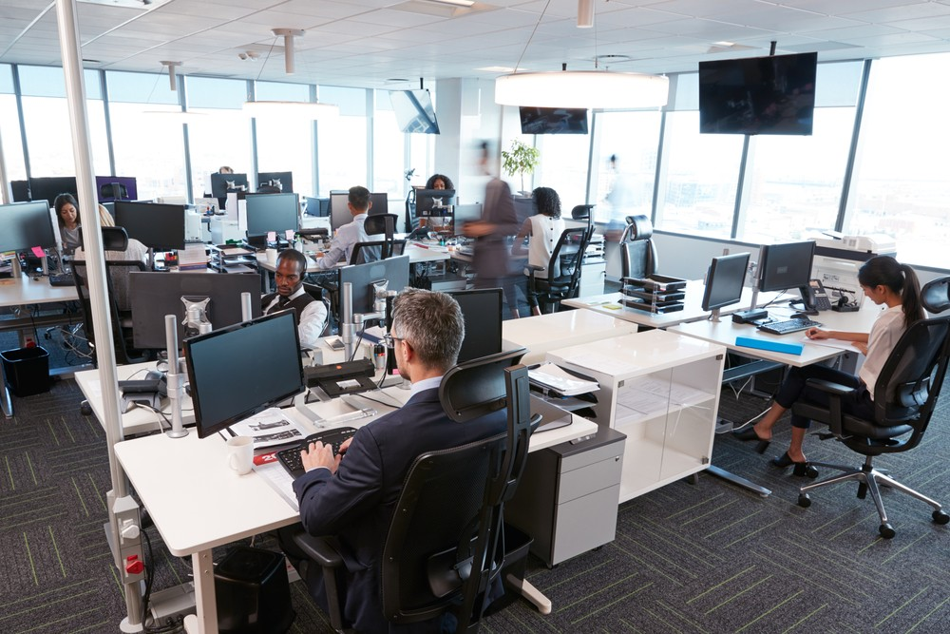
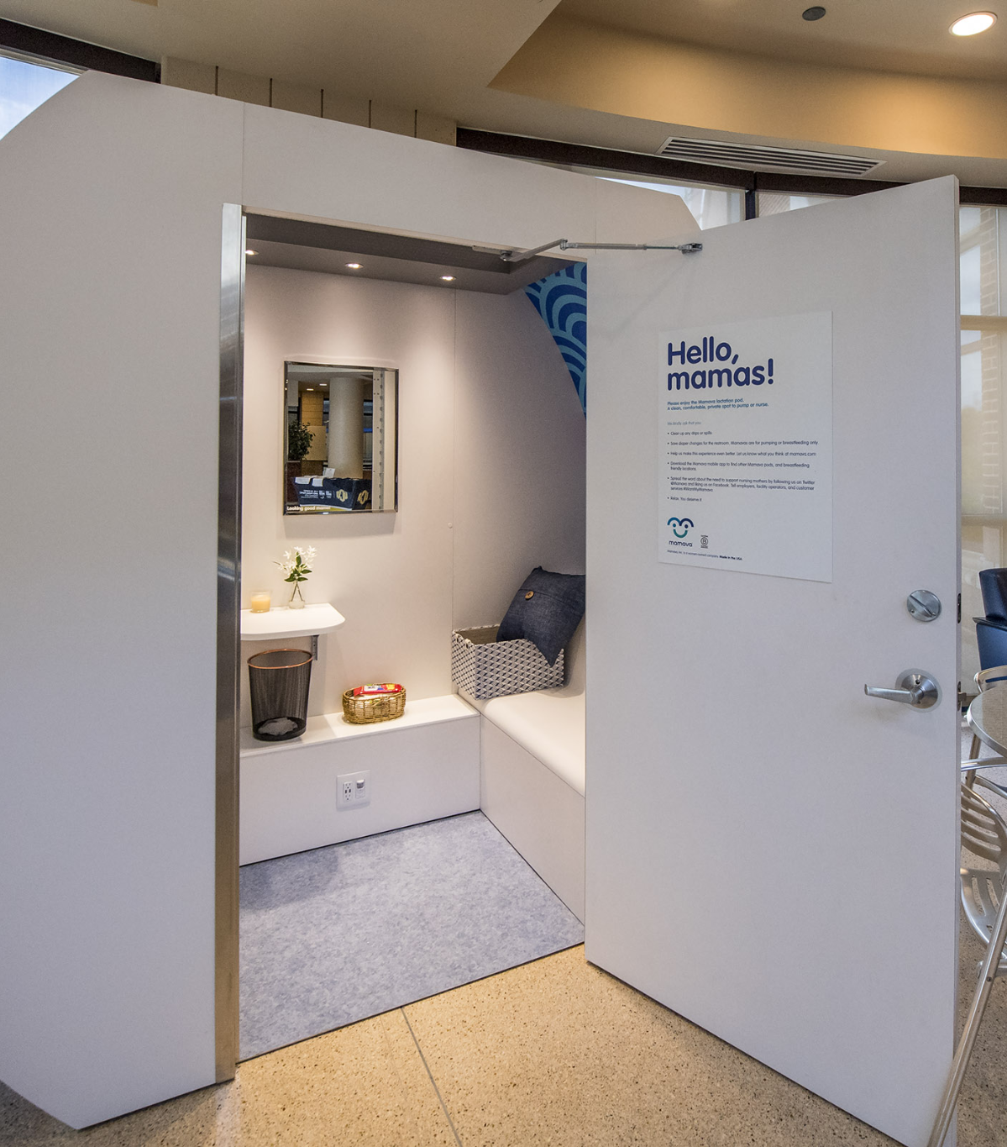
Creative Agenda Concept
Transparent
Translucent
Opaque
24
Notes:
These images reflect the idea of this concept, with transparent areas having the least amount of visual privacy and the opaque areas being more fully enclosed.

Slide 28
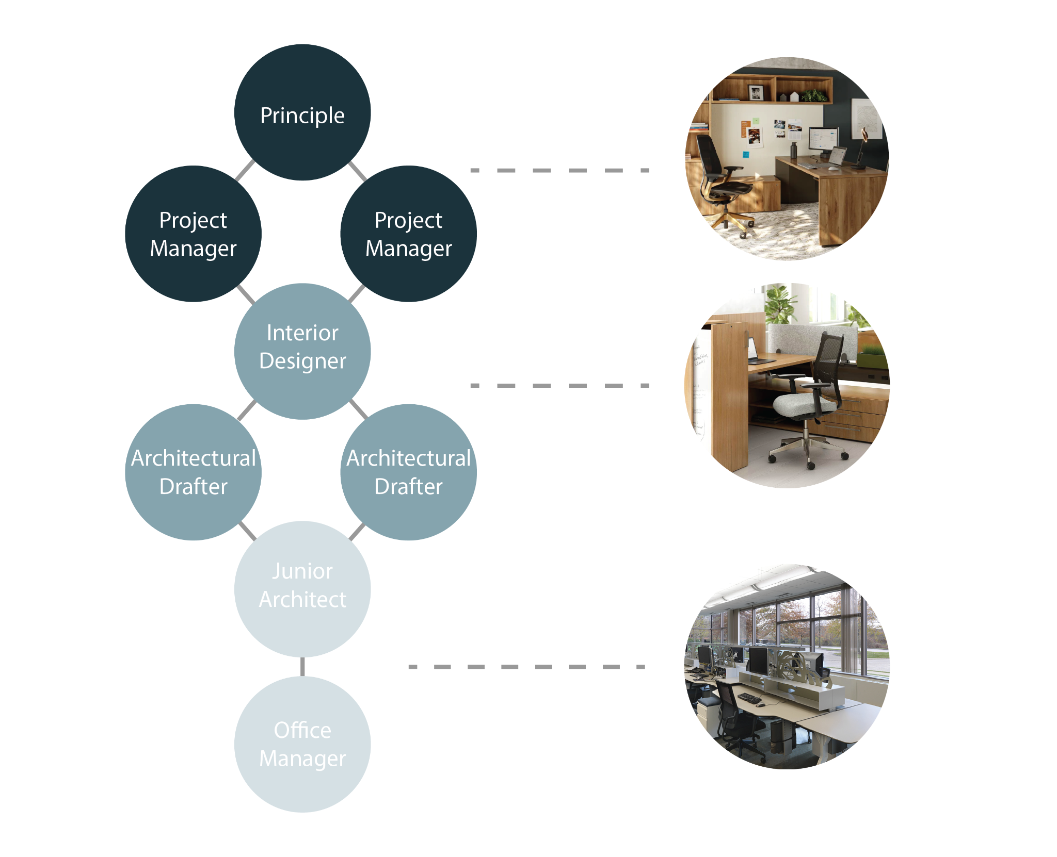
Architectural Firm Hierarchy
25
Notes:
An architecture firm working in an open office would most likely employ this hierarchical divide of space, with the higher-ups having private offices with a large amount of space, storage, and higher-end furniture. However, the lower an employee is in the structure, the more likely they would be to be placed in the open, be exposed to more distractions, and have to use furniture that does not best suit their bodies or the work that they do.

Slide 29
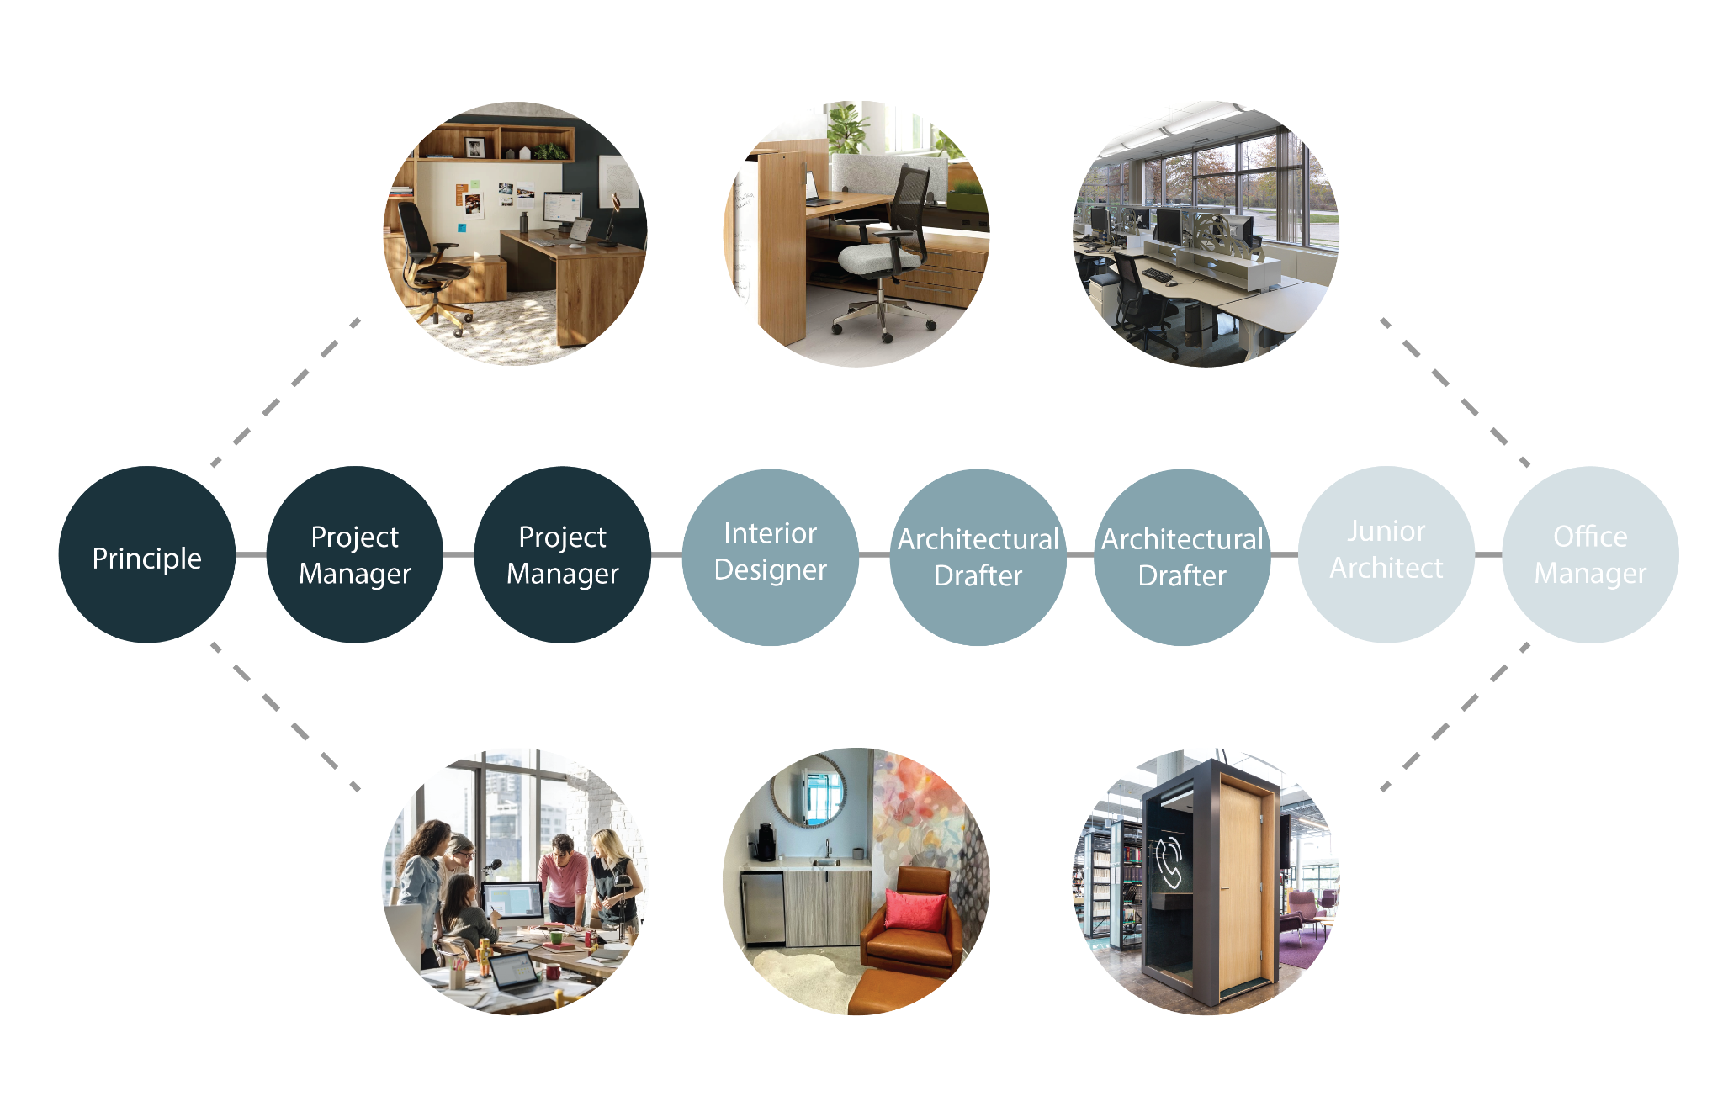
Architectural Firm In an Activity Office
26
Notes:
In an activity-based office layout, everyone is given the same workspace opportunities, no matter their status in the organization. This layout also emphasizes ancillary spaces, such as areas for creative group work and private phone pods.

Slide 30
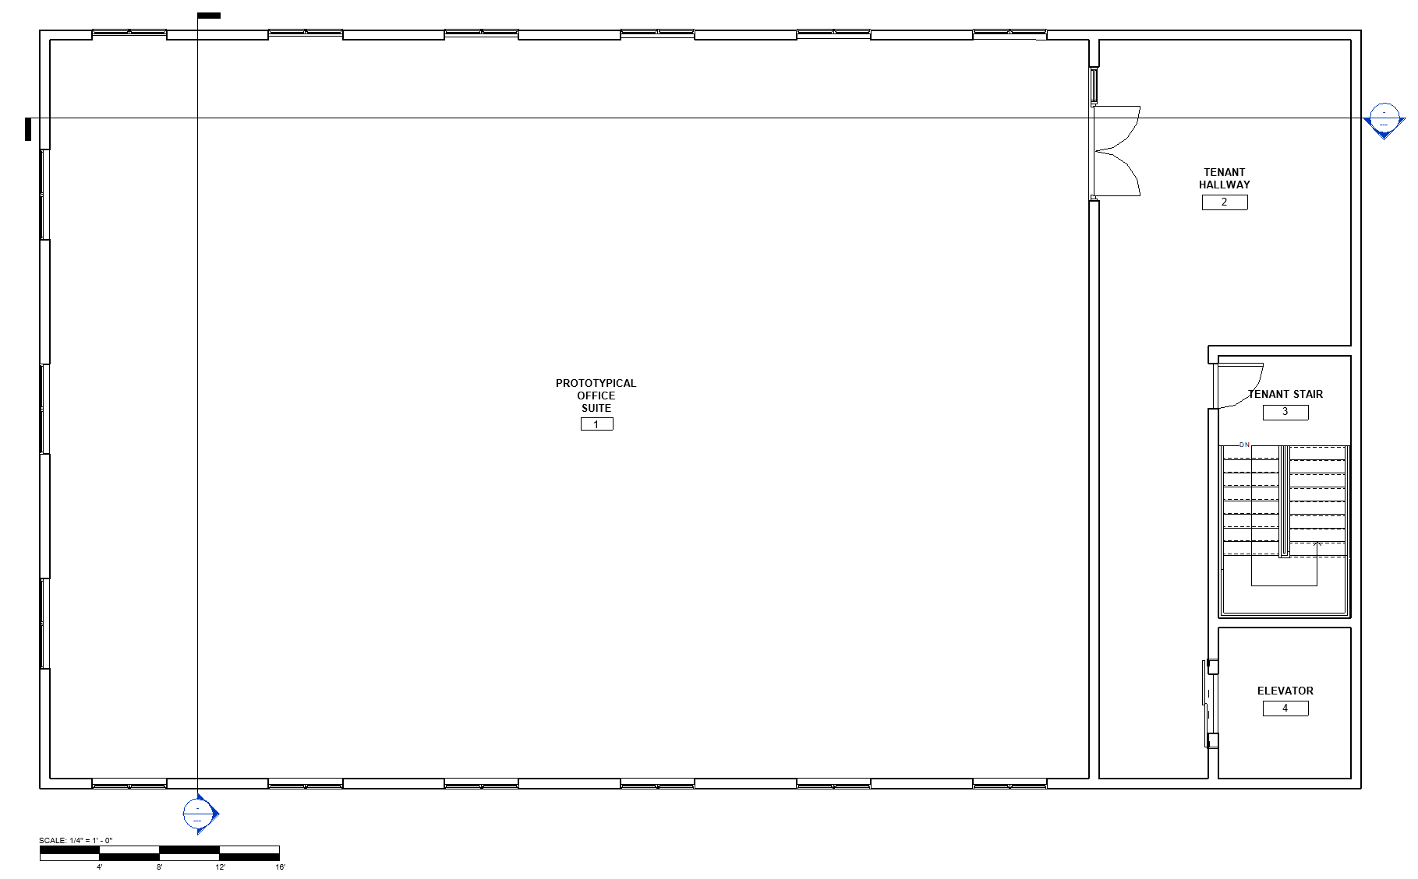
Prototypical Office Building
27
Notes:
The proposed floor plan is 3,420 square feet and is on the second floor of a two story office building.

Slide 31
Prototypical Office Building
28
Notes:
These sections show the main entrance doorway as well as the windows that run along three of the four walls of the office space.

Slide 32
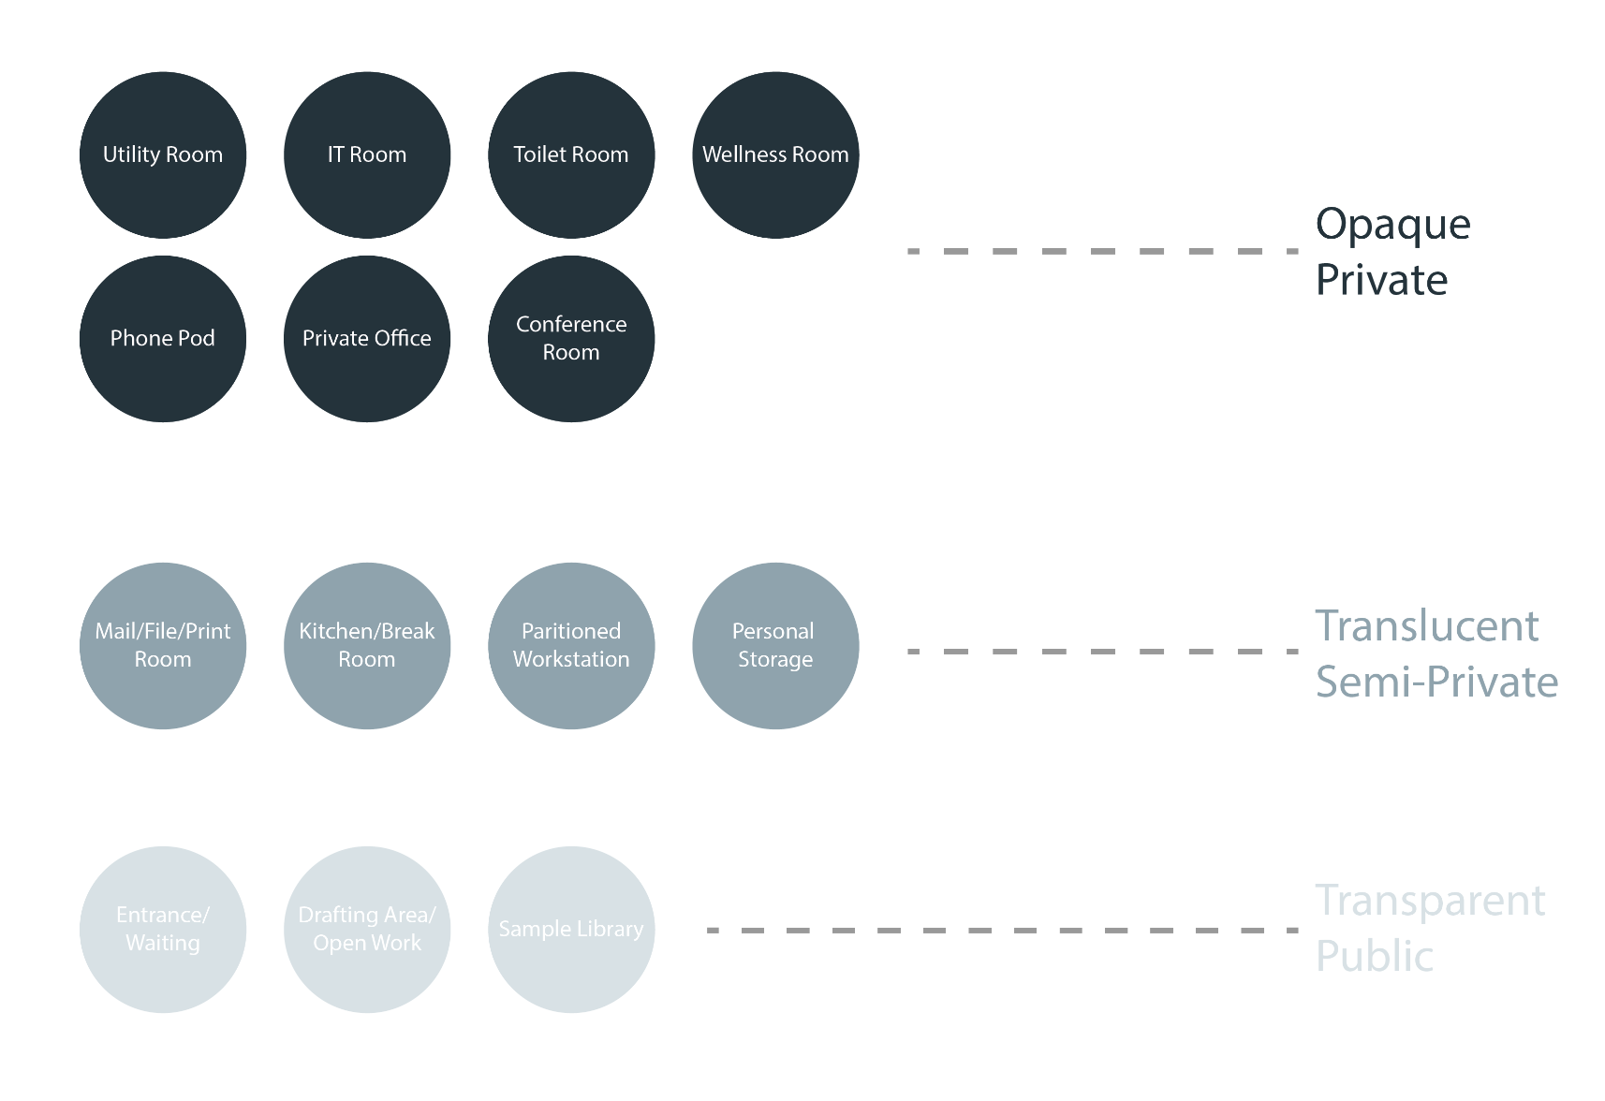
Programming
29
Notes:
Space planning began with an understanding of what was needed for an architecture firm in an activity-based layout, and then dividing these spaces by their level of privacy requirements. Some notable spaces that were included are a group drafting area and sample library, wellness rooms, and a personal storage area - which is essential in an activity-based layout, as people are not given personal workstations with storage for their belongings.

Slide 33
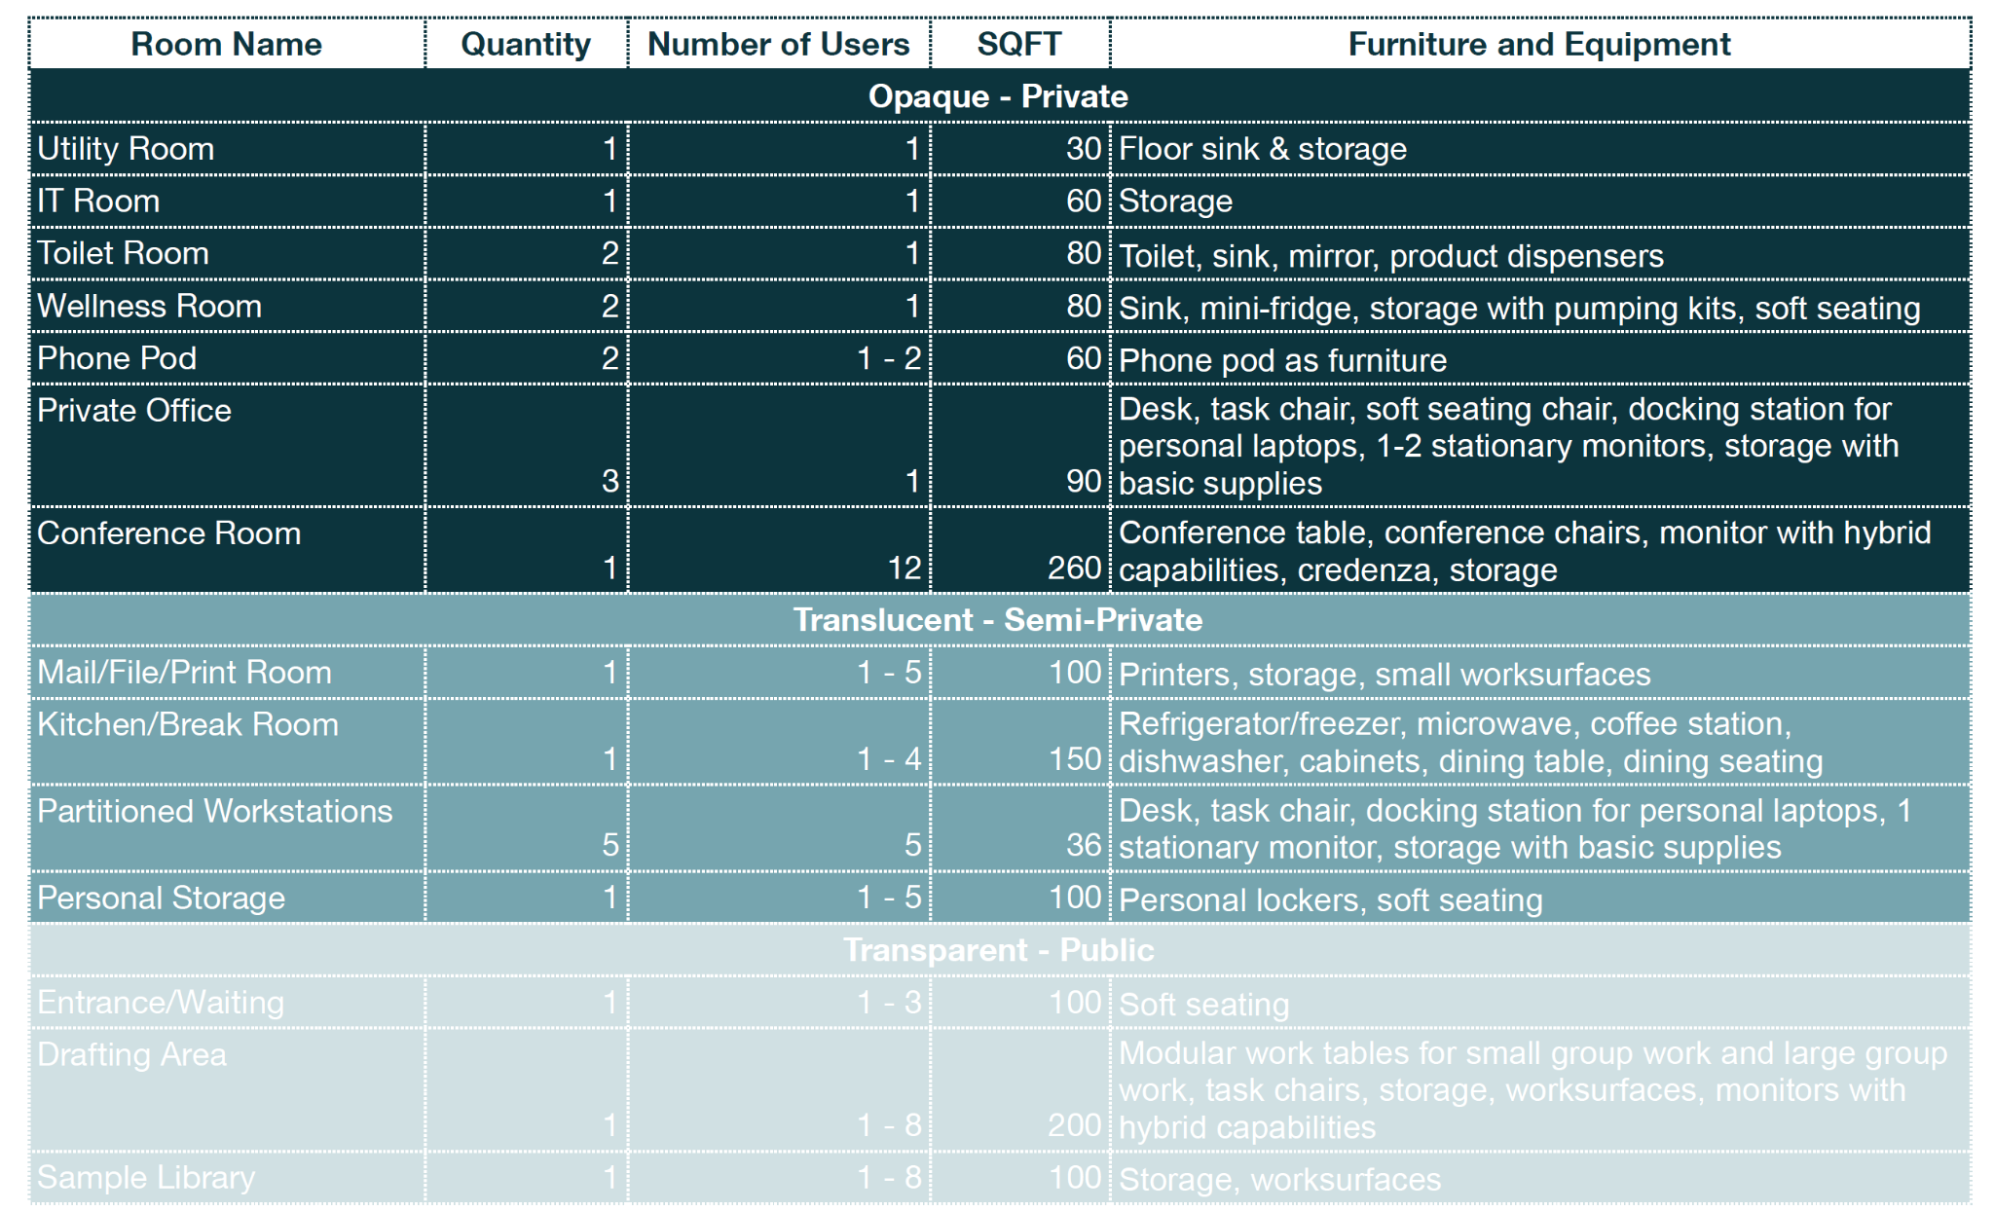
Programming
30
Notes:
These spaces were then given more detailed programming requirements, included estimated square footage allotments, and furniture and equipment needs.

Slide 34
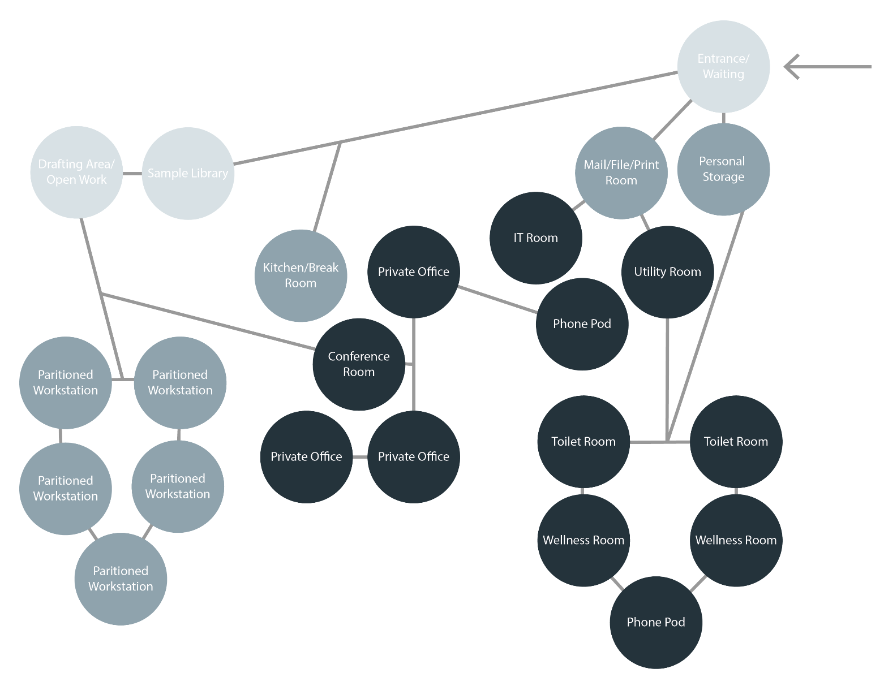
Programming
31
Notes:
Bubble diagrams were then made in order to begin the exploration of space. This final bubble diagram begins to highlight important adjacencies.

Slide 35
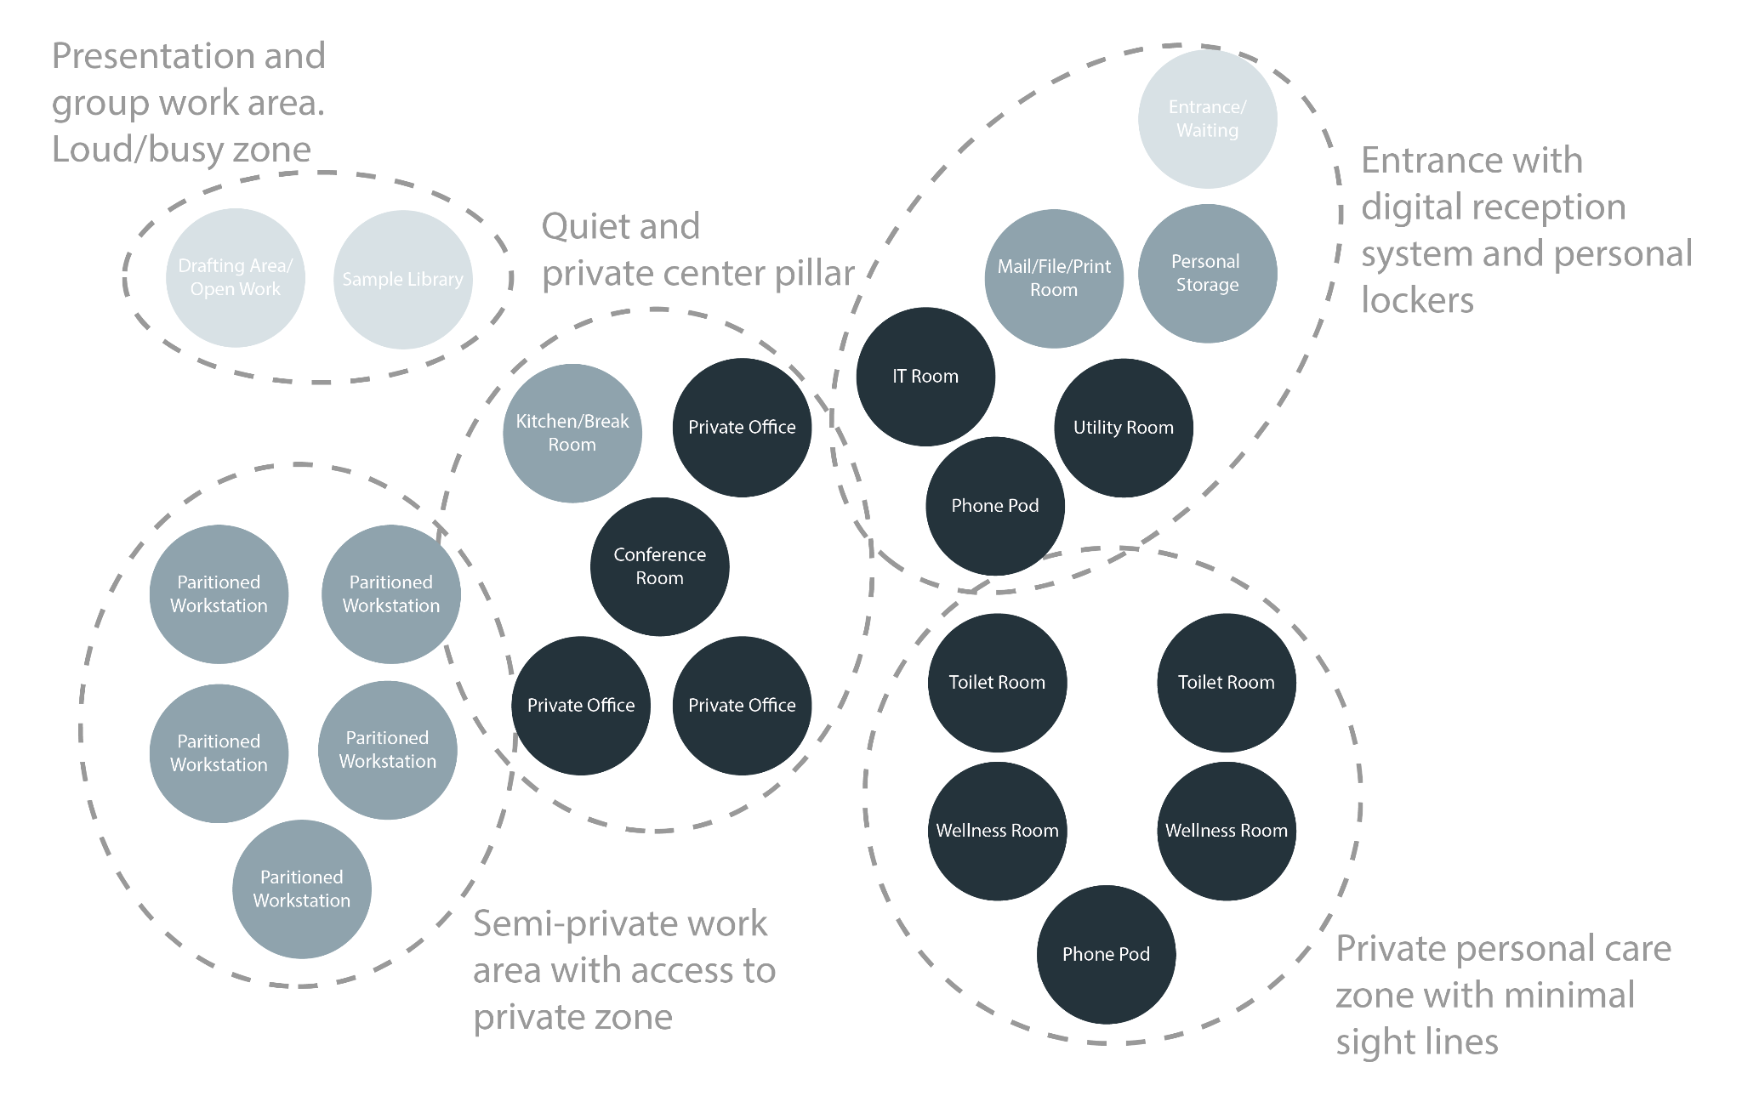
Programming
32
Notes:
This layout is purposely zoned into different areas based on function and privacy. For example, the person care areas are grouped together in order to minimize sight lines. Because one of the main goals was to allow corridors to be private, a central, private zone was established in the center of the building, in order to allow all surrounding areas to remain more private. Lastly, the more loud and busy areas of the building were grouped together to consolidate noise.

Slide 36
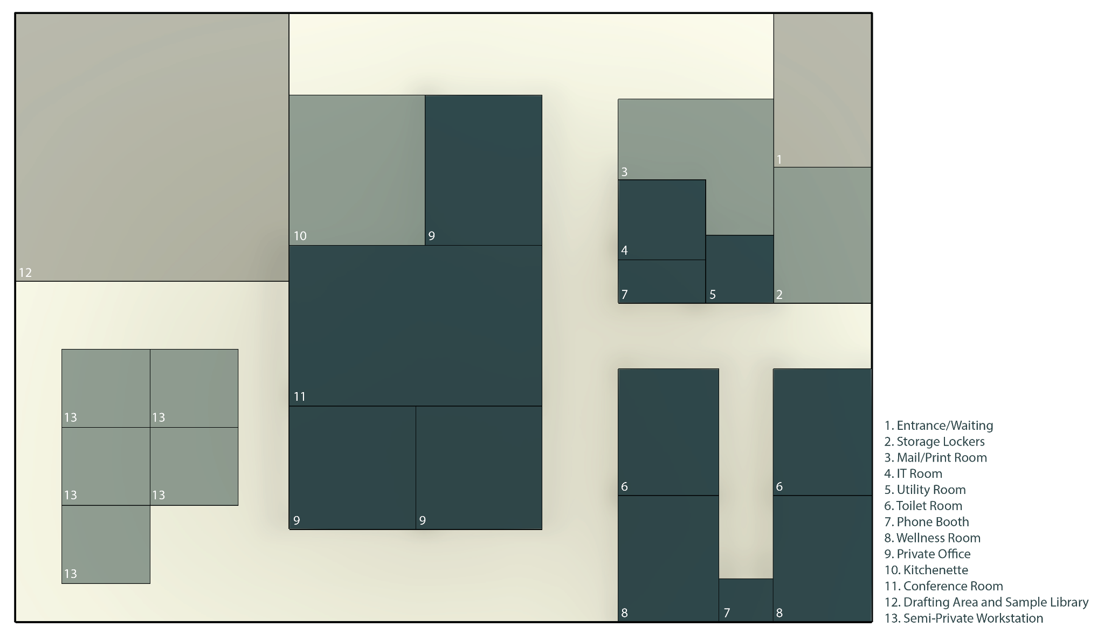
Space Planning - Blocking
33
Notes:
The bubble diagrams were then translated into 2D and 3D block diagrams to establish sizing and paths of travel.

Slide 37
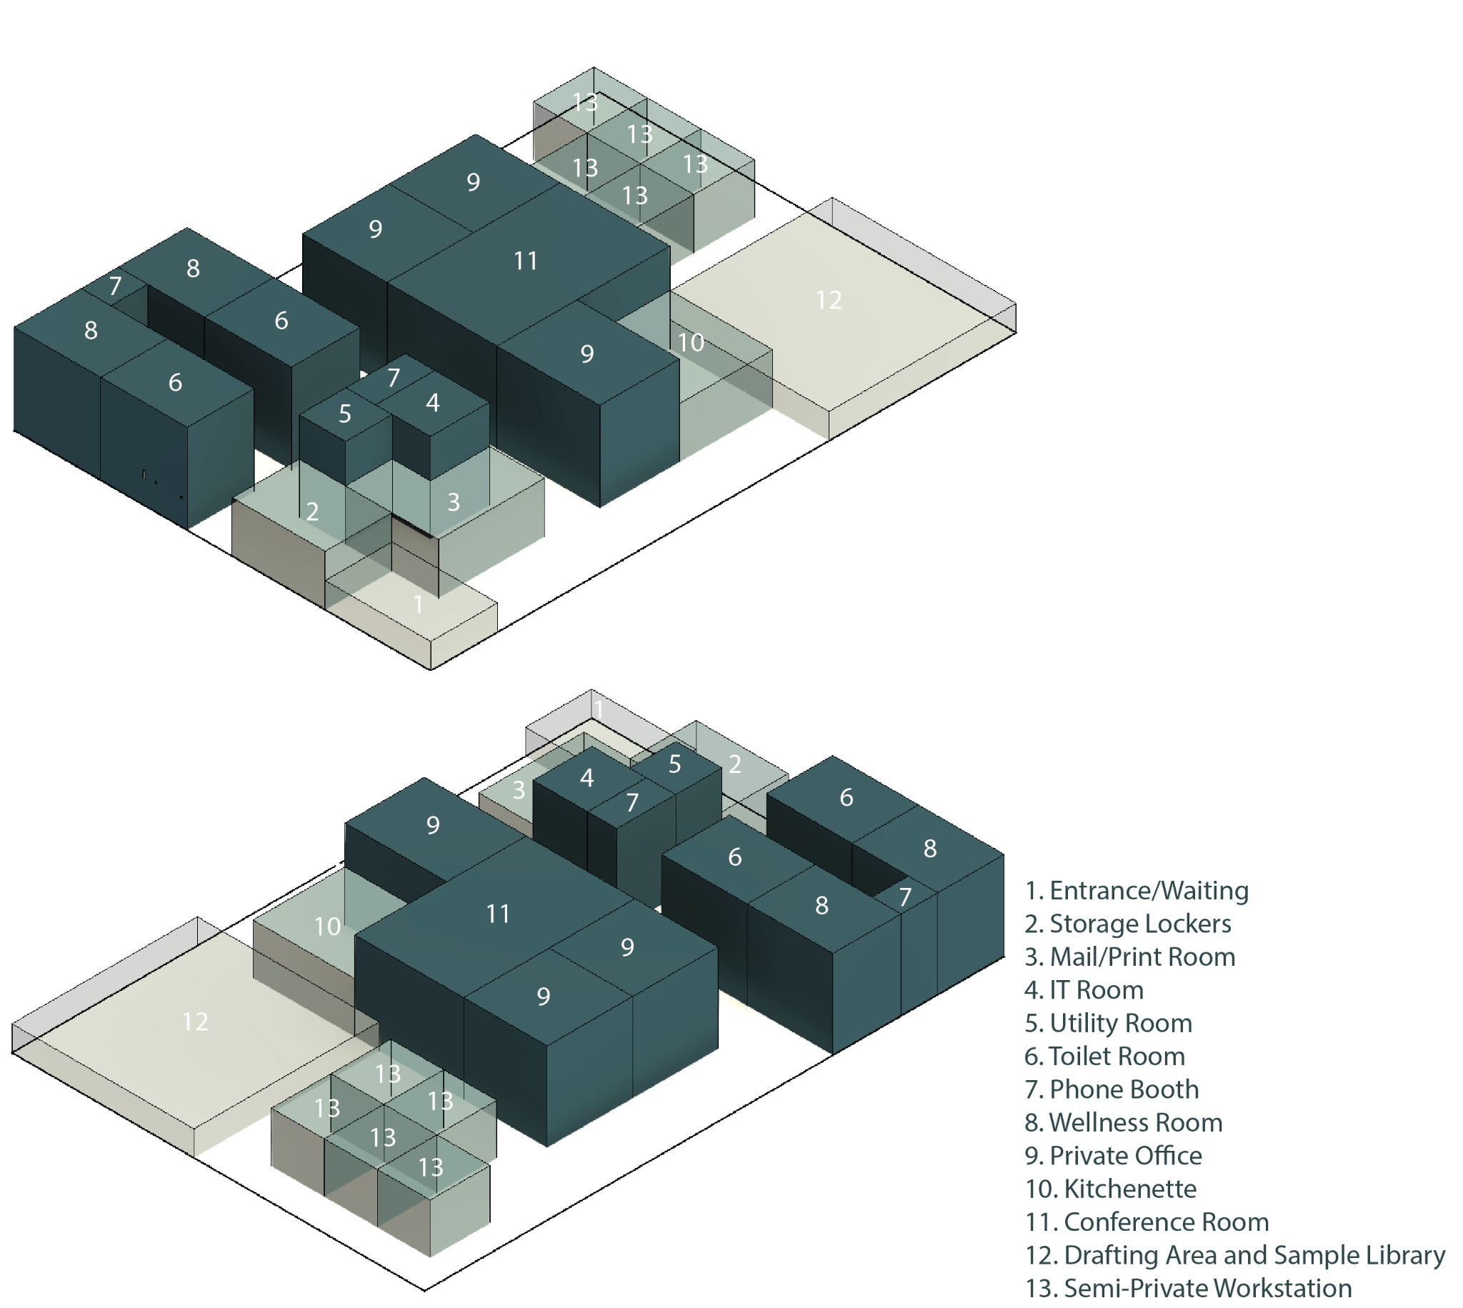
Space Planning - Blocking
34
Notes:
These 3D axonometric blocks represent the various levels of privacy of the spaces. The more transparent and shorter the blocks are, the more public the space would be. This is to represent the fact that the more public a space is, the less likely it is to be enclosed by full height partitions like a private space would be.

Slide 38
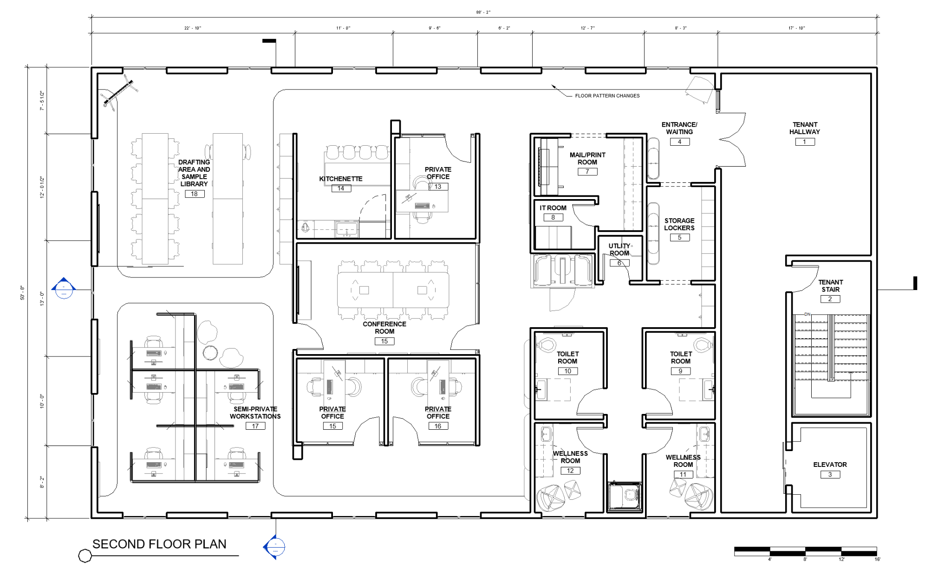
Floor Plan
35
Notes:
The final floor plan includes 3 private offices, 2 Framery phone booths, 5 semi-private workstations, and 1 large drafting and group work area that fits everyone in the company, plus space for guests. One of the framery pods used is a single phone or office pod, and the other is a slightly larger model with soft seating and a center table, which could be used for small meetings or private work. There are two private bathrooms with free sanitary product dispensers, and two wellness rooms with all the equipment necessary for the rooms to be used as lactation rooms if needed. These self-care areas have their own private corridor that is adjacent to the storage lockers, so if anyone were to need to retrieve a personal belonging before using the toilet room or wellness room, they would have maximized visual privacy. Lastly, there are three task chairs used in the various different work areas: the Herman Miller Aeron, the Herman Miller Embody, and the Knoll Life. All three are highly ergonomic and adjustable. The goal is to allow employees to move the chairs as they please in order to allow everyone to sit in the chair that best suits their bodies and needs.

Slide 39
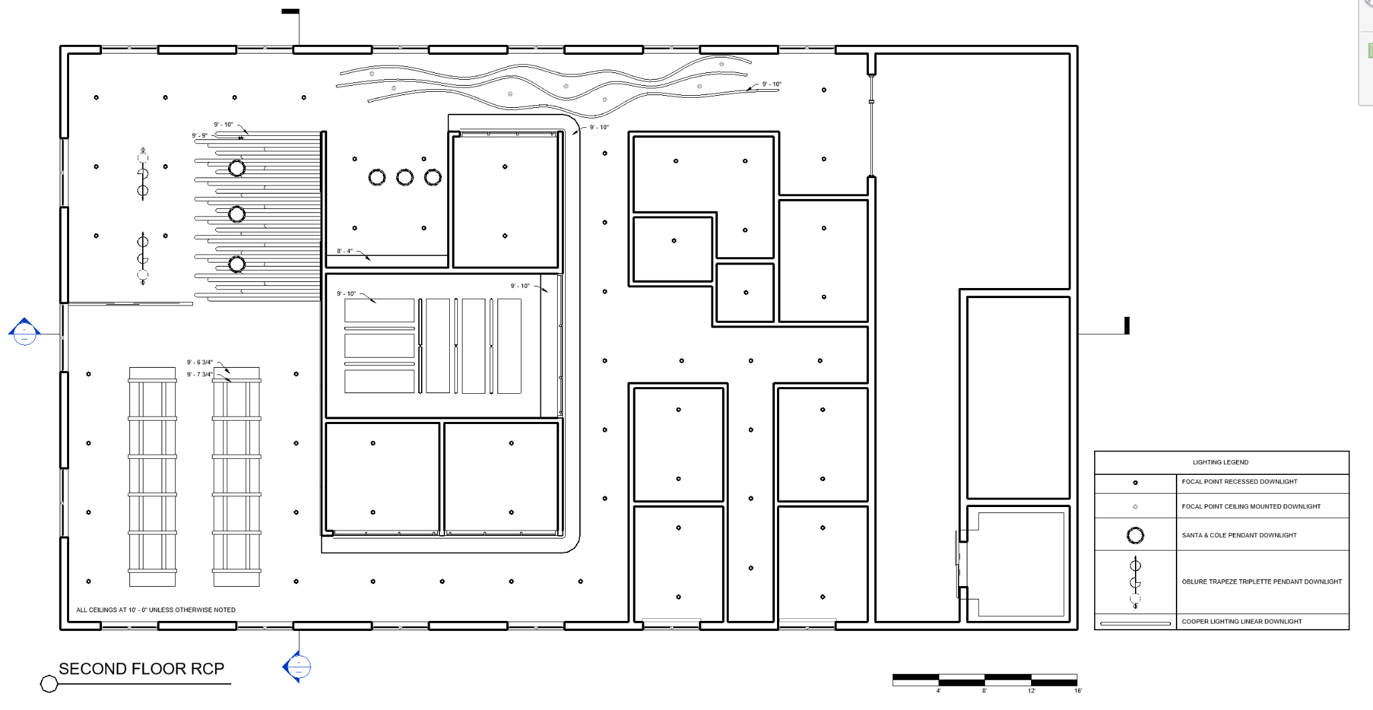
RCP
36
Notes:
The RCP includes various felt baffles and clouds which will be seen shortly in the renders. These were used in order to control acoustics in some of the more open areas, in order to minimize distractions and stress.

Slide 40
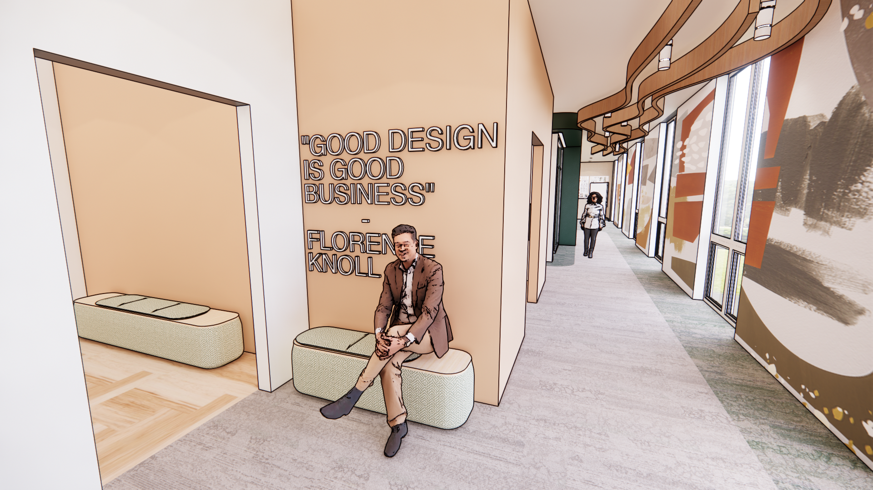
Entrance
37
Notes:
We begin at the entrance of the office. An employee can enter with swipe access, and any guests or deliveries can contact employees on a device directly outside the main entrance. When you first enter you are encountered with a quote from one of the most famous female designers in history - Florence Knoll. The quote reads “good design is good business”. This concept was one of many that inspired my final design - as I would argue that good design is inherently equitable.

Slide 41
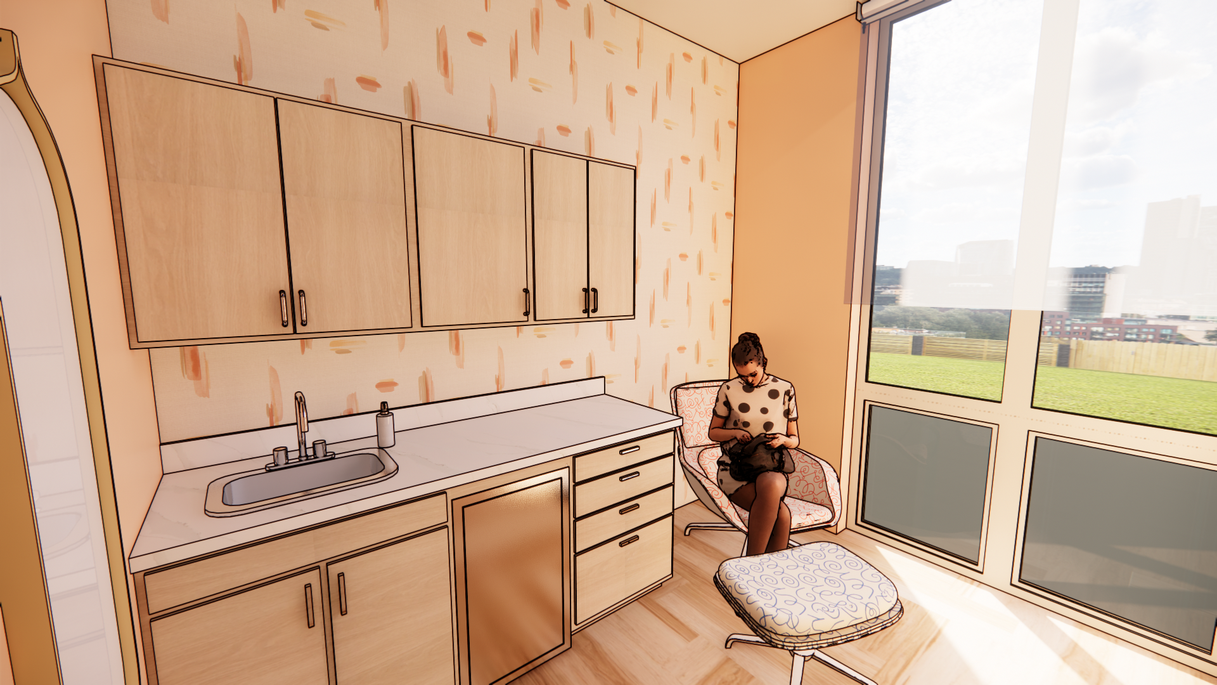
Wellness Room
38
Notes:
Moving on to one of the two wellness rooms. There are windows in both rooms to allow natural light, but shade systems have been used in order to give the user flexible levels of privacy.

Slide 42
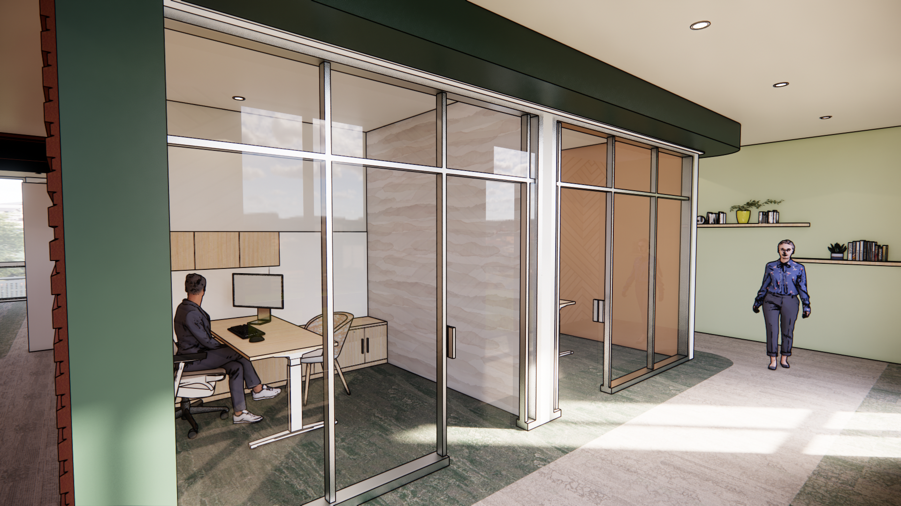
Private Offices - Switch-Glass Off
39
Notes:
All the private offices have glass walls in order to allow natural light into the rooms. However, unobstructed glass, or even glass with a privacy film, does not meet my concept and goals of flexible privacy and private corridors.

Slide 43
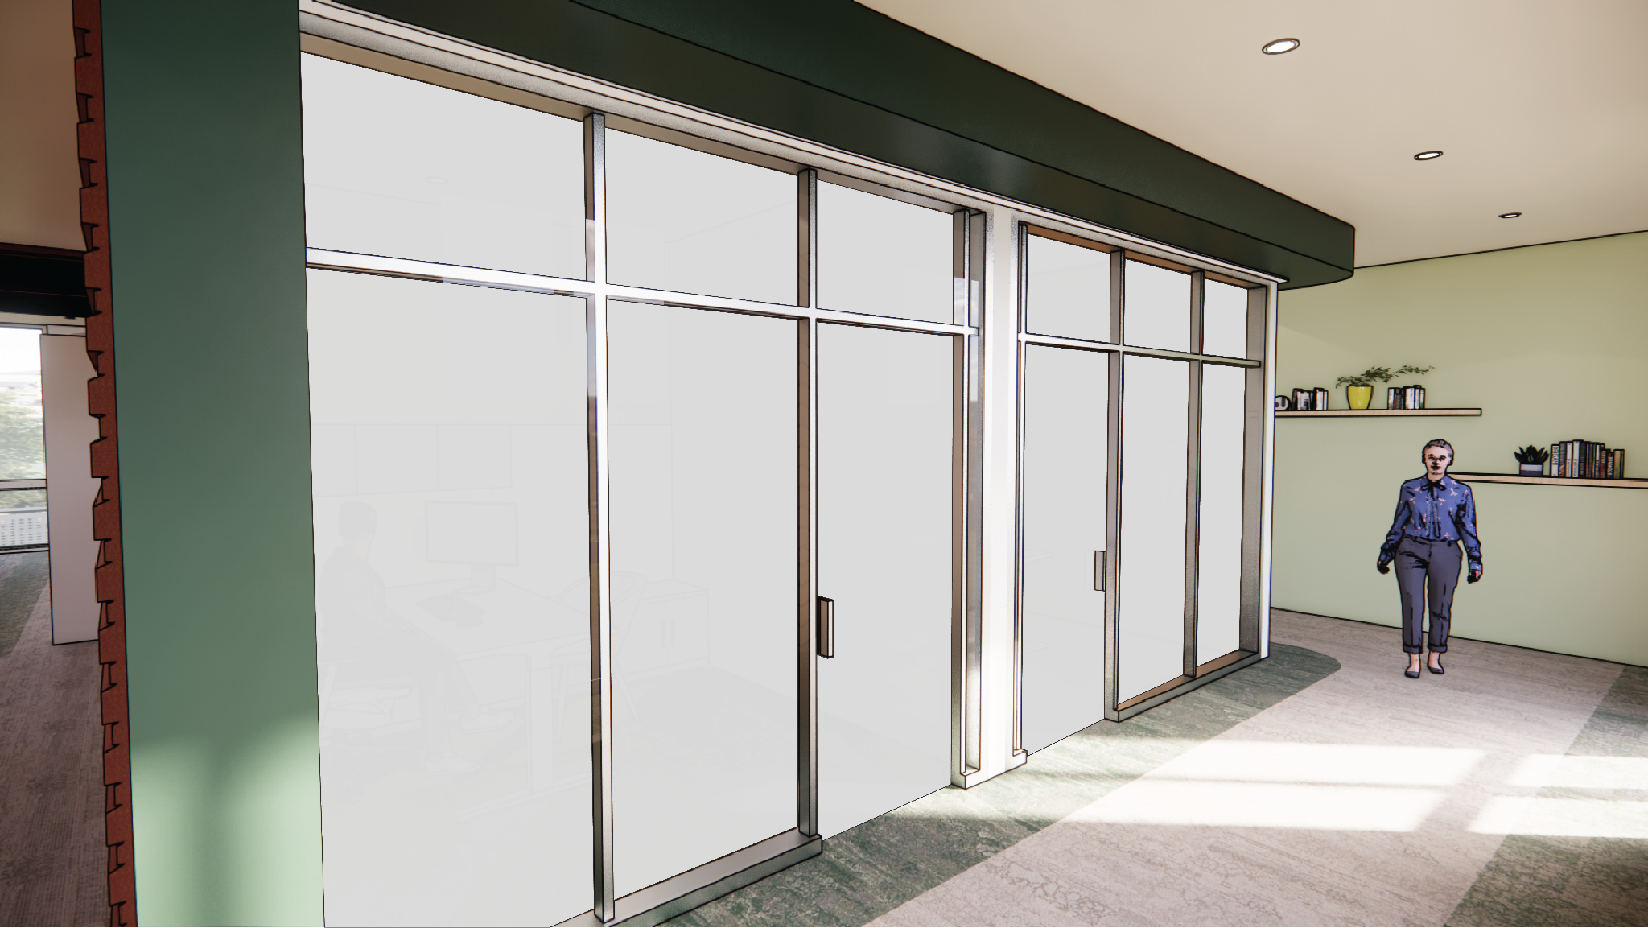
Private Offices - Switch-Glass On
40
Notes:
To mitigate this, I have used a switch-glass system in all glass walls of the private offices and conference room. This gives a fully opaque effect, allowing users, and people walking through corridors, the highest level of privacy, while also remaining flexible.

Slide 44
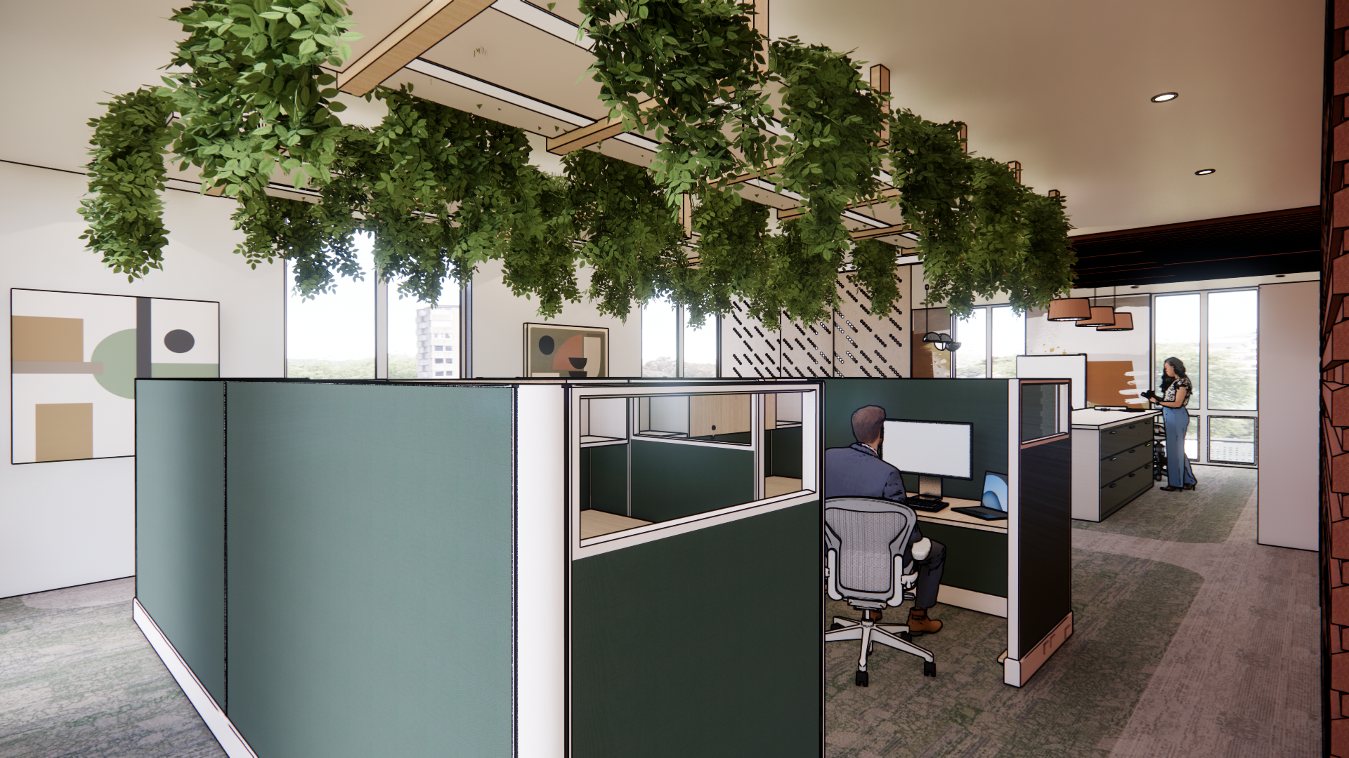
Semi-Private Workstations
41
Notes:
The semi-private workstations are constructed of the Herman-Miller Action Office system, which was one of the first systems ever used in open offices. Over this area there is a hanging plant display. The system uses Biotile and ceiling mounted irrigation systems to keep the plants alive with minimal care needed. Because one of my goals was to design an alternative to a “neutral”, masculine oriented office, I wanted to introduce biophilia and bright colors that are mixes of traditionally masculine and feminine tastes. This plant system brings in that “homey” feel that women crave in an office setting, and also functions are a great sound absorber in the more open area.

Slide 45
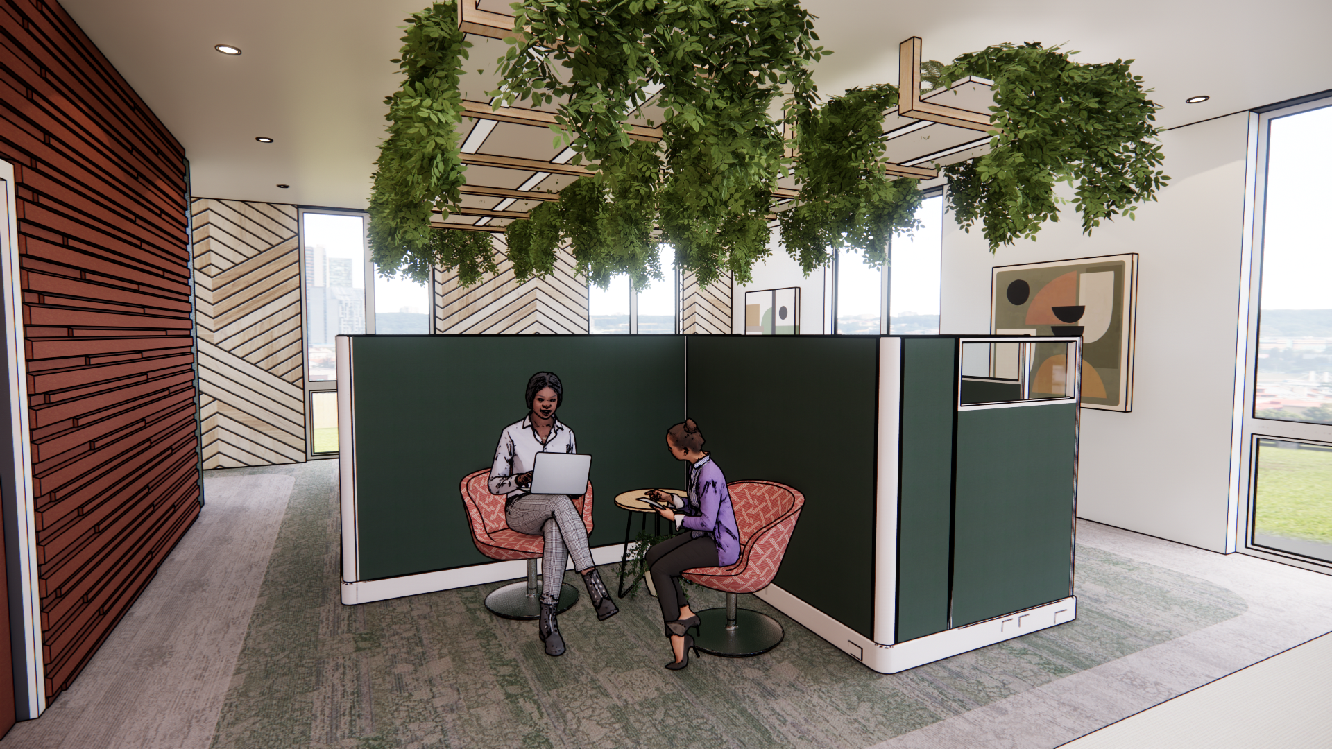
Seating Area
42
Notes:
Here is another look at this space and the small seating area that is included at the other end of the workstations

Slide 46
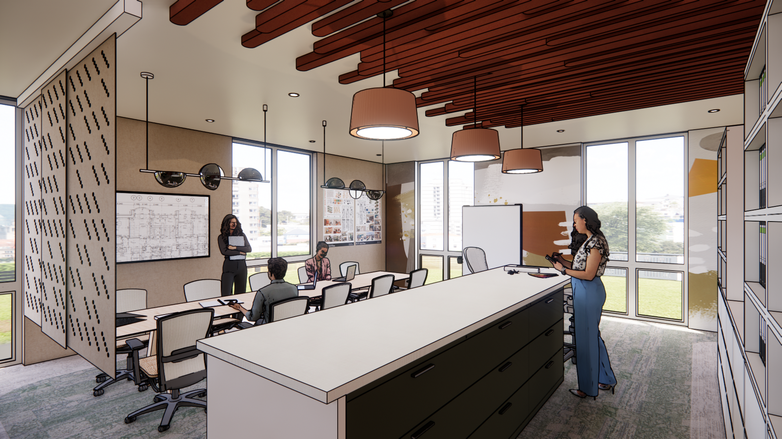
Drafting Area and Sample Library
43
Notes:
Moving onto the drafting area and sample library, this is the most public area in the design. Because so much space is required to build physical models, store and display project samples, and spread out scaled drawings, I wanted to give a lot of surface area to this space. Additionally, I wanted to consider the level of noise in this area. In order to dampen distracting noise, felt system surround the area. One of these system are ceiling mounted, movable felt panels, which allow for further flexibility when it comes to the level of privacy that is wanted by the users.

Slide 47
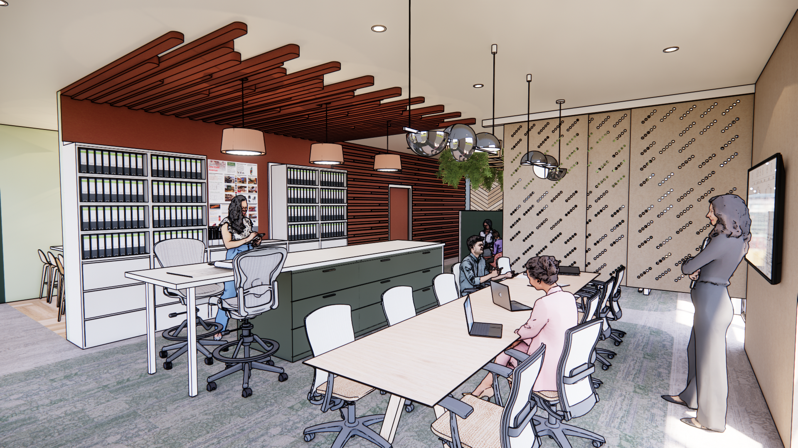
Drafting Area and Sample Library
44
Notes:
On the opposite wall is more felt system, including standard felt wallcoverings and felt wall panels. The wallcovering also serves as a pinup spot for anything that might be displayed. The sample library features several different storage options and work surfaces for display.

Slide 48
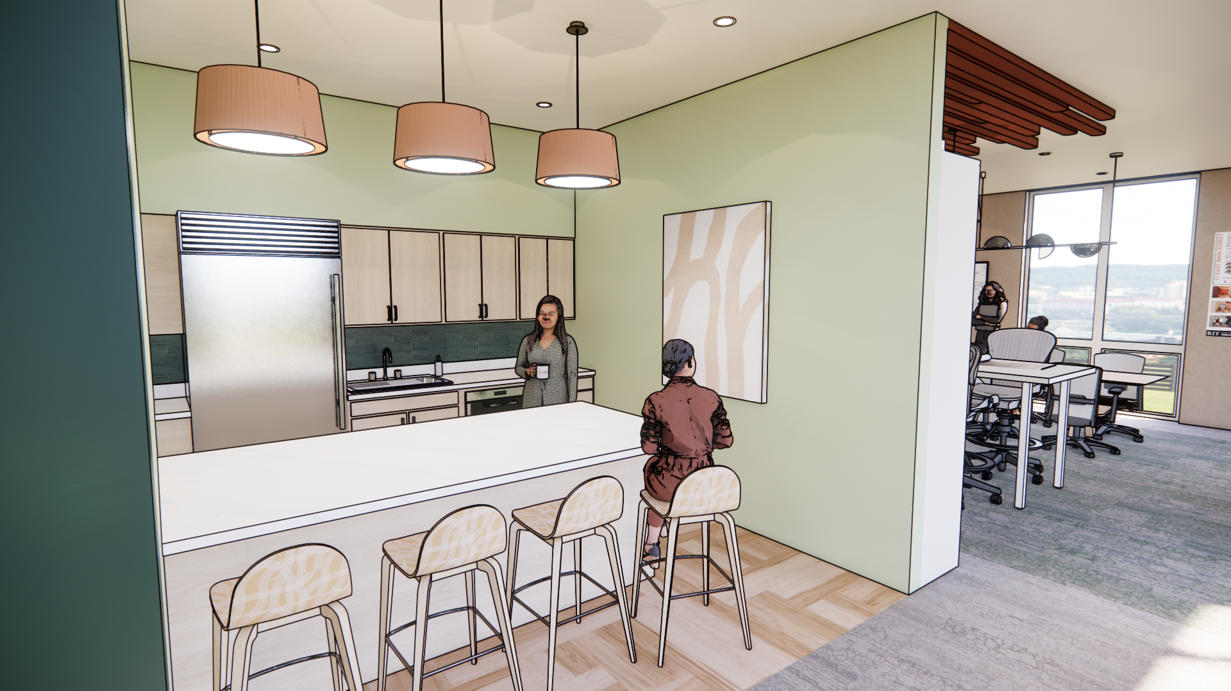
Kitchenette
45
Notes:
Lastly, I’ll briefly show the kitchenette and conference room. Both these areas were less of a focus for my concept and design, but they still reflect the aesthetics I had chosen for the final design.

Slide 49
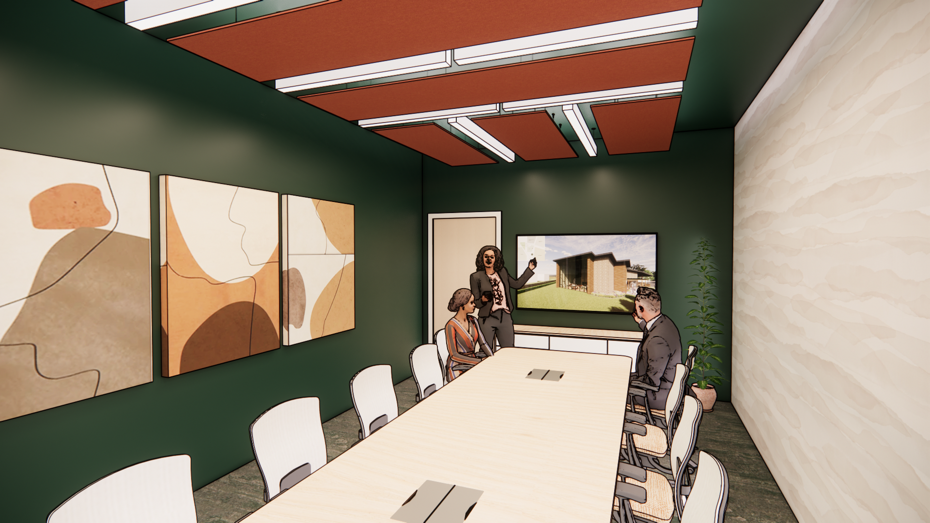
Conference Room
46

Slide 50
In Conclusion
47
Notes:
While the focus of this capstone project was on a small scale office proposal, many of the same techniques can be applied to large office spaces. While a full activity-based layout may not work best for the function of a large company, teams can be grouped together with different areas for working both in groups and individually. In this arrangement, office communication will be fostered amongst team members working in close proximity, but people will still be able to choose what level of privacy they want on a daily basis. Other important considerations include the level of noise in open areas of the office, sight lines in public corridors, and the inclusion of wellness and lactation rooms. The final proposal includes all of these considerations, but on a smaller scale, in order to foster comfort, and the subsequent productivity, of women in the office.

Slide 51
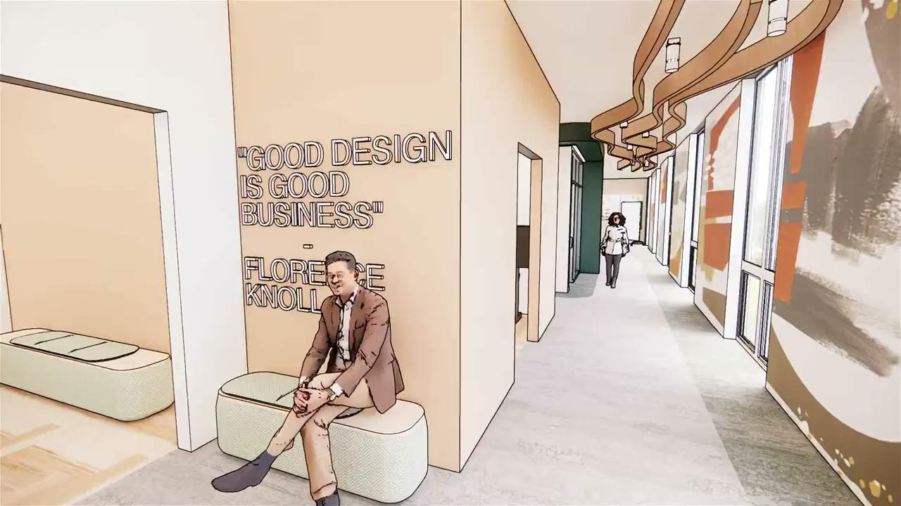
Animation
48
Notes:
As I wrap up, I will play this short walk-through animation. Thank you so much for listening, and I’m happy to answer any questions.

Slide 52
Bibliography
Bodin Danielsson, Christina, et al. “Office Design’s Impact on Sick Leave Rates.” Ergonomics, 27 Jan. 2014, https://doi.org/10.1080/00140139.2013.871064.
Bodin Danielsson, Christina, et al. “The Relation between Office Type and Workplace Conflict: a Gender and Noise Perspective.” Journal of Environmental Psychology, 5 May 2015, https://doi.org/10.1016/j.jenvp.2015.04.004.
Bodin Danielsson, Christina. “Office Experiences.” Product Experiences, Elsevier Science, 2007, pp. 605–628.
Bos, Nathan, et al. “WORKPLACE SATISFACTION BEFORE AND AFTER MOVE TO AN OPEN PLAN OFFICE - INCLUDING INTERACTIONS WITH GENDER AND INTROVERSION.” Human Factor and Ergonomics Society, 2017, https://doi.org/10.1177/1541931213601594.
Fried, Yitzhak, et al. “The Joint Effects of Noise, Job Complexity, and Gender on Employee Sickness Absence: An Exploratory Study across 21 Organizations — the CORD|S Study.” Journal of Occupational and Organizational Psychology, 2002, https://doi.org/10.1348/09631790260098181.
Gerdenitsch, Cornelia, et al. “Need–Supply Fit in an Activity-Based Flexible Office: A Longitudinal Study During Relocation.” Environment and Behavior, 2018, https://doi.org/10.1177/0013916517697766.
Hirst, Alison, and Christina Schwabenland. “Doing Gender in the ‘New Office.’” Gender, Work and Organization, vol. 25, no. 2, Mar. 2018, https://doi.org/10.1111/gwao.12200.
Johnson, Katherine M., and Salpini, Colleen. "Working and Nursing: Navigating Job and Breastfeeding Demands at Work." Community, Work & Family, vol. 20, no. 4, 2017, pp. 479-496. ProQuest, https://doi.org/10.1080/13668803.2017.1303449
Kaufmann-Buhler, Jennifer. “If the Chair Fits: Sexism in American Office Furniture Design.” Journal of Design History, vol. 32, no. 4, 14 June 2019, https://doi.org/10.1093/jdh/epz022.
Kaufmann-Buhler, Jennifer. “Progressive Partitions: The Promises and Problems of the American Open Plan Office.” The Journal of the Design Studies Forum, 07 Jun. 2016, https://doi.org/10.1080/17547075.2016.1189308.
Kingma, Boris R M, and van Marken Lichtenbelt, Wouter D. “Energy Consumption in Buildings and Female Thermal Demand.” Nature Climate Change, Aug. 2015, https://doi.org/10.1038/nclimate2741.
Morrison, Rachel L, and Smollan, Roy K. “Open Plan Office Space? If You're Going to Do It, Do It Right: A Fourteen-Month Longitudinal Case Study.” Applied Ergonomics, 26 Aug. 2019, https://doi.org/10.1016/j.apergo.2019.102933.
Tyler, Melissa, and Cohen, Laurie. “Spaces That Matter: Gender Performativity and Organizational Space.” Organization Studies, 2010, https://doi.org/10.1177/0170840609357381.
Van Dellen, Sjoukje A, et al. “Effects of Lactation Room Quality on Working Mothers’ Feelings and Thoughts Related to Breastfeeding and Work: a Randomized Controlled Trial and a Field Experiment.” International Breastfeeding Journal, 2022, https://doi.org/10.1186/s13006-022-00499-0.
Wasserman, Varda. “THE GENDERED AESTHETICS OF THE PHYSICAL ENVIRONMENT OF WORK.” 2020.

Slide 53
Thank You
Questions?

